Slide 1
D9859 Advance Transcoder Receiver
Licensing Presentation
January 2014

Slide 2
D9859
Cisco Swift Licensing
Intro
Ordering Process
License registration
License upload

Slide 3
D9859
Advanced Eight Channel
Receiver Transcoder Solution
Key Features
8 Channel HD/SD Advanced Receiver Transcoder Supports MPEG-4 HD/SD to MPEG-2 SD/HD Transcoding and pass-through of original input Field Upgradable Licenses Enhanced DPM feature (status display & auto sync) 4 RF L band Inputs PowerVu decryption and control support DVB-S/S2 Demodulation with QPSK & 8PSK 4:2:0 High Definition 1080i & 720p video decoding 1 ASI input and 3 ASI outputs 1 MPEGoIP output (1 MTPS) Dolby Digital & Dolby Digital Plus audio decoding Audio pass thorough sync for transcoded programs

Slide 4
D9859 Advanced Receiver Transcoder
D9859 Advanced Receiver Transcoder
CH-1 MPEG 4 HD/SD
HD & SD
Transcode
Engine
CH-1 MPEG 2 HD/SD
TS1
ASI Out
CH-2 MPEG 4 HD/SD
CH-2 MPEG 2 HD/SD
RF/ASI
TS Input
CH-3 MPEG 4 HD/SD
HD & SD
Transcode
Engine
CH-3 MPEG 2 HD/SD
CH-4 MPEG 4 HD/SD
CH-4 MPEG 2 HD/SD
CH-5 MPEG 4 HD/SD
HD & SD
Transcode
Engine
CH-5 MPEG 2 HD/SD
TS2
MPEGoIP
Out
CH-6 MPEG 4 HD/SD
CH-6 MPEG 2 HD/SD
CH-7 MPEG 4 HD/SD
HD & SD
Transcode
Engine
CH-7 MPEG 2 HD/SD
CH-8 MPEG 4 HD/SD
CH-8 MPEG 2 HD/SD
Up to 8 HD channels of HD or SD Transcoding and pass-through
Flexible field upgradable additional channel licensing
Over-the-air license upgrade controlled by PNC
Cost effective multi channel solution
Feature rich solution with excellent picture quality

Slide 5
Default Configurations
All D9859 have default 1 HD License and 1 SD License
  Only PE1 and PE2 can be configured
  Only PE1 can be configured to transcode HD output
Additional licenses are required to enable PE3-PE8
Additional SD to HD Upgrade license is required for PE2 to transcode to HD output
Additional Licenses can be installed at the factory using Direct Fulfillment.
Additional Licenses can also be installed by users by purchasing License PAK and fulfilling via SWIFT.

Slide 6
Available licenses
LIC-D9859-HD-CH – Additional HD transcoding license
LIC-D9859-SD-CH – Additional SD transcoding license
LIC-D9859-HD-UP – SD to HD transcoding upgrade license
HD license
  This allows an additional PE to transcode HD output
  Customer may buy multiple of these (up to 6 with the base unit)
SD license
  This allows an additional PE to transcode SD output
  Customer may buy multiple of these (up to 6 with the base unit)
SD to HD Upgrade license
  This allows an SD output to upgrade to transcode HD output

Slide 7
D9859
Cisco Swift Licensing
Intro
Ordering Process
License registration
License upload

Slide 8
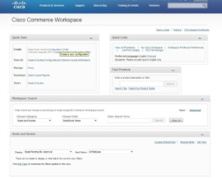
License Ordering Process
Step 1:
Customer/partners orders the license in CCW and receives License PAK
PAK=> Product Authorization Key
Ex: Need 1000 HD channel, 500 SD & 200 SD to HD upgrade licenses
To order licenses after the base unit is ordered, go to CCW and type the top level license PID: D9859-LIC-UPGR
Step 2:
Order is passed to manufacturing
Step 3:
Manufacturing ships claim certificates (PAKs) over email (setup during ordering)
Customer
3
Mfg/eLD ships Claim Certificates (PAKs) via email
Cisco Commerce Workspace (CCW)
E-Delivery for License without base unit
Manufacturing
1
Customer Orders license
Order goes to MFG/eLD for build & ship
2

Slide 9
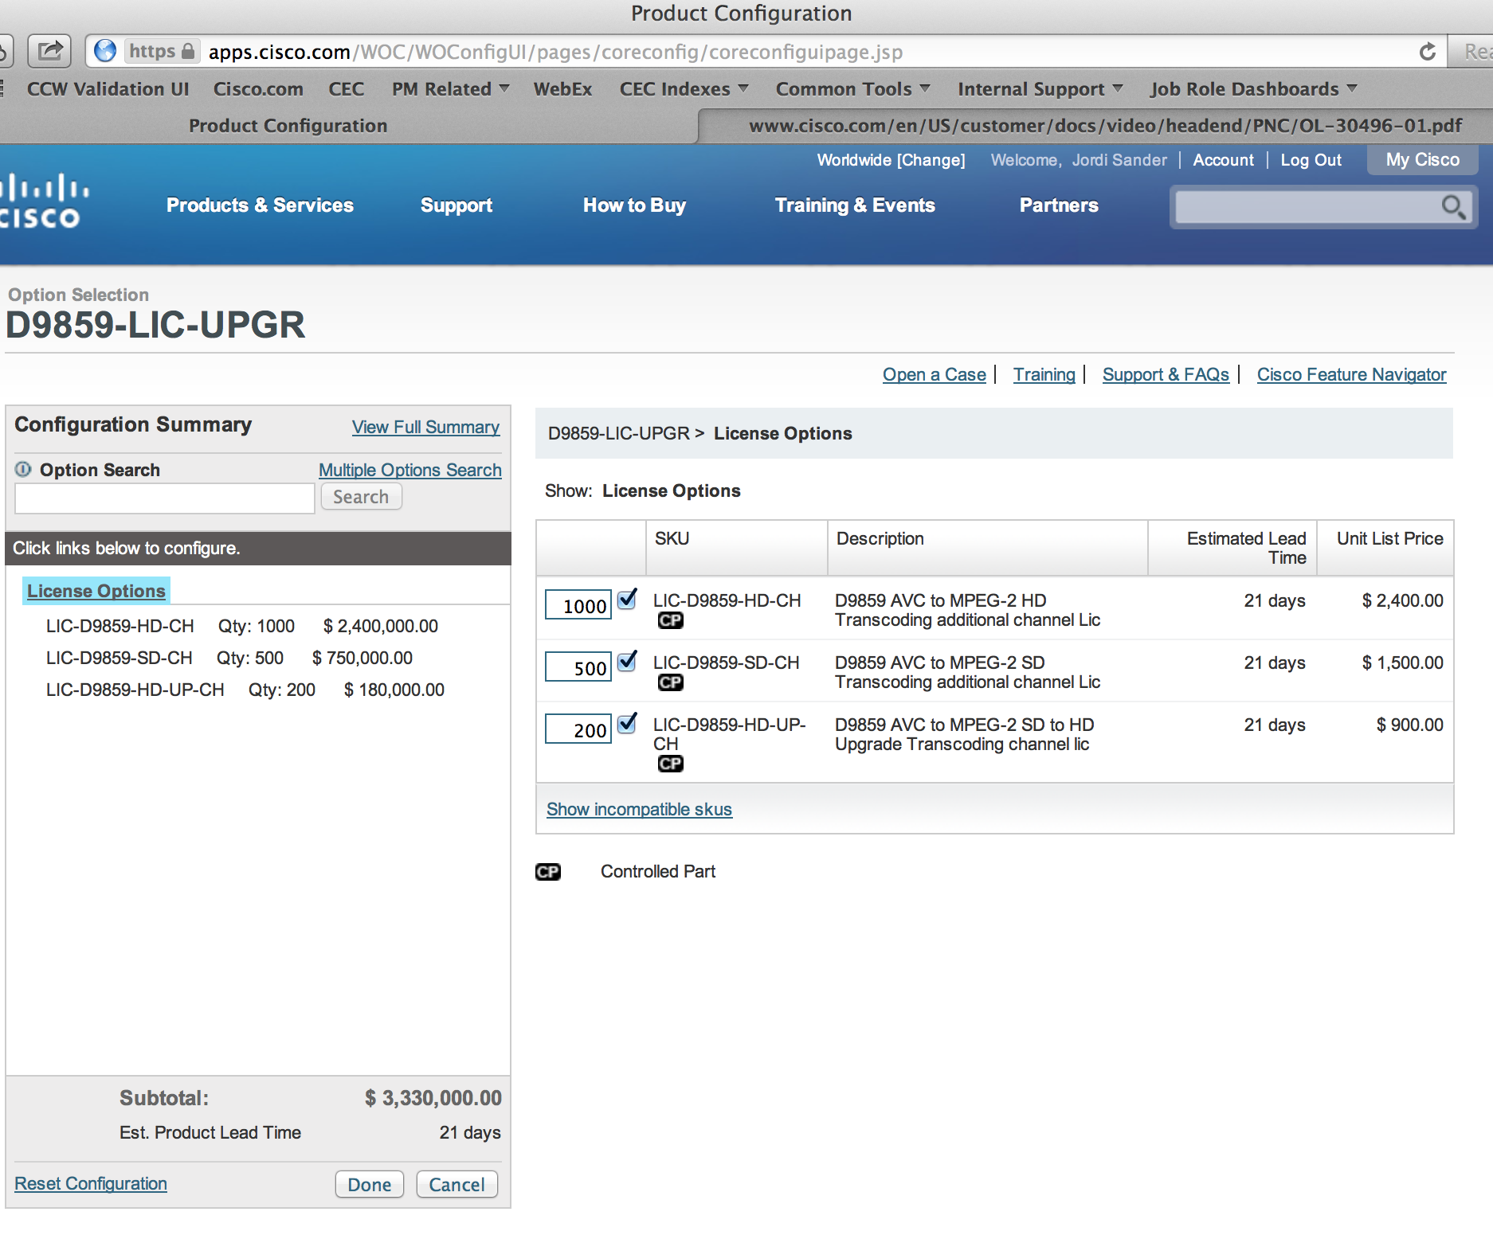
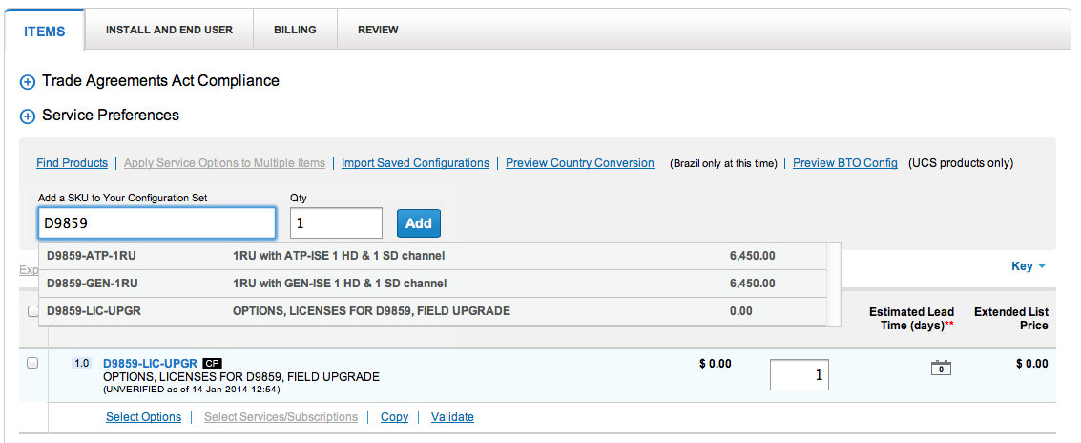
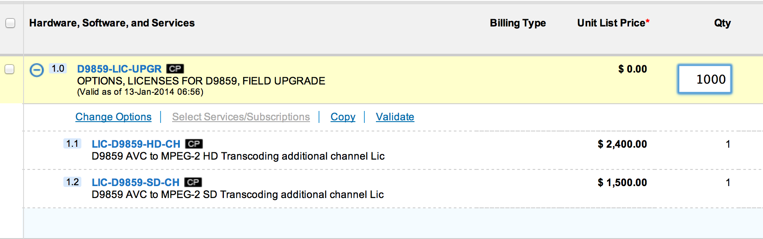
Ordering extra Licenses in CCW:
D9859-LIC-UPGR
Important: Select the number of SD/HD licenses needed within the D9859-LIC-UPGR package!
Do not: order multiple D9859-LIC-UPGR packages, this to avoid receiving too many License PAK numbers.

Slide 10
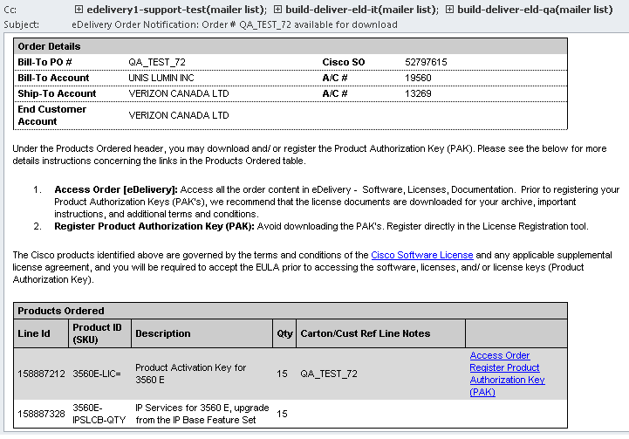
PAK Registration and License Generation
Once you order the licenses from CCW you will receive an email with the link.
By clicking on that link customers can download the PAK number (Ex: FXPAKC246F2)
PAK info can also be retrieved from Sales Order numbers
Cisco e-delivery order notification email
Ordered products, in PAK
Link to Cisco site where Claim Certificate with PAK info can be downloaded

Slide 11
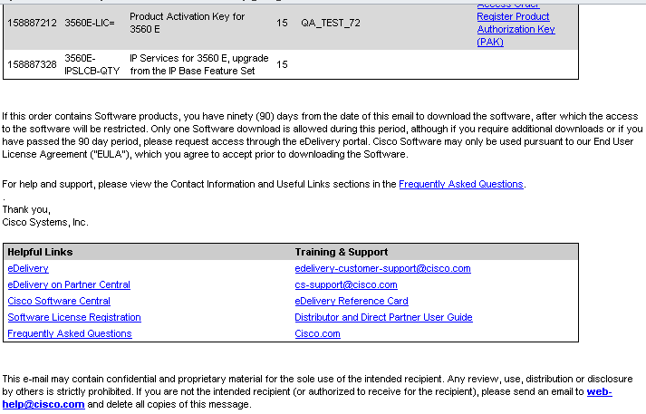
Cisco e-delivery order notification email
Additional information found in the email
FAQ
Helpful Links

Slide 12
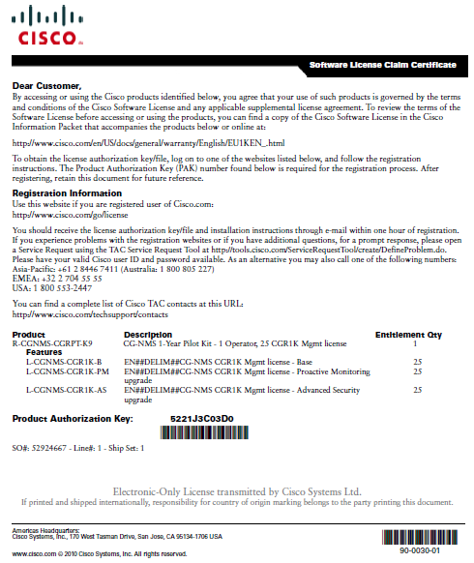
Cisco e-delivery Sample Claim Certificate
Where to redeem the PAK
Ordered products, in PAK
PAK number

Slide 13
D9859
Cisco Swift Licensing
Intro
Ordering Process
License registration
License upload

Slide 14
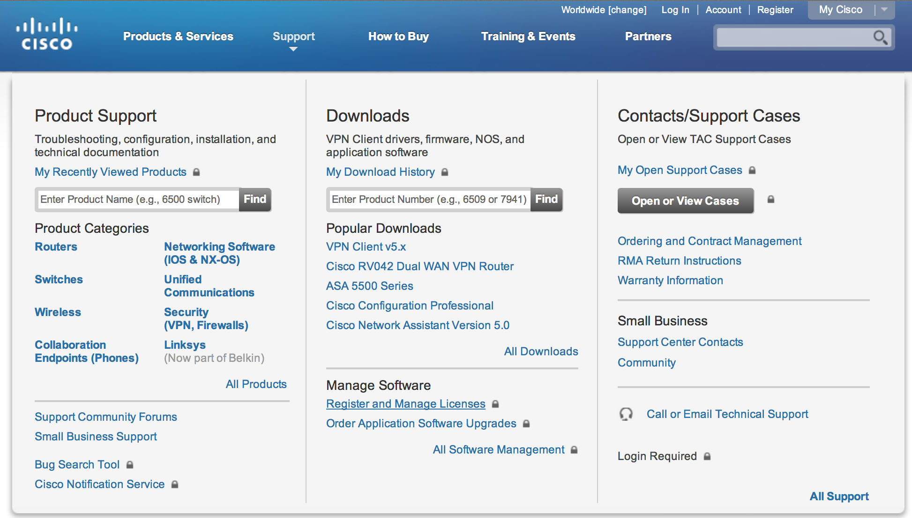
How to find the Cisco Licensing website
Go to www.Cisco.com
Select Support from the top.
Go to “Register and Manage Licenses”
Or go to the following link:
http://tools.cisco.com/SWIFT/LicensingUI/Home
Both will take you to the secure login page of the Software Licensing Portal
Enter your CCO credentials
You will be at the Quick Start page of the licensing Portal
The following slides will show you exactly what the process looks like.

Slide 15
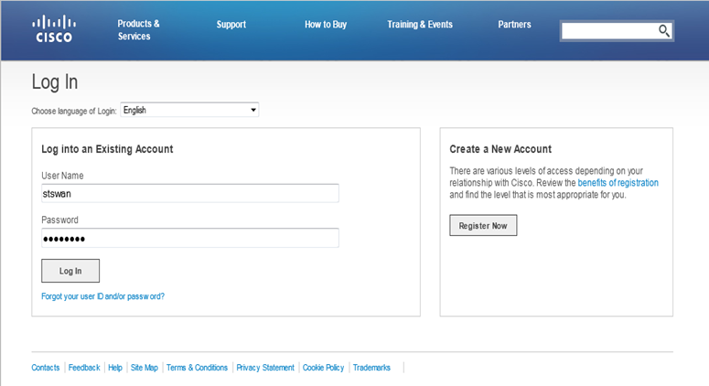
Login to Licensing Portal http://tools.cisco.com/SWIFT/LicensingUI/Home
Enter your credentials and click
Log In

Slide 16
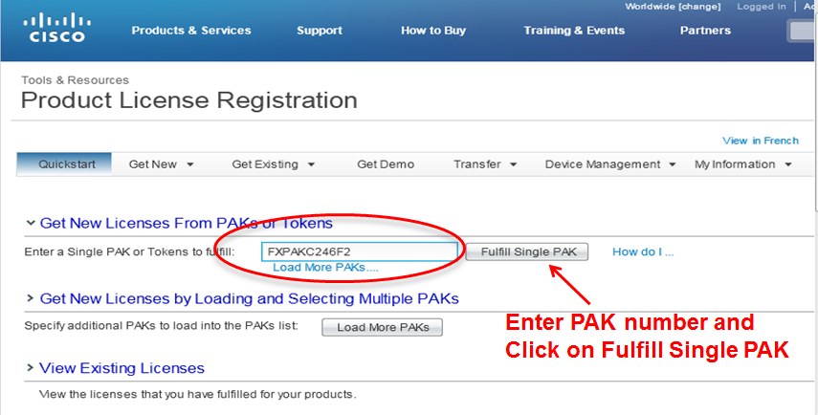
PAK Registration and License Generation

Slide 17
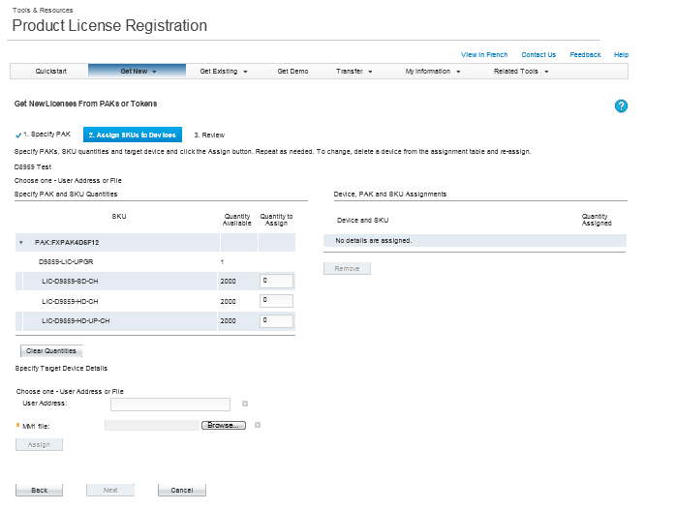
PAK Registration and License Generation
The License types and Quantity of each type in the PAK are displayed.

Slide 18
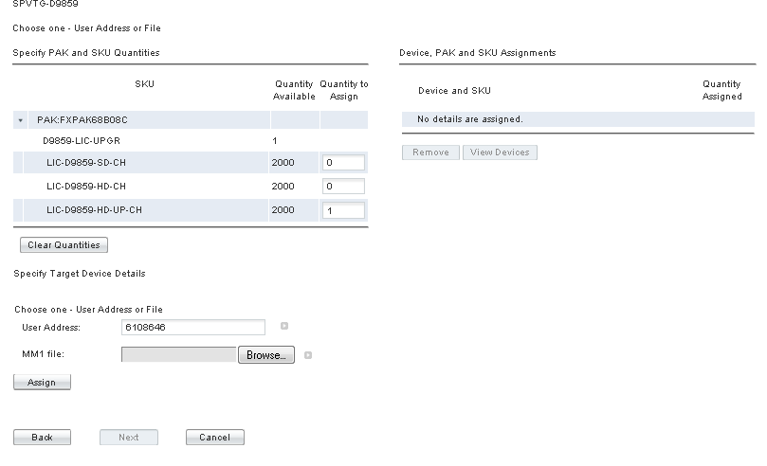
Adding Licensing to a single device
To add Licenses to a single device:
Specify the Number/Type of licenses
Enter the Master UA of the D9859
And then click Assign

Slide 19
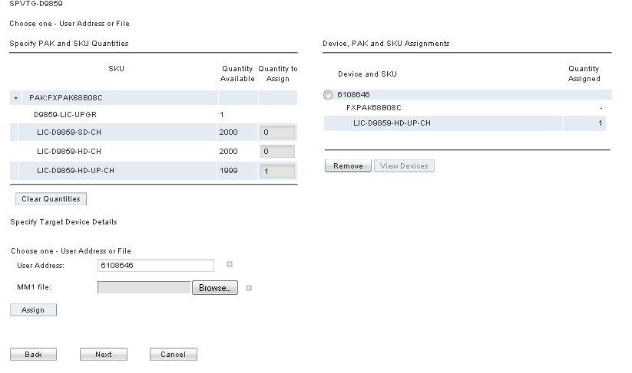
Adding Licenses to a single device
The Assignment of the Licenses to the device specified is shown above.
You can select the device and remove if desired
Continue by clicking Next

Slide 20
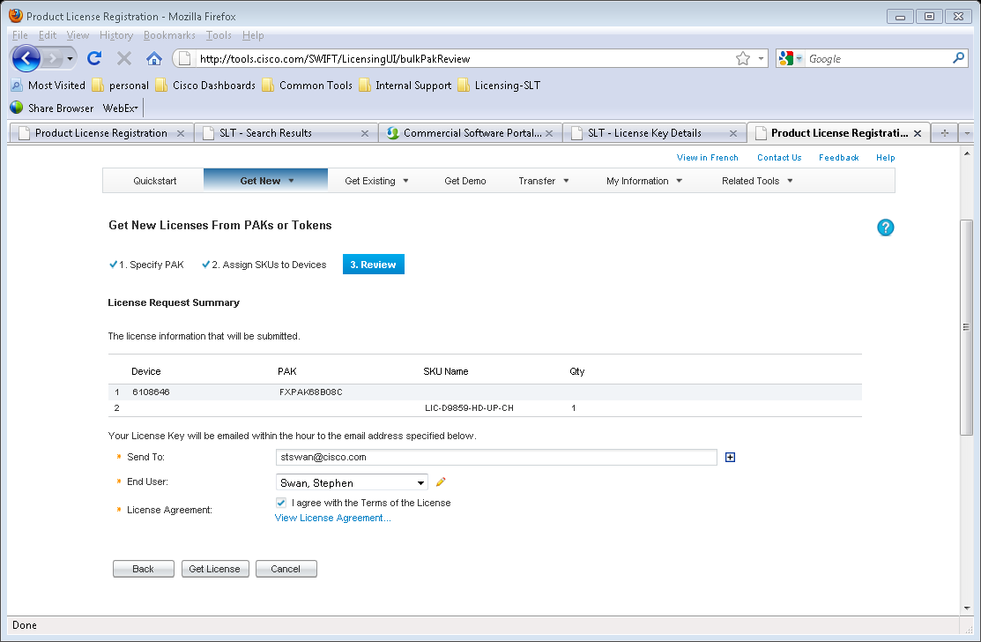
Adding Licenses to a single device
License Request Summary is shown.
Once verified, check the box indicating that you agree with the Terms of the License agreement.
This enables the “Get License” button.
Click the Get License button to generate the license.

Slide 21
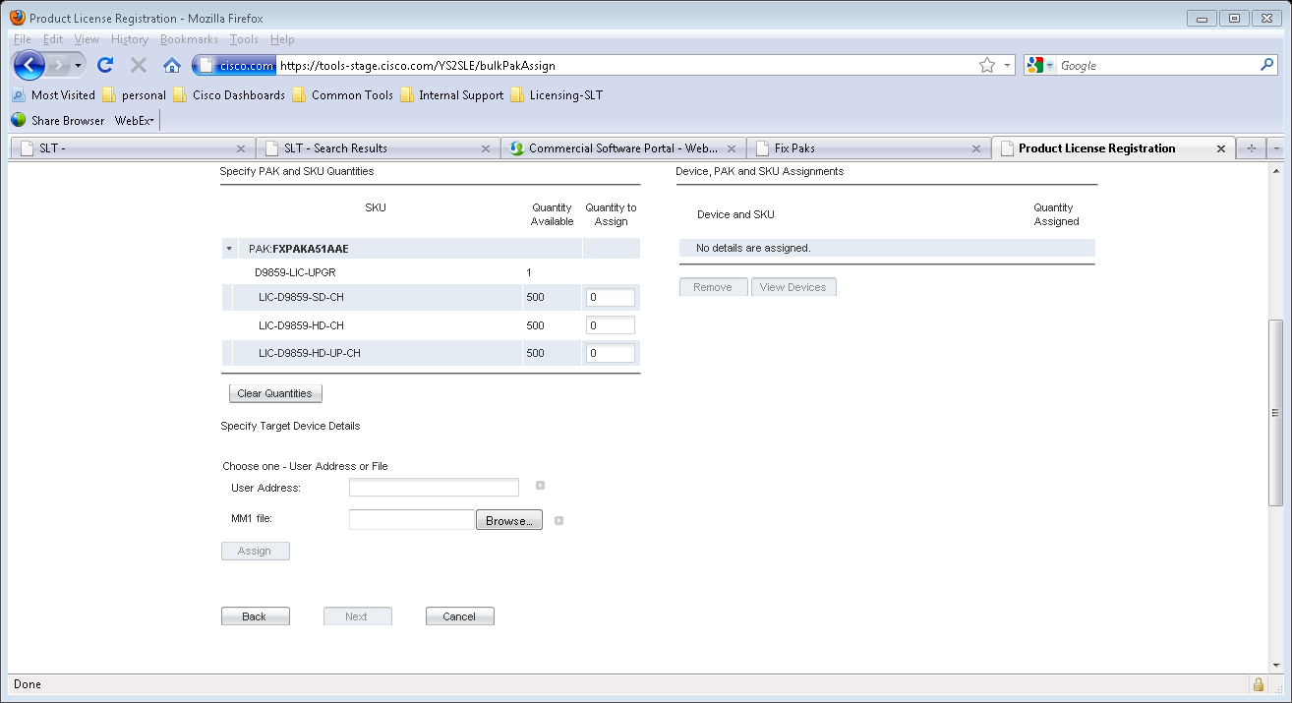
Adding Licenses to a number of devices
To create a license for more than one device you must select the number of License Types you want enabled on each device
(all devices will be licensed with the same License Types and qty).
Next, upload the file containing all of the device ID/UA’s you want to license. This file can be created from the MM1 file delivered when purchasing D9859s or through a csv file with all master UAs.
(Enter the file name and/or browse to find your file)
Once you locate your file click on Assign.

Slide 22
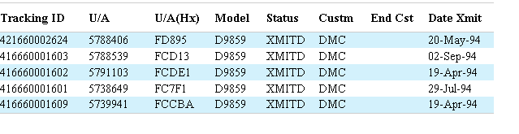
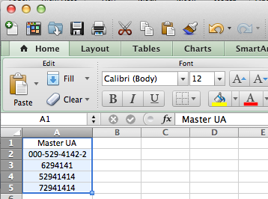
MM1 vs CSV file
MM1: Comes from Cisco, contains all recently purchased receivers (could be mix). System will filter out the D9859 Master UAs. No sorting or filtering options, all UAs are displayed, hard to work through if licensing is required on a subset.
CSV: Can be created ad hoc, only needs Master UA, simple list in Excel that can easily be manipulated. Customer generated.
Supports following UA number formats:
  000-123-4567-8, 00012345678, 1234567

Slide 23
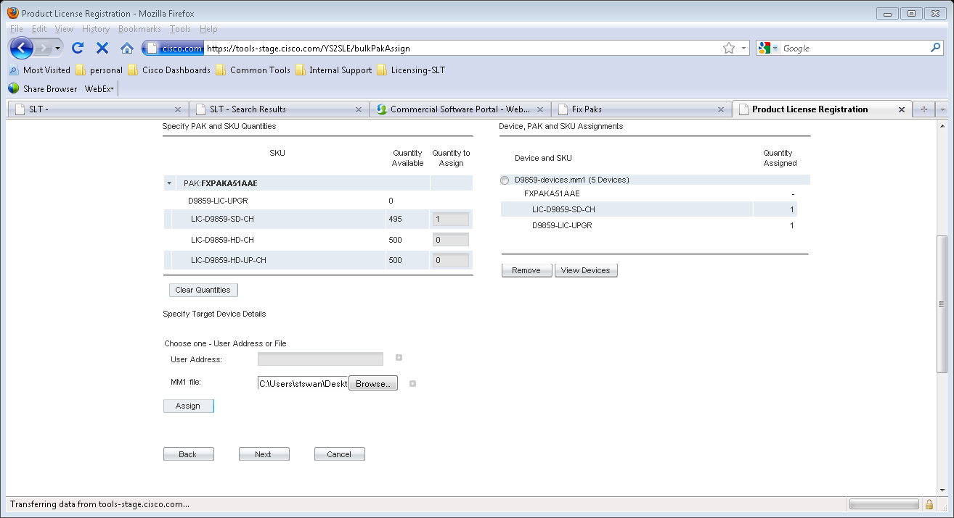
Adding Licenses to a number of devices
Here we have selected one LIC-D9859-SD-CH License to be added to all our devices (5) contained in our file. (500 – 5 = 495)
We can see the devices by clicking on the View Devices button. (see above)
Once reviewed, select Next to generate License file

Slide 24
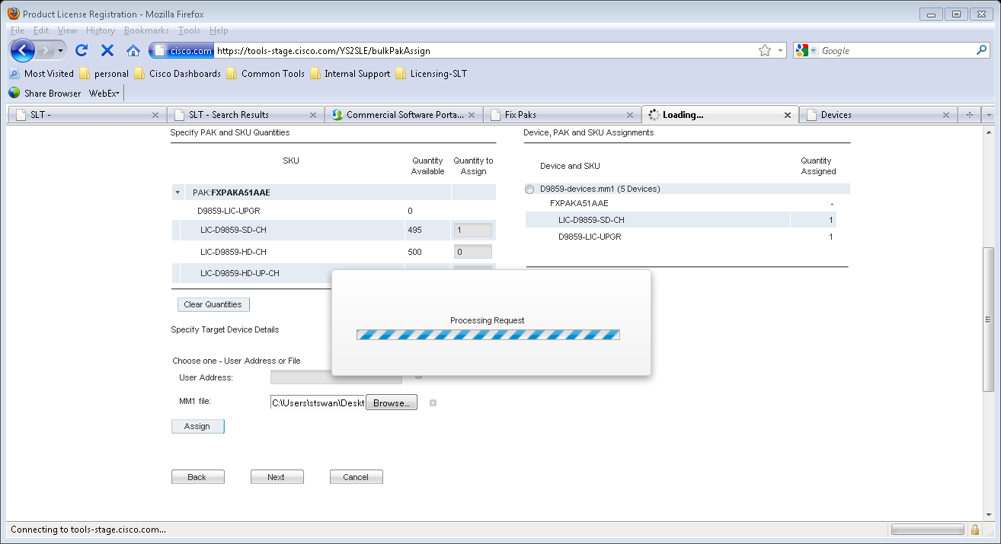
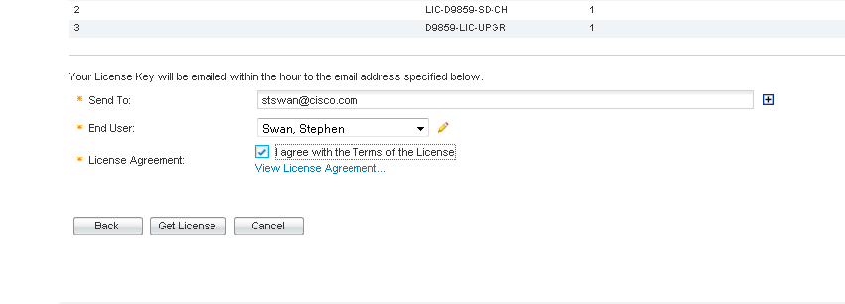
Adding Licenses to a number of devices
License Request Summary is shown.
Once verified, check the box indicating that you agree with the Terms of the License agreement.
This enables the “Get License” button.
Click the Get License button to generate the license.

Slide 25
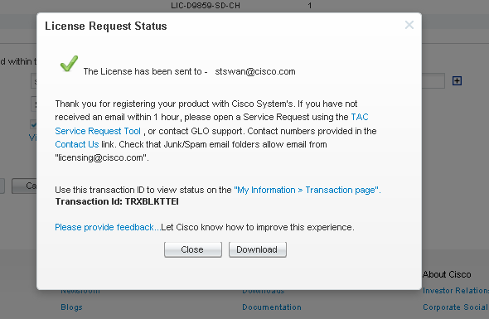
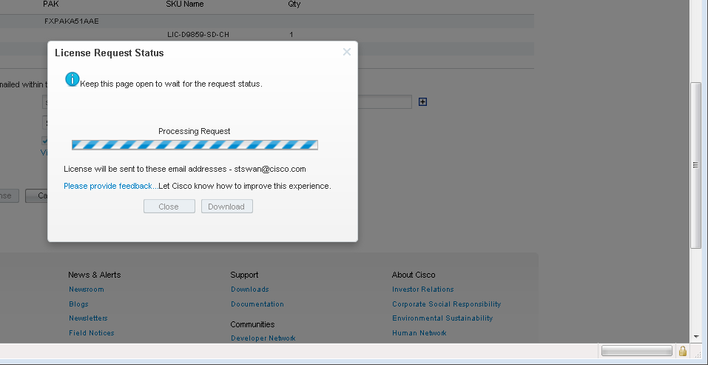
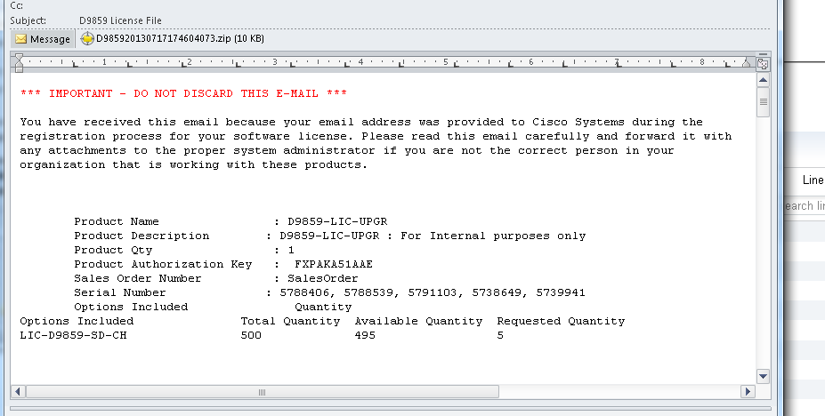
License file email
Generation complete
After license file generation:
You can download the license from tool
You can retrieve the email containing the license file.
The below email contains the file as well as a summary of the license operation, showing features remaining, device ID’s, and PAK used

Slide 26
License Files
The license file is encrypted and signed
Each license file contains information such as UA’s (User Addresses), features and feature counts registered during a single session.
A license file can contain any number of License types
Examples of License types:
  SD license
  HD license
  SD to HD upgrade license
Examples of License file:
  D9859_sw_license_v0.1.cdt
License file 1:
UA: X, Y, Z
SD License: 3
HD License: 2

Slide 27
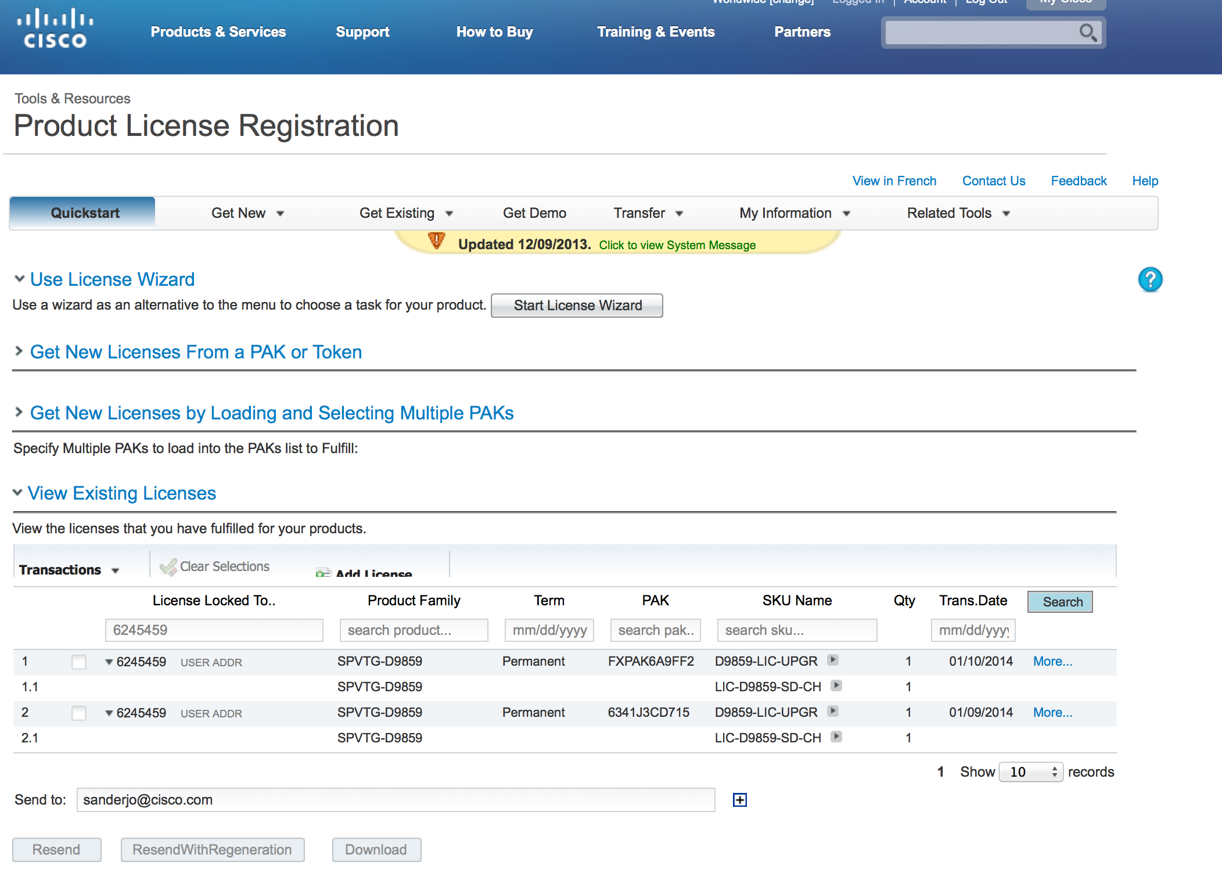
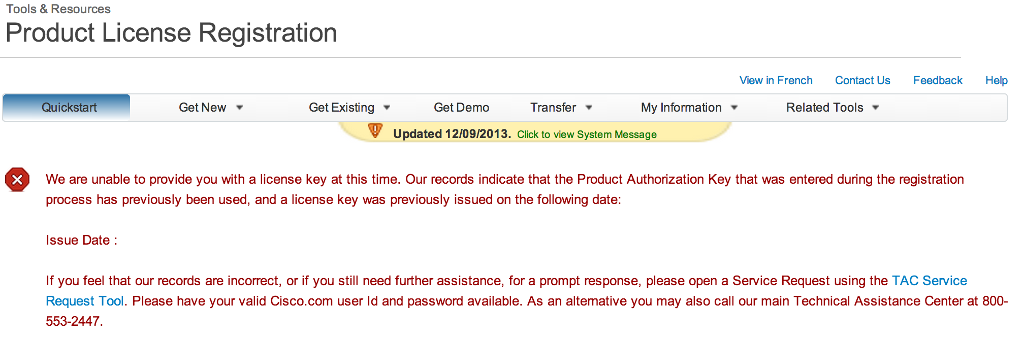
Helpful info:
Checking UA assignments
If PAK you are trying to register is
already used up, you will get error message
When registering licenses to UAs only draw from a single PAK per License session
(multi-PAK registration to Single UA target April 2014)
If you have multiple PAKs with single licenses to register to UAs:
  Use different sessions to create the multiple licenses. They will all need to be loaded on the unit.
  Contact Global Licensing Org to consolidate your PAKs into a single PAK for ease of registration

Slide 28
D9859
Cisco Swift Licensing
Intro
Ordering Process
License registration
License upload

Slide 29
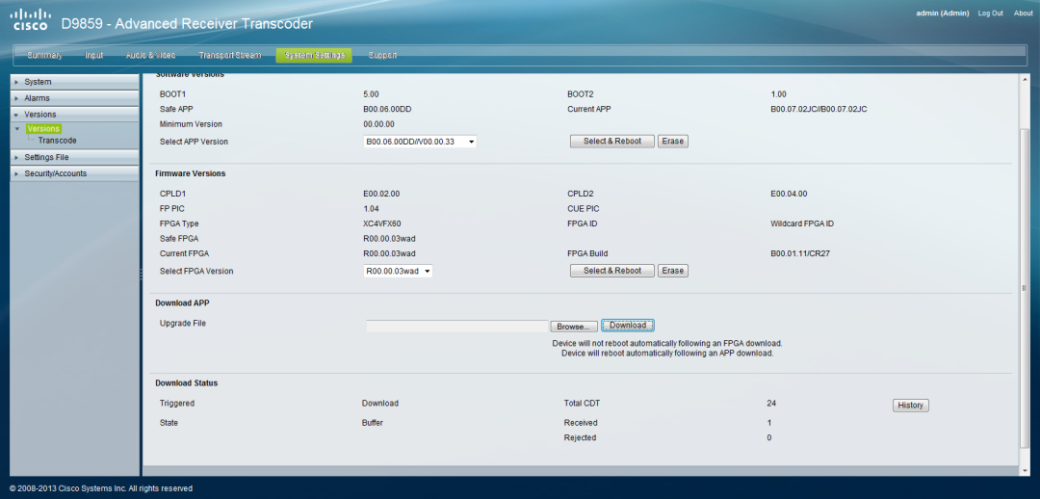
Downloading License file from Web user interface
Process:
Locate the CDT file received from Cisco SWIFT license process through D9859 web user interface:
  Go to System settings – Versions and select the file and press download

Slide 30
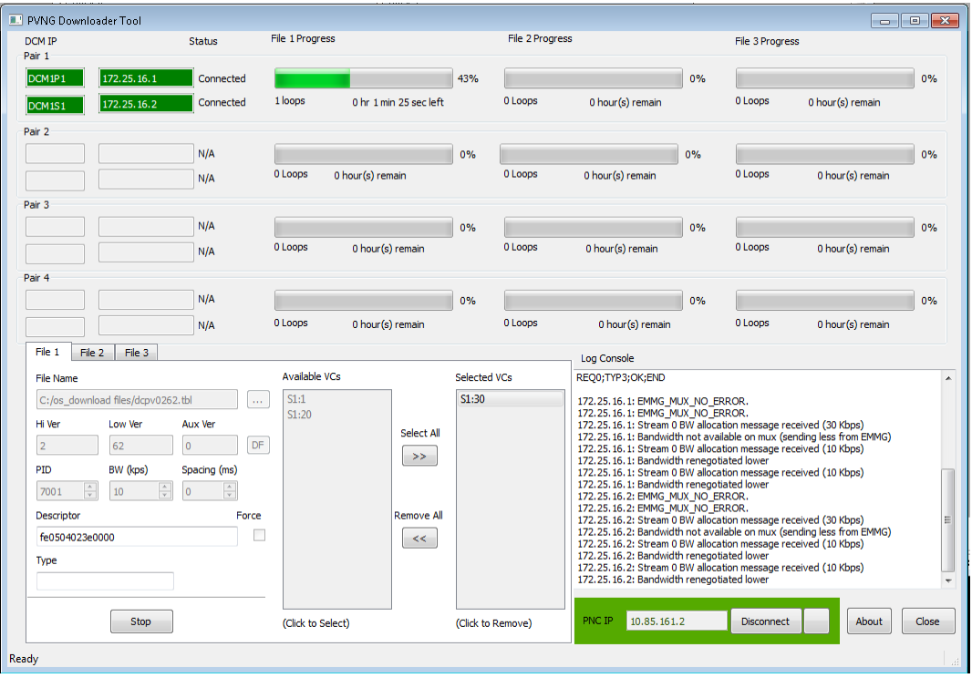
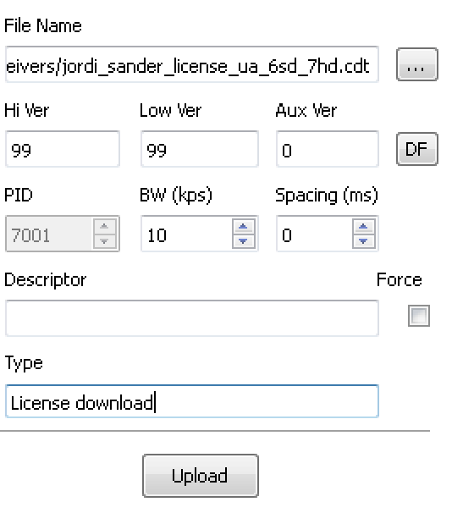
Over the Air license upload process
DCM/PCAM based signal
Required:
New PVNG Downloader tool v1.2
PVNG tool is dedicated for DCM/PCAM signals and talks to PNC system
instead of direct to D9140s in the old downloader tool
PNC v11.6 upgrade
2. DCM/PCAM based signals are identified
4. Select the VCs you want to use for the download
5. Select Upload to start process of OTA license downloads
3. Take CDT file received from licensing process and add it to one of the 3 file tabs in the tool. Type will show “License Download” if it is a license file.
(same process as with application firmware for SW downloads)
1. Connect to PNC system

Slide 31
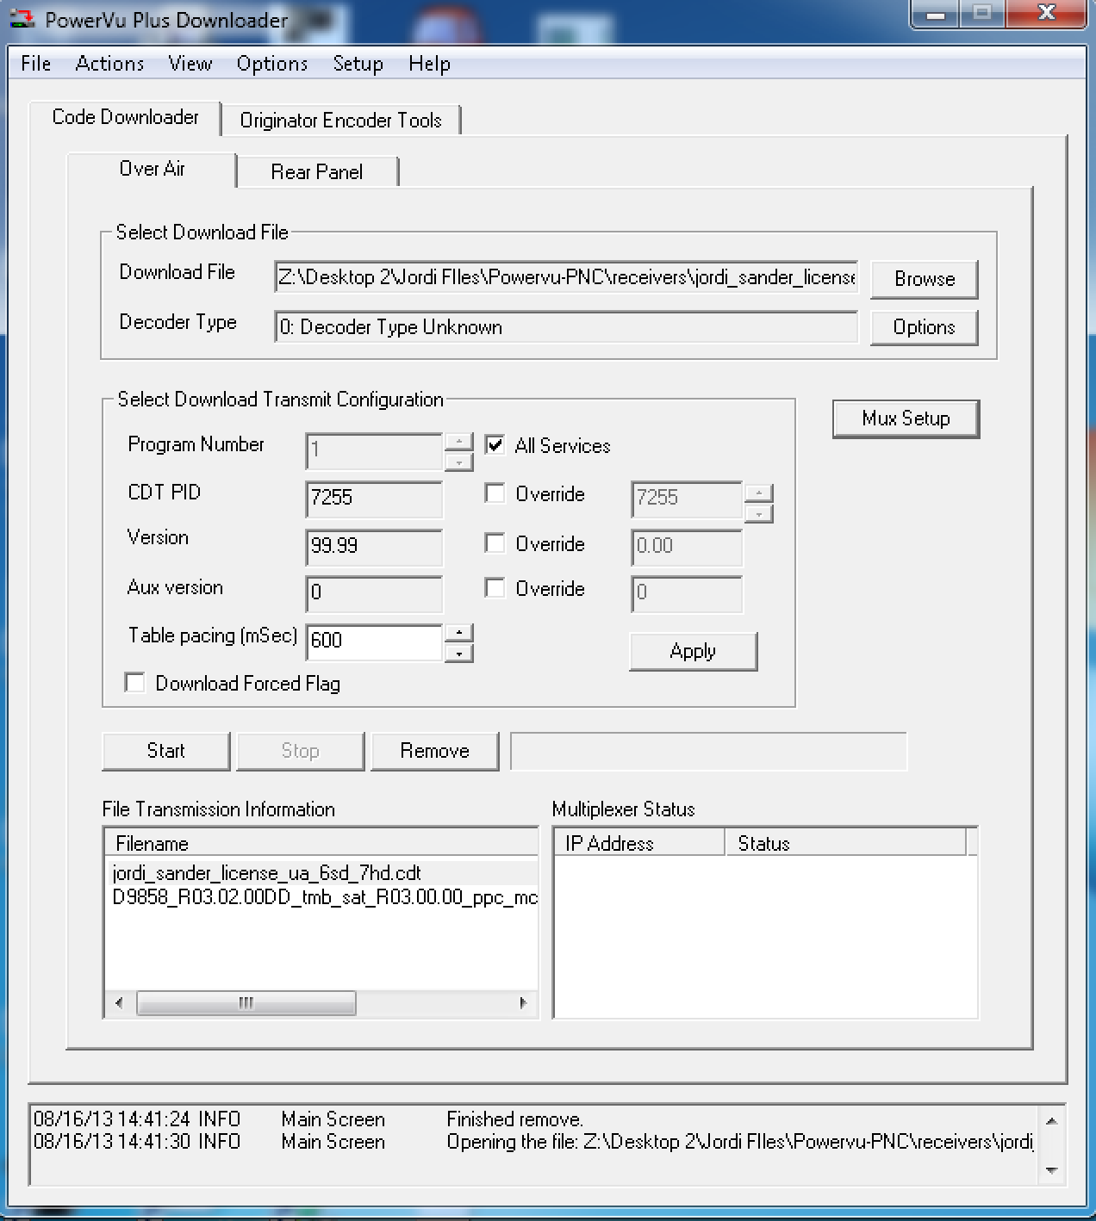
D9859 Over the Air license upload process
D9140 based Signal
Required parts:
New PowerVu Plus Downloader tool (v2.04)
PNC 11.5 or later
(to recognize D9859 officially in PNC)
Process:
Take file received from Cisco SWIFT license process
(one CDT file per order which contains all selected licensing)
Launch downloader tool on PNC GUI and make sure it is connected to D9140.
Load File into tool
Select Program number and other settings similar to Firmware CDT upload
Select apply and go to Actions and select start to initiate the download process.

Slide 32
D9859
Cisco Swift Licensing
Contacts and useful links

Slide 33
D9859 References
Cisco Commerce Workspace (CCW)
https://cisco-apps.cisco.com/cisco/psn/commerce
D9859 License-IT application
https://sso.cisco.com/autho/forms/CDClogin.html
Cisco SPVTG support forum
https://supportforums.cisco.com/community/netpro/service-providers/video
If you have specific questions on the D9859 licensing for the BU,
you can also email 9859@external.cisco.com .

Slide 34
License specific contact info
Cisco Global Licensing Operations (GLO Support Contact Information)
If you need assistance with obtaining a new license or have questions about one that you already received, please complete the Global Licensing Operations (GLO) request form at:
https://survey.opinionlab.com/survey/s?s=10422 for a faster resolution
or send an email to licensing@cisco.com (email can be used till April 2014)
Licensing Contact Phone Numbers
If you need immediate assistance with obtaining a new license or have questions about one that you already received, please call the Global Licensing Operations (GLO) team. You can find the Cisco Global Licensing Operations Phone numbers at -
http://www.cisco.com/en/US/support/tsd_cisco_worldwide_contacts.html
TAC Support
Cisco Technical Assistance Center (TAC)

Slide 35
D9859
Cisco Swift Licensing
FAQ

Slide 36
D9859 Licensing FAQ
What happens if you take a settings file from a fully configured and licensed unit and take it to a unit with less licenses.
The unit with less licenses will take the settings file but will only activate PEs according to its number of licenses. So some of the PEs will be disabled.
How are the licensing features and quantities protected in the licensing tool to avoid oversubscribing the licensing on a receiver.
Currently, the system will prevent you from adding more then 6 license features to a single UA at one time. We do advise to pay attention as not every combination is protected from oversubscription.
Can you register a license feature to a blank UA
No, you cannot. The system will show an error and you will be able to correct.
Can you get PAK notifications sent to multiple emails/users
Yes you can. The ordering entity can add more email destinations in the edelivery tool.

Slide 37
D9859 Licensing FAQ
Where are the licenses being sent from: licensing@cisco.com
When uploading a license file over the air, does the receiver show a DL (download ongoing) and DT (Download taken) indication?
The receiver will show briefly the DL indication during the download. A DT indication will be shown once done.
If the license OTA process is restarted with the same file, it will show the same results since the IRD has to process the license file again to see if it is new or not.
On another note: Targeting D9859s with Over The Air License CDT uploads combined with D9859 Firmware CDT uploads is not supported!
Supported example:
Targeting D9824/54/58s with a firmware upload combined with targeting D9859s with a license upload is supported.
Non-supported example:
Targeting your D9859s with a D9859 firmware upload while at the same time uploading theD9859 license files is NOT supported.

