Slide 1
Drive to 9
CUCM Install Base Upgrade Program
Technical Training

Slide 2

Drive to 9 - Objective
Enable Customers to leverage next generation Collaboration Experiences by upgrading to Cisco Unified Communications Manager 9.1 or higher!
Video, BYOD, B2B, Virtualization & Contact Center

Slide 3

Drive to 9 Program
Enable Customers to leverage next generation Collaboration Experiences by upgrading to Cisco Unified Communications Manager 9.1 or higher!
Simplified Upgrade Process
Customized Upgrade Collateral
Simplified License Migration
Readiness Assessment Tools
VODs
Compelling Offers and Incentives
    Server Hardware offers
    Licensing & Services offers
    Video Accelerator Bundles
    Endpoints & Application Offers
Drive to 9
Focused Support
Upgrade Resource Central
Drive to 9 TAC and PDI help desk
    GLO & Licensing SWAT team
    Support Forums
Comprehensive Enablement
    Partner Workshops
    Field Workshops
    e-Learning and training
    AS Upgrade Services
Video
BYOD
Cloud/B2B
Virtualization
Mobility
Contact Center
Notes:
3
3

Slide 4

What is in it for the Customer?
Next Generation
Collaboration Experience
B2B
Mobility
IM/Presence
Customer Collaboration
Video
BYOD
Virtualization
Customer
Cloud

Slide 5
Customer Install Base – Version Distribution
CUCM 6.x
CUCM 8.x
CUCM 8.5/8.6
CUCM 4.x
CUCM 5.x
CUCM 7.x
CUCM 9.x
%
6%
2%
24%
37%
14%
16%
<2%
#
6K | 2K | 24K | 37K | 14K | 16K | <2K
4.x, 5.x
6.x, 7.x, 8.x
(91% of install base)
Untapped Innovations
Ease of Upgrading
Source: CIBU PM

Slide 6
Cisco Unified CM: Features Matrix
 | CUCM 4.x/5.x | CUCM 6.x/7.x | CUCM 8.0.x | CUCM 8.5/8.6 | CUCM 9.1
Virtualization | X | X | ✓ | ✓ | ✓
BYOD (Jabber on Win/MAC/IOS for voice and video) | X | X | X | ✓ | ✓
Video (Unified Voice/Video call Control) | X | X | X | ✓ | ✓
Mobility (SNR for Voice and Video) | X | X | X | X | ✓
B2B (SIP URI-Dialing & VCS Expressway) | X | X | X | X | ✓
Enterprise License Management (ELM) | X | X | X | X | ✓
Bandwidth Management (Locations Based CAC) | X | X | X | X | ✓
Native Queuing for Contact Center | X | X | X | X | ✓
Notes:
Notes: Mobility/Jabber on x/Video/SIP URI/VCS express/B2B/Virtualization/
Mobility features at CUCM 6.x/7.x: Mobility connect, mobile voice access, etc
Video: native support of Tandberg endpoints started from CUCM 8.5
BYOD/Jabber: Jabber started from CUCM 9.0.x. Before that, CUCI-Connect, CUCI-MoC, CUPC were much less successful than Jabber.
CUCM 10 ICE features: Identity / Single Sign On, Common In-meeting Experience / One Touch, Installation & Upgrades, Edge & Firewall Traversal, etc

Slide 7











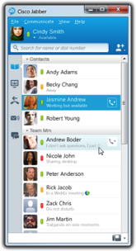





Cisco Unified CM 9.1 Architecture
Cisco Unified CM is the heart of Cisco collaboration services, enabling session and call control for Video, Voice, Messaging, Mobility, B2B, IM & Presence.
Internet
B2B
Presence
Contact Center
Voice/Video
VCS Expressway™ Firewall Traversal
Unified CM 9.1
Messaging
Mobility
Security
Session Management
Remote User
BYOD
Mobility/SNR
PSTN Gateway
Voice
Video & TelePresence
Video
BYOD
Mobility
B2B
Virtualization
Contact Center

Slide 8
Migration to 9.1(2)
Streamlining Upgrade Process
Download 9.1(2) SW
No Gaps
Readiness Assessment (HW, SW, Applications, Licenses, Services)
Upgrade & Update Licenses
Customer
Decides to
Upgrade to
CUCM 9.1(2)
Customer
Partner
AS
Remediation
Upgrade Server, Endpoints, Applications, Licenses, UCSS, ESW
Gaps
Identified
Upgrade Resources and Support
PDI Help Desk Drive to 9 TAC Upgrade Resource Center
Migration SWAT Team Engineering Escalation Upgrade Services
Notes:
Use the User Count Tool (UCT) to determine the license count
Contact Global Licensing Operations (GLO) team to migrate the licenses.

Slide 9
Drive to 9 Key Upgrade Process Simplifications
Readiness Assessment Tool: Automates Readiness Assessments
Jump Upgrade: Reduces Time & Risk during upgrade
Customized Collateral: Tested, Validated and Simplified upgrade procedures
Single POC for License Migration: Error-free migration of licenses to 9.1.(2)

Slide 10
Upgrade Steps
Enable Customers to leverage next generation Collaboration Experiences by upgrading to Cisco Unified Communications Manager 9.1 or higher!
Drive to 9 Upgrade Process
1
2
3
4
5
Readiness Assessment
Pre-upgrade Checklist
License
Entitlement
Upgrade
CUCM
Post-upgrade
Checklist

Slide 11
Upgrade Procedure
Step By Step Instructions
1
2
3
4
5
Run Readiness Assessment
Perform readiness assessment including system compatibility checks with other UC applications
iPad App - CUCM Collaboration Central:
https://itunes.apple.com/us/app/id650114526?mt=8
Web Tool - Upgrade Readiness Assessment: http://tools.cisco.com/cucst/upgrade/index.jsp
Use one of the tools to generate readiness report.
Remediate any gaps, including UC system application compatibility, CUCM HW, Gateways and endpoints
Download the required software from PUT: http://tools.cisco.com/gct/Upgrade/jsp/index.jsp
Chose one of the recommended upgrade options provided by the readiness assessment.
If choosing “jump” upgrade, obtain the intermediate 6.1(x) or 7.1(x) software by opening a TAC case.

Slide 12
Upgrade Procedure
Step By Step Instructions
1
2
3
4
5
Pre-Upgrade Checklist
Perform pre-upgrade tasks in preparation of the upgrade
Review the Release notes for 9.1(2)
Perform bug-scrubs and evaluate impact of any open bugs to your configuration
Remediate any gaps as identified in Readiness Report
Schedule maintenance windows
Plan for required downtime during maintenance windows
Upgrade Phone Firmware/ IOS Voice Gateway/ Associated UC Applications
Migrate to Cisco Unified X Attendant Console (CUxAC) before or during Unified CM 9.X upgrade
Document Production CUCM Locales and Phone Locales
Manual back-up of background images and customized ringtones
Document network parameters of Production Cluster
Document registered device count
Purge CDR records to reduce upgrade time
Make sure the DB Replication Status is ‘2’ before upgrade
Restrict admin access during upgrade to avoid upgrade failures
Proactive TAC case can be opened for you to help you through the upgrade http://www.cisco.com/web/partners/tools/pdi.html
Cisco PDI Help Desk has been trained specifically on upgrades and will be available 12x5 for partners hd-uc@cisco.com
Notes:
Media size of some version of 8.6 and later will not fit on a single layer DVD. Check to ensure that servers supports dual layer DVD
Open a Case Online:
http://www.cisco.com/web/partners/tools/pdi.html
Email PDI Help Desk:
pdihd-uc@cisco.com

Slide 13


Upgrade Procedure
Step By Step Instructions
1
2
3
4
5
License
Planning
Contact GLO for your 9.1 license entitlement
Run License Count Utility (LCU) on existing system for 5.x/higher. Download from Cisco Download site License Count Utility
Contact GLO to understand current license entitlement
Use the drive to 9 promotions through CB+ to up level current licenses or convert unused DLUs
Fulfill any unused license PAKs
Install all pre-9.x licenses prior to upgrade
For more information: https://communities.cisco.com/docs/DOC-33804
Open a Case Online (Select Problem Type as “Licensing”):
http://cisco.com/tac/caseopen
Email GLO:
licensing@cisco.com
Worldwide Telephone Numbers (Press 3 for Licensing):
www.cisco.com/en/US/support/tsd_cisco_worldwide_contacts.html
Plan for growth, unused DLU allocation and additional UCSS.
You must apply all pre-9.x licenses to CUCM before you upgrade. After upgrade, you cannot install pre-9.x licenses to the Enterprise License Manager.

Slide 14
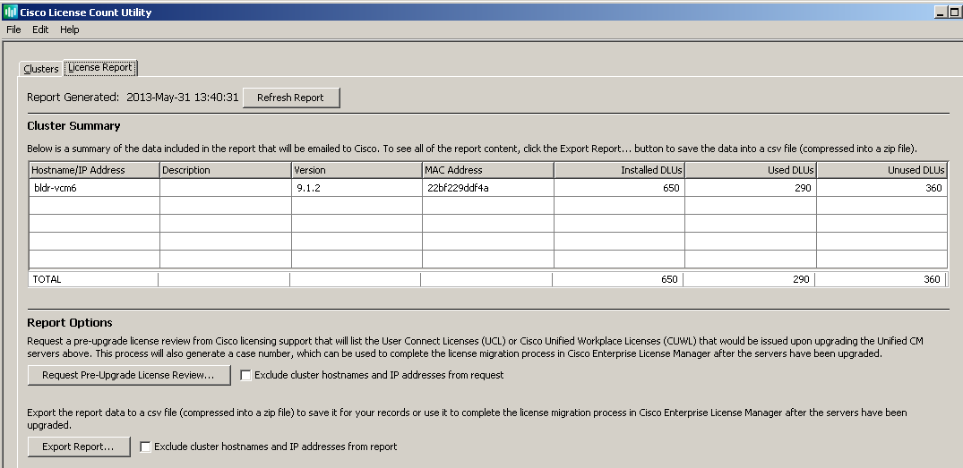
License Count Utility
Use LCU for data gathering and submittal of the request for license migration, prior to upgrade
8.6.2
IP/Hostname can be excluded for security

Slide 15
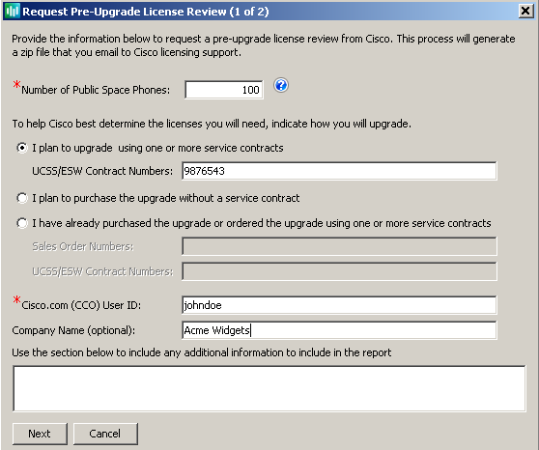
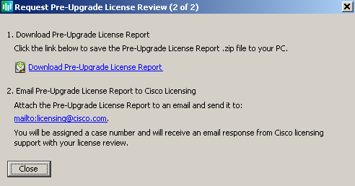
License Count Utility
Provide additional information to assist GLO in fulfilling the license migration
Download generated report (signed zip file) and email to licensing@cisco.com
Review licensing assessment and place upgrade order

Slide 16
Upgrade Procedure
Step By Step Instructions
1
2
3
4
5
Upgrade
CUCM
Perform the CUCM upgrade by following one of the customized procedures
Stop all configuration tasks
Disable extension mobility for the cluster
Follow one of the upgrade procedures available for your scenario
Open a Case Online: Select keyword “Communications Manager Upgrade to v9 (Drive-To-9 Initiative)”
http://cisco.com/tac/caseopen
Direct Upgrade
Upgrade Directly on your existing hardware
Email TAC:
tac@cisco.com
High Availability Upgrade
Multi-hop: Migrate to new hardware providing maximum availability
Worldwide Telephone Numbers: www.cisco.com/en/US/support/tsd_cisco_worldwide_contacts.html
Jump Upgrade
Multi- hop: Virtualize UCM in parallel to production, reduce risk and downtime
Notes:
Install ELM

Slide 17
Follow the Simplified Upgrade Procedure
Customized Collateral for Upgrade Procedures
Current Release | Direct UCS | Direct MCS | High Availability | Jump
8.6(1) – 9.0(1)
8.0.2 - 8.5.1
8.0.1, 7.1.3, 6.1.4 - 6.1.5
7.1.5
7.0.1 - 7.1.2, 6.1.2 - 6.1.3
5.x(x) | http://www.cisco.com/en/US/docs/voice_ip_comm/cucm/ upgrade/5_1/upgrd513.html
4.x(x) | http://www.cisco.com/en/US/docs/voice_ip_comm/cucm/dma/ 7_0_1/dmaug701a.html
Direct upgrade virtual versions 8.0.2-9.0.1 to 9.1.1
Direct upgrade versions 6.1.2-9.0.1 to 9.1.1
High Availability upgrade versions 8.0.2-9.0.1 to 9.1.1
High Availability upgrade versions 6.1.2-6.1.5, 7.0.1-7.1.3, 8.0.1 to 9.1.1
Jump upgrade versions
4.x*, 5.x*, 6.1.4-6.1.5, 7.1.3, 7.1.5 to 9.1.1
TBD
EDCS-1245853
High Availability upgrade versions 7.1.5 to 9.1.1
EDCS-1244204
High Availability upgrade versions 6.1.2-6.1.5, 7.0.1-7.1.3, 8.0.1 to 9.1.1
In Progress
EDCS-1245432
Notes:
EDCS-124546 Drive_to_Nine_Direct_upgrade_virtual_versions_8.0.2-9.0.1_to_9.1.1
EDCS-1245820 Drive_to_Nine_Direct_upgrade_versions_6.1.2-9.0.1_to_9.1.1
EDCS-1245432 Drive_to_Nine_High_Availability_upgrade_versions_6.1.2-6.1.5_7.0.1-7.1.3__8.0.1_to_9.1.1
EDCS-1244204 Drive_to_Nine_High_Availability_upgrade_versions_7.1.5_to_9.1.1
EDCS-1245164 Drive_to_Nine_High_Availability_upgrade_versions_8.0.2-9.0.1_to_9.1.1
EDCS-1245853

Slide 18
Types of Upgrade
Types of CUCM Upgrades
Direct Upgrade
High Availability Upgrade
Jump Upgrade
Notes:
18

Slide 19
CUCM-Direct Upgrades
Definition
Upgrade process to 9.1(2) where the hardware platform supports 9.1(2) version of CUCM
Single-hop or Multi-hop Upgrades
Qualification Criteria
CUCM software version/Hardware: 6.1(2) and Above/MCS
CUCM software version/Hardware: 8.0(2) and Above/UCS
Target Version: CUCM 9.1(2)
Supported MCS Hardware
http://www.cisco.com/en/US/prod/collateral/voicesw/ps6790/ps5748/ps378/prod_brochure0900aecd8062a4f9.html

Slide 20
Direct Upgrade Paths
6.1(2)
Or 6.1(3)
6.1(4)
CUCM
9.1(2)
7.0(1)
7.0(2)
7.1(3)
7.1(2)
7.1(5)
8.0(2)
8.5/8.6

Slide 21
Direct Upgrade High Level Steps
Stop all configuration tasks
Disable extension mobility
Install the refresh upgrade COP files on all nodes
Upgrade the publisher node to Release 9.1(2); choose “Run new version at the completion of the upgrade”
After Pub , Upgrade TFTP and Subscriber nodes
Virtualization – For each node, shut down the virtual machine and change the Guest OS version to Red Hat Enterprise Linux 5 (32-bit).
Phase 1 – Upgrade to Intermediate Release
DRS backup of MCS/UCS
Production Cluster
Upgrade to Intermediate
Release
Phase 2 – Final Upgrade to 9.1
DRS backup of
Intermediate Release
Install RU COP file
Refresh Upgrade
to 9.1(2)
Migrate Licences
to 9.1(2)
Notes:
Pre upgrade cluster information
Upgrade phone firmware
Verify database replication
Perform backup
Apply RU upgrade COP (v8.5 and earlier)
Upgrade cluster
Verify Database replication
Post upgrade/migration testing
Stop all configuration tasks
Disable extension mobility for the cluster
Install the refresh upgrade COP files on all nodes
Upgrade the publisher node to Release 9.1(2); choose “Run new version at the completion of the upgrade”
After Pub , Upgrade TFTP and Subscriber nodes
Virtualization – For each node, shut down the virtual machine and change the Guest OS version to Red Hat Enterprise Linux 5 (32-bit).

Slide 22
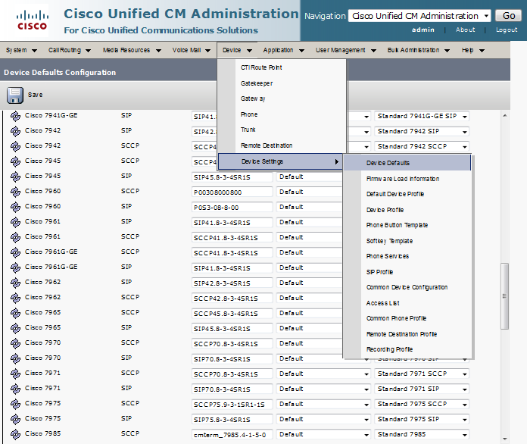
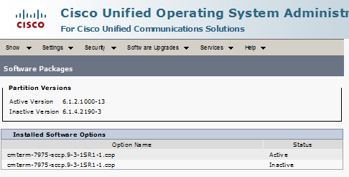
Upgrade firmware
Install the phone firmware
Verify the phone default loads
Verify the versions on the server

Slide 23
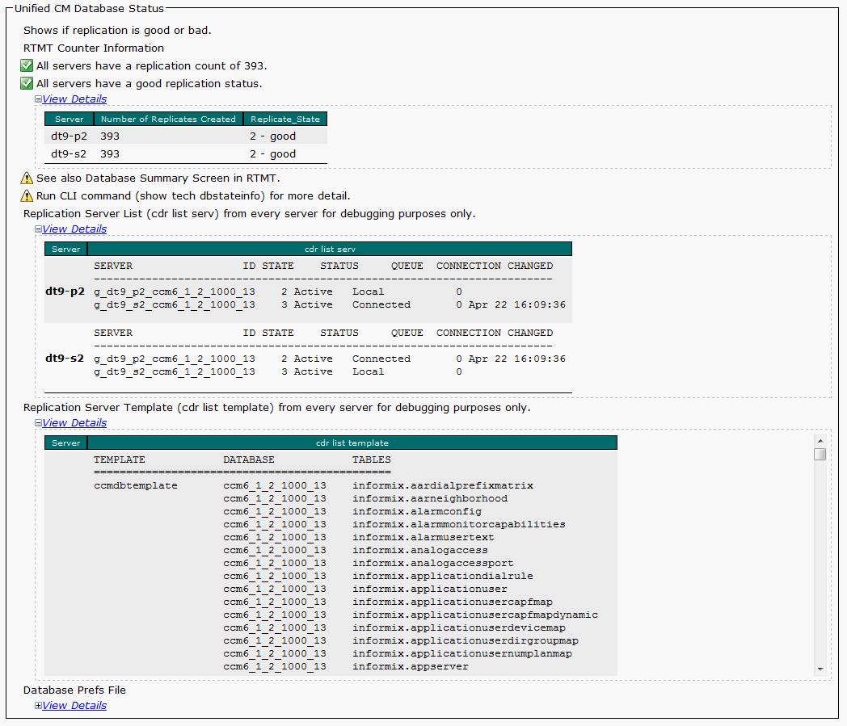
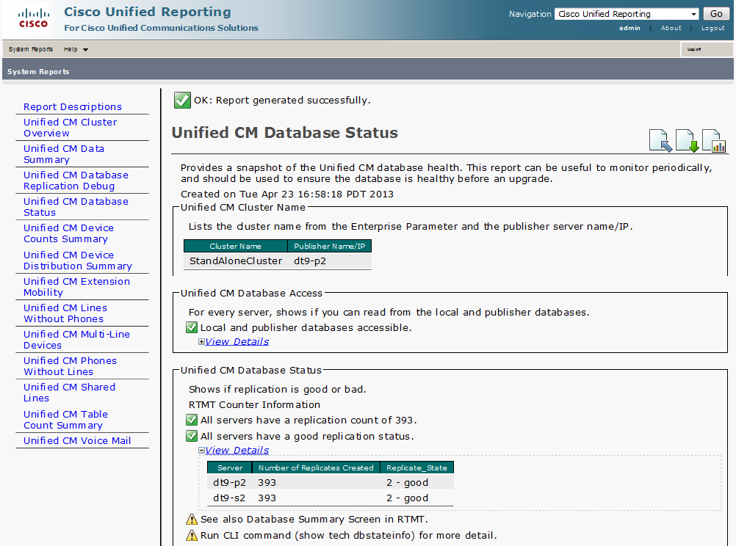
Verify Database replication
Cisco Unified Reporting tool (CURT)
Database replication status

Slide 24
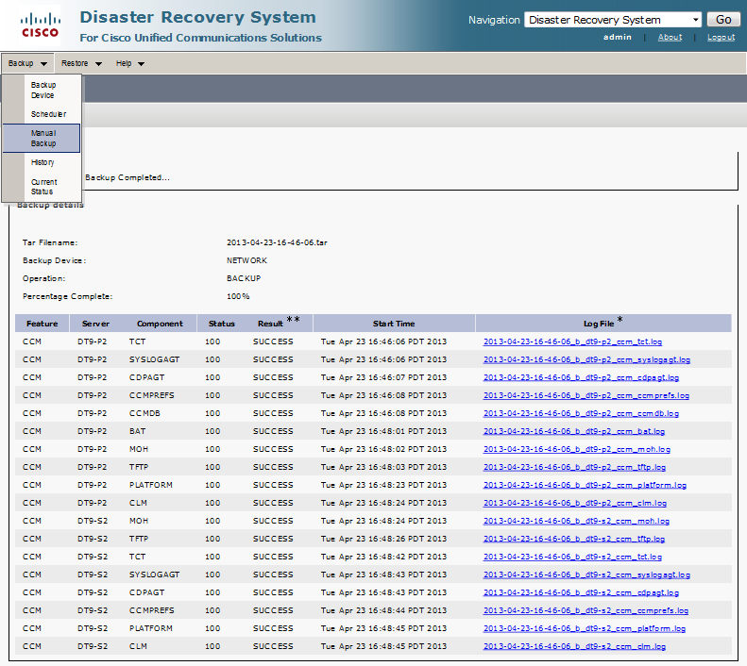
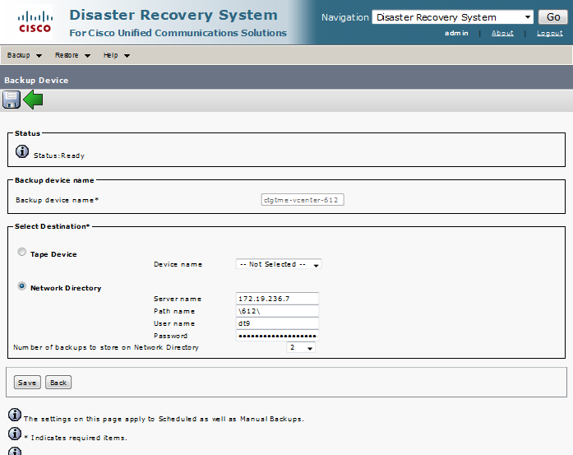
DRS Backup
Configure the Backup device
Perform manual backup for all nodes

Slide 25
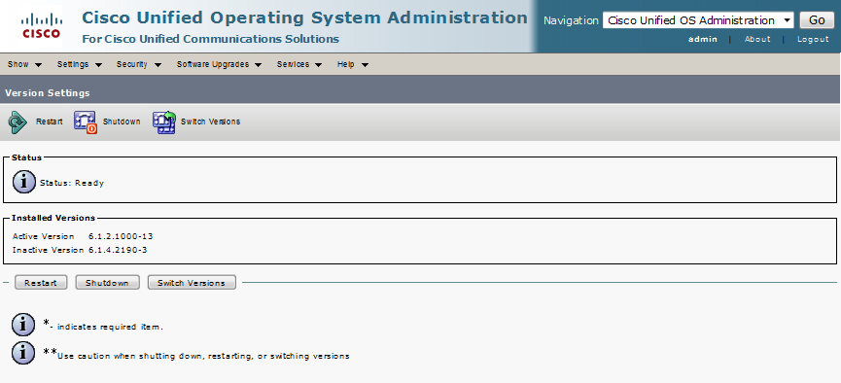
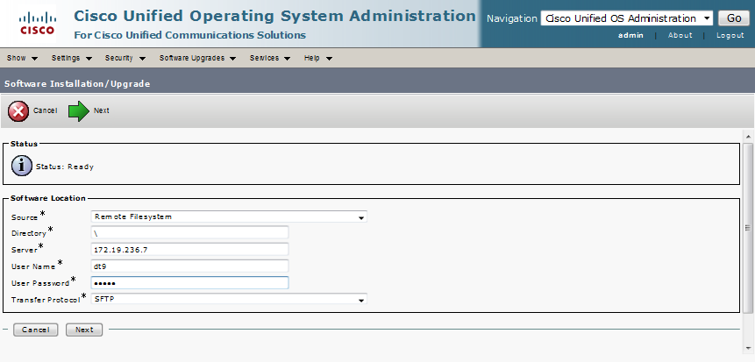
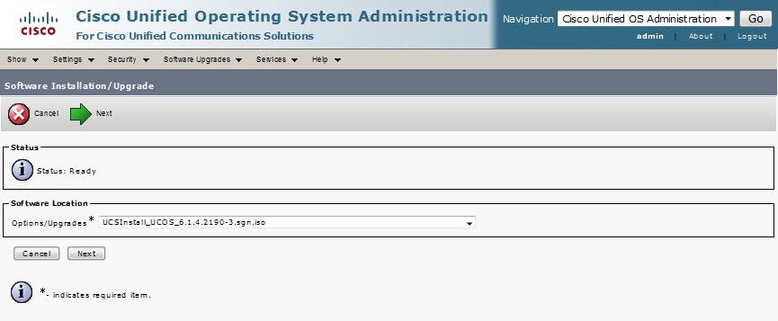
Perform Upgrade
Configure the remote file system
Select the COP file to upgrade
  RU for all 8.5(x) and earlier (no reboot)
  Upgrade COP file for new version
Verify the version on the server (for all servers)

Slide 26
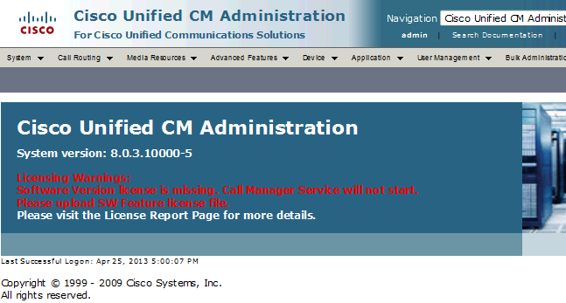

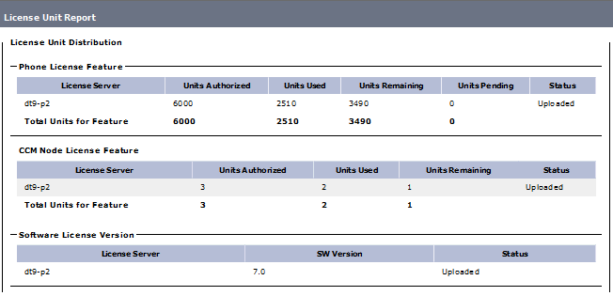
Apply Licenses
High availability upgrade for interim release 7.x and 8.x
Interim versions need Software feature license

Slide 27
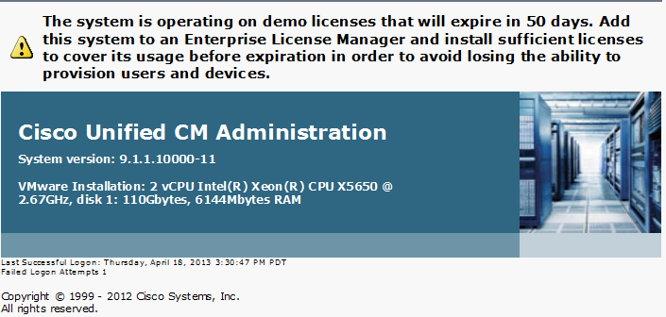
Apply Licenses
Interim versions need license to be re-hosted on virtual version
Jump release doesn’t need licenses for interim versions
Install the migrated license on Unified CM 9.1(2) during its 60 days demo mode

Slide 28
Types of Upgrade
Types of CUCM Upgrades
Direct Upgrade
High Availability Upgrade
Jump Upgrade
Notes:
28

Slide 29
CUCM High Availability (HA) Upgrade
Definition
Upgrade process to 9.1(2) where existing MCS Hardware doesn’t support 9.1(2)
Virtualize existing MCS environment
Multi Hop Upgrade – Intermediate version upgrade is needed before upgrading to 9.1(2)
HA upgrade provides the highest service availability throughout the upgrade process
Qualification Criteria
Customer using MCS servers for their production CUCM clusters
MCS Servers does not support upgrade to CUCM 9.1(2)
MCS Servers must support CUCM upgrade to intermediate versions
No Change in Hostname or IP Address during this upgrade

Slide 30
High Availability - Supported Upgrade Paths
  6.1(2) – 6.1(5), 7.0(1) – 7.1(3), 8.0(1) -> Upgrade to 8.0(3) -> Virtualize and upgrade to 9.1(2)
6.1(2)
- 6.1(5)
CUCM
9.1(2)
7.0(1)
- 7.1(3)
8.0(3)
UCS
8.0(3)
8.0(1)
  7.1(5) -> Upgrade to 8.5(1) -> Virtualize and upgrade to 9.1(2)
CUCM
9.1(2)
7.1(5)
8.5(1)
UCS
8.5(1)
8.0(2) – 9.0(x) -> Virtualize and upgrade to 9.1(2)
8.0(2)
– 9.0(x)
UCS 8.0(2)-
9.0(2)
CUCM
9.1(2)

Slide 31
High Level Block Diagram
Upgrade from CUCM 6.1(2) – 6.1(5), 7.0(1) – 7.1(3), 8.0(1)
Phase 1 – Upgrade to intermediate version on MCS
DRS backup of Production
Cluster on MCS HW
L2 Upgrade to
8.0(3)
Phase 2 – Virtualize the cluster
DRS backup of MCS
Production Cluster
Fresh Install CUCM
using 8.0(3) OVA
Restore DRS Backup
on VM Cluster
Phase 3 – Final Upgrade to 9.1(2)
DRS backup of VM
Production Cluster
Install RU COP file
Refresh Upgrade
to 9.1(2)
Migrate Licences
to 9.1(2)

Slide 32
High Level Block Diagram
Upgrade from CUCM 7.1(5)
Phase 1 – Upgrade to intermediate version on MCS
DRS backup of Production
Cluster on MCS HW
L2 Upgrade to
8.5(1)
Phase 2 – Virtualize the cluster
DRS backup of
Production Cluster
on MCS
Fresh Install CUCM
using 8.5(1) OVA
Restore DRS Backup
on VM Cluster
Phase 3 – Final Upgrade to 9.1(2)
DRS backup of VM
Production Cluster
Install RU COP file
Refresh Upgrade
to 9.1(2)
Migrate Licences
to 9.1(2)

Slide 33
High Level Block Diagram
Upgrade from CUCM 8.0(2) – 9.0(x)
Phase 1 – Virtualize the cluster
DRS backup of MCS
Production Cluster
Fresh Install CUCM
using right OVA version
Restore DRS Backup
on VM Cluster
Phase 2 – Final Upgrade to 9.1(2)
DRS backup of VM
Production Cluster
Install RU COP file
Refresh Upgrade
to 9.1(2)
Migrate Licences
to 9.1(2)

Slide 34
Virtualization Considerations
Following parameters need to match on new UCS server:
Hostnames
IP address/subnet mask
Administrator ID and Administrator Password
Application User ID and Password
Additional application users
Security Password
Default Gateway, NTP
DNS Server and Domain
SMTP server details

Slide 35
Types of Upgrade
Types of CUCM Upgrades
Direct Upgrade
High Availability Upgrade
Jump Upgrade
Notes:
35

Slide 36
CUCM Jump Upgrade
Definition
Simplified upgrade process to 9.1(2) that allows migration from MCS to UCS in a controlled lab environment, followed by flash-cut to Production
Replaces the need for interim HW as required by Bridged Upgrade
Minimal Impact to Production
Qualification Criteria
CUCM software version: 6.1(4), 6.1(5), 7.1(3) or 7.1(5)
Hardware: MCS Hardware that doesn’t support 9.1(2)
Target Version: CUCM 9.1(2)

Slide 37
Jump Upgrade Benefits
New upgrade path to be supported with UCM 9.1(2)
Today:
6.1(4), 6.1(5), 7.1(3) or 7.1(5)
MCS
Upgrade
8.0(3)
MCS
Re-host Licenses
Migrate Licenses
8.0(3)
UCS
Upgrade
9.1
UCS
DRS restore
Drive to 9 Process Improvement: “Jump” Upgrade
Build new cluster and flash-cut.
6.1(4), 6.1(5), 7.1(3) or 7.1(5) MCS
Parallel Upgrade Process Minimum Downtime
DRS Restore
6.1(4), 6.1(5), 7.1(3) or 7.1(5)
(Same Version)
UCS
Obtain Licenses
Upgrade
9.1
UCS
Customer’s current production environment remains untouched (top ask from customer)
Eliminates the intermediate HW requirement to move old releases to 9.1(2)
Not supported as production
Notes:
Production cluster untouched/unchanged.
Easy fallback
Minimal downtime
Minimal upgrade hops, less risk
No interim HW needed to perform migration
No re-hosting of license needed in interim hop

Slide 38
Install matching CUCM nodes on VM in the lab
Install publisher and all subscribers in the lab
Install pub, then add subscribers to the server list (System->Server)
Minimum requirement for install:
  Default gateway (and active network connection)
  FTP and/or SFTP server
  NTP server
  Data storage for firmware, images and backups
  DNS server (required if used in existing production environment)
  SMTP server (required if used in existing production environment)
  LDAP server (required if used in existing production environment)
  Phones and Gateways (required for validation and testing)
  Application servers (Voicemail, policy servers, contact center application servers , etc. for validation and testing)
Notes:
Following network elements need to match in LabNet for DRS Restore to succeed :
Version
Hostname
IP address/Subnet
Default Gateway
DNS and NTP Server
Domain
Security Password

Slide 39
High Level Process
Phase 1 – Fresh Install of 6.1.4/6.1.5/7.1.3/7.1.5 on VM and RU to 9.1(2)
DRS backup
Of Production
Fresh Install on VM
LabNet (9.1 OVA)
RU v1.2 COP
File
DRS Restore in
VM LabNet
Refresh Upgrade
to 9.1(2)
Phase 2- Re-align VM OVA
DRS backup
of LabNet
Re-install CUCM
with 9.1 OVA
DRS Restore
of 9.1(2)
Phase 3- Flash Cut
Move UCS to
Production N/W
Flash Cut MCS
to UCS
Migrate Licences
to 9.1(2)
* LabNet – Lab Network
Notes:
Upgrade phone firmware (production)
Perform backup
Install matching CUCM nodes on VM in the lab
DRS/DMA Restore the cluster
Verify Database replication
Apply RU upgrade COP (v8.5 and earlier)
Upgrade cluster
Verify Database replication
Apply Licensing

Slide 40
LabNet Reference
DNS Server
VLAN X
VLAN Z
Default Gateway
NTP Server
VLAN Y

Slide 41
Low Level Jump Upgrade Process
Phase 1
Build LabNet (See LabNet Requirements & LabNet Reference )
DRS backup of Production MCS cluster
Create VMs with 9.1 OVA ; change RHEL version from 5 to 4
Build 6.1(4)/6.1(5)/7.1(3)/7.1(5) on UCS using 9.1 OVA
Apply COP file v1.2 for RU
DRS restore of Production cluster on LabNet UCS
Upgrade to 9.1(2)
Virtualization – For each node, shut down the virtual machine and change the Guest OS version to Red Hat Enterprise Linux 5 (32-bit)
Fresh Install of
Production Cluster
in Lab N/W

Slide 42
Low Level Jump Upgrade Process
Phase 2
DRS backup of LabNet UCS 9.1(2) DB
Rebuilt VM with 9.1(2) OVA [ 6.x disk formatting different than 9.x]
DRS restore of CUCM 9.1(2)
Post Upgrade Checklist
Migrate Licenses from Pre-9.1(2) to 9.1(2)
Upload Locale Files, Background Images, etc.
Perform validation–confirm phone/gateway registration, call flows, application interoperability
Verify DB Replication
Rebuild the Cluster
with 9.1(2) OVA

Slide 43
Low Level Jump Upgrade Process
Phase 3
Shutdown UCS Servers in LabNet
Connect UCS Servers to Production Network
Ensure that individual VMs are powered down
During Migration Maintenance window :
  Shutdown Switch ports connected to Production MCS
  Power-on UCS 9.1(2) VMs
  Perform validation–confirm phone/gateway registration, call flows, application interoperability
Flash Cut to
Production N/W

Slide 44
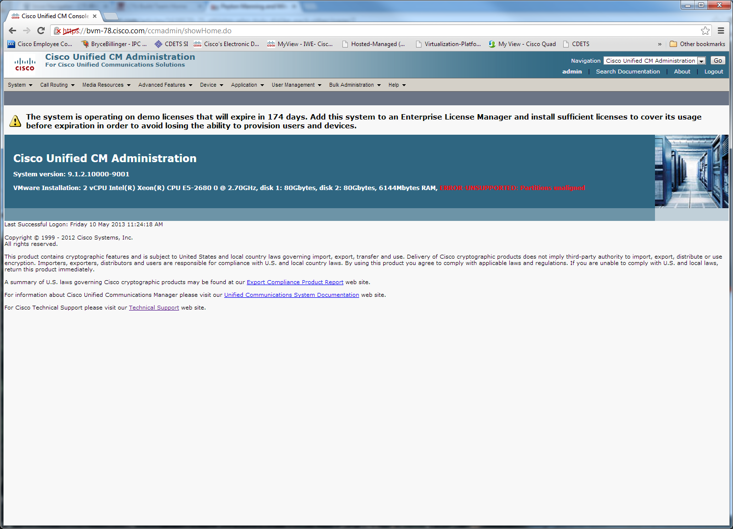
Troubleshooting: Partition Alignment Message
If the final step in “Jump” which is fresh install cluster with CUCM 9.1(2) OVA is not done, you will see “ERROR UNSUPPORTED partitions unalligned”

Slide 45
CUCM Upgrade from 4.x / 5.x
DMA file from MCS
Production Cluster (4.x)
Upgrade to Intermediate
Release 6.1.4
Follow one of the available Process
DRS backup of MCS
Production Cluster (5.x)
Upgrade to Intermediate
Release 6.x or 7.x
Follow one of the available Process
http://www.cisco.com/en/US/docs/voice_ip_comm/cucm/compat/ccmcompmatr1.pdf

Slide 46
Upgrade Procedure
Step By Step Instructions
1
2
3
4
5
Perform post-upgrade tasks
Post-Upgrade Checklist
Add upgraded CUCM 9.1(2) cluster to ELM server
Migrate Licenses using ELM within 60 day grace period
Change RHEL version on VM post RU upgrade
Manual Restore of the Background images and Ringtones.
Install Locale files
Verify DB Replication
For secure cluster, re-run CTL client
Perform validation–confirm phone/gateway registration, call flows, application interoperability
For capturing details logs for troubleshooting:
Change log level on ELM Diagnostic Logs Admin
Page to Debug to maximize trace output
Note : ELM Version 9.1(2) can be installed with CUCM or as standalone server

Slide 47
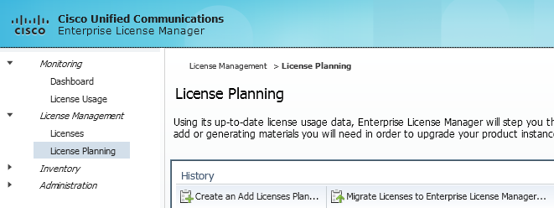
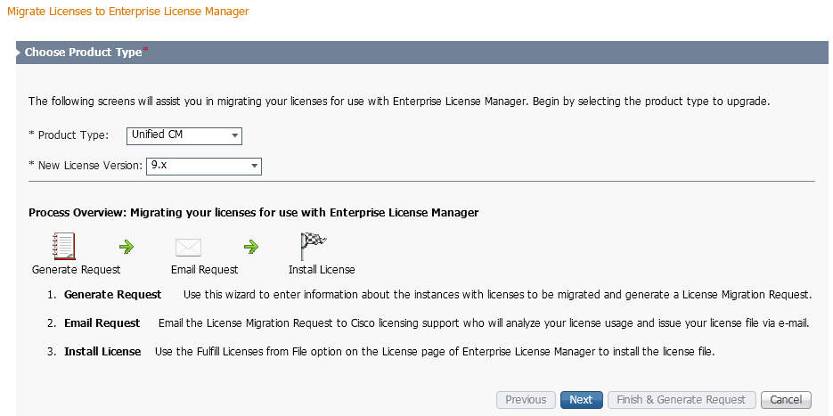
License Migration Steps using ELM – Step 1
Start Migration Utility
Select product type and version

Slide 48
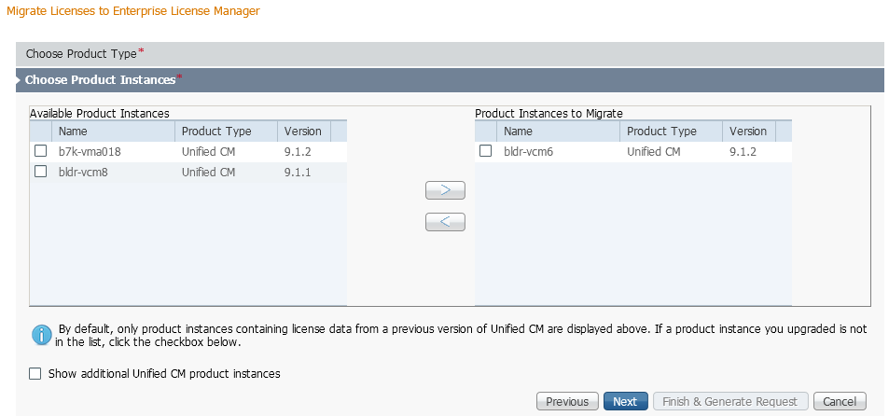
License Migration steps using ELM – Step 2
Select product instances to migrate

Slide 49
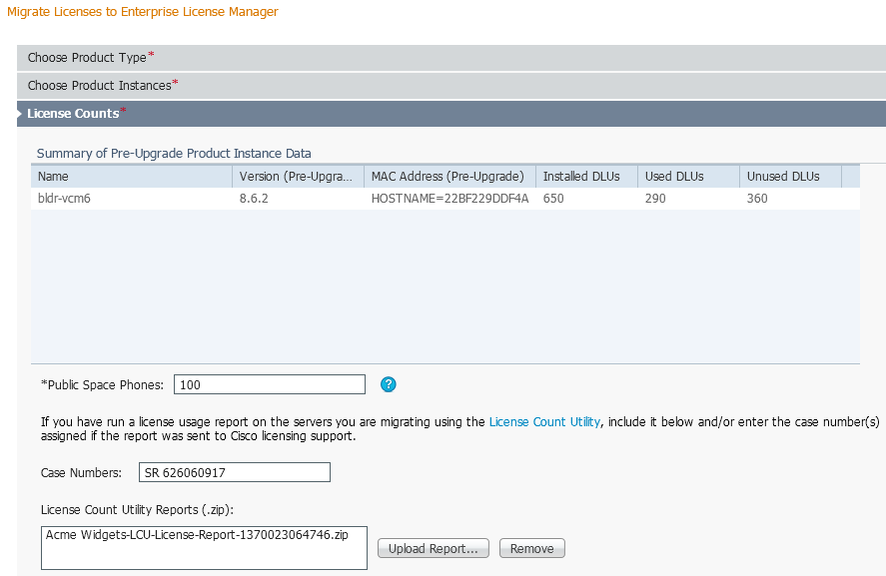
License Migration steps using ELM - Step 3
Attach License Count Utility report and GLO case number
DLU / license data from previous version retained after upgrade

Slide 50
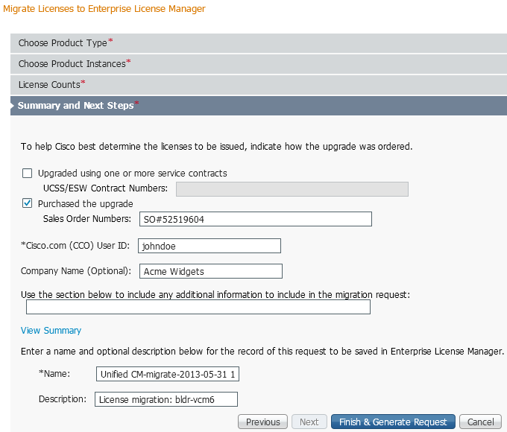
License Migration steps using ELM – Step 4
Provide additional information to assist GLO in fulfilling the license migration request

Slide 51
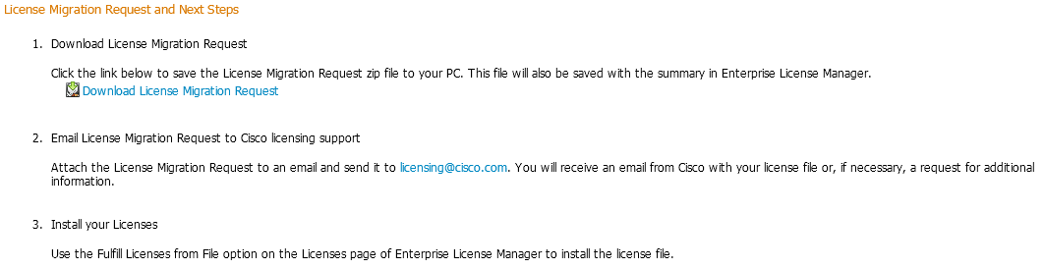
License Migration steps using ELM – Step 5
Download generated migration request (signed zip file) and Email to licensing@cisco.com

Slide 52
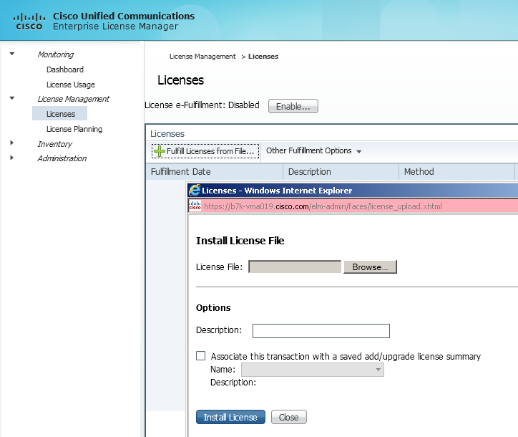
License Migration steps using ELM – Step 6
Install license file received from Cisco licensing office

Slide 53
Reference Materials
Upgrade Readiness Assessment
http://tools.cisco.com/cucst/upgrade/inputs.jsp?reset=1 (Direct Web App Link)
Upgrade Resource Central
https://communities.cisco.com/community/partner/collaboration/migration?#/?tagSet=2089
Upgrade Process FAQ https://communities.cisco.com/docs/DOC-34033
Notes:
e CUCM and IOS gateway version compatibility is at:
http://www.cisco.com/en/US/docs/voice_ip_comm/cucm/compat/ccmcompmatr1.pdf
Cisco Unified CM Software compatibility Matrix:
http://www.cisco.com/en/US/prod/collateral/routers/ps259/product_data_sheet0900aecd8057f2e0.pdf

