Slide 1



Slide 2


Slide 3

Zero Trust
Debunking the myth
Luis Miguel Acosta Guzmán, Cybersecurity Solutions Architect

Slide 4
What is and what is not Zero Trust
Zero Trust Principles
Cisco Zero Trust Framework
Zero Trust Frameworks
The Zero Trust “sweet spot”
Adopting Zero Trust through Cisco Secure
Q&A

Slide 5
The old security model no longer works
Businesses competing as ecosystems
Everyone is an insider
Hybrid work is here to stay

Slide 6
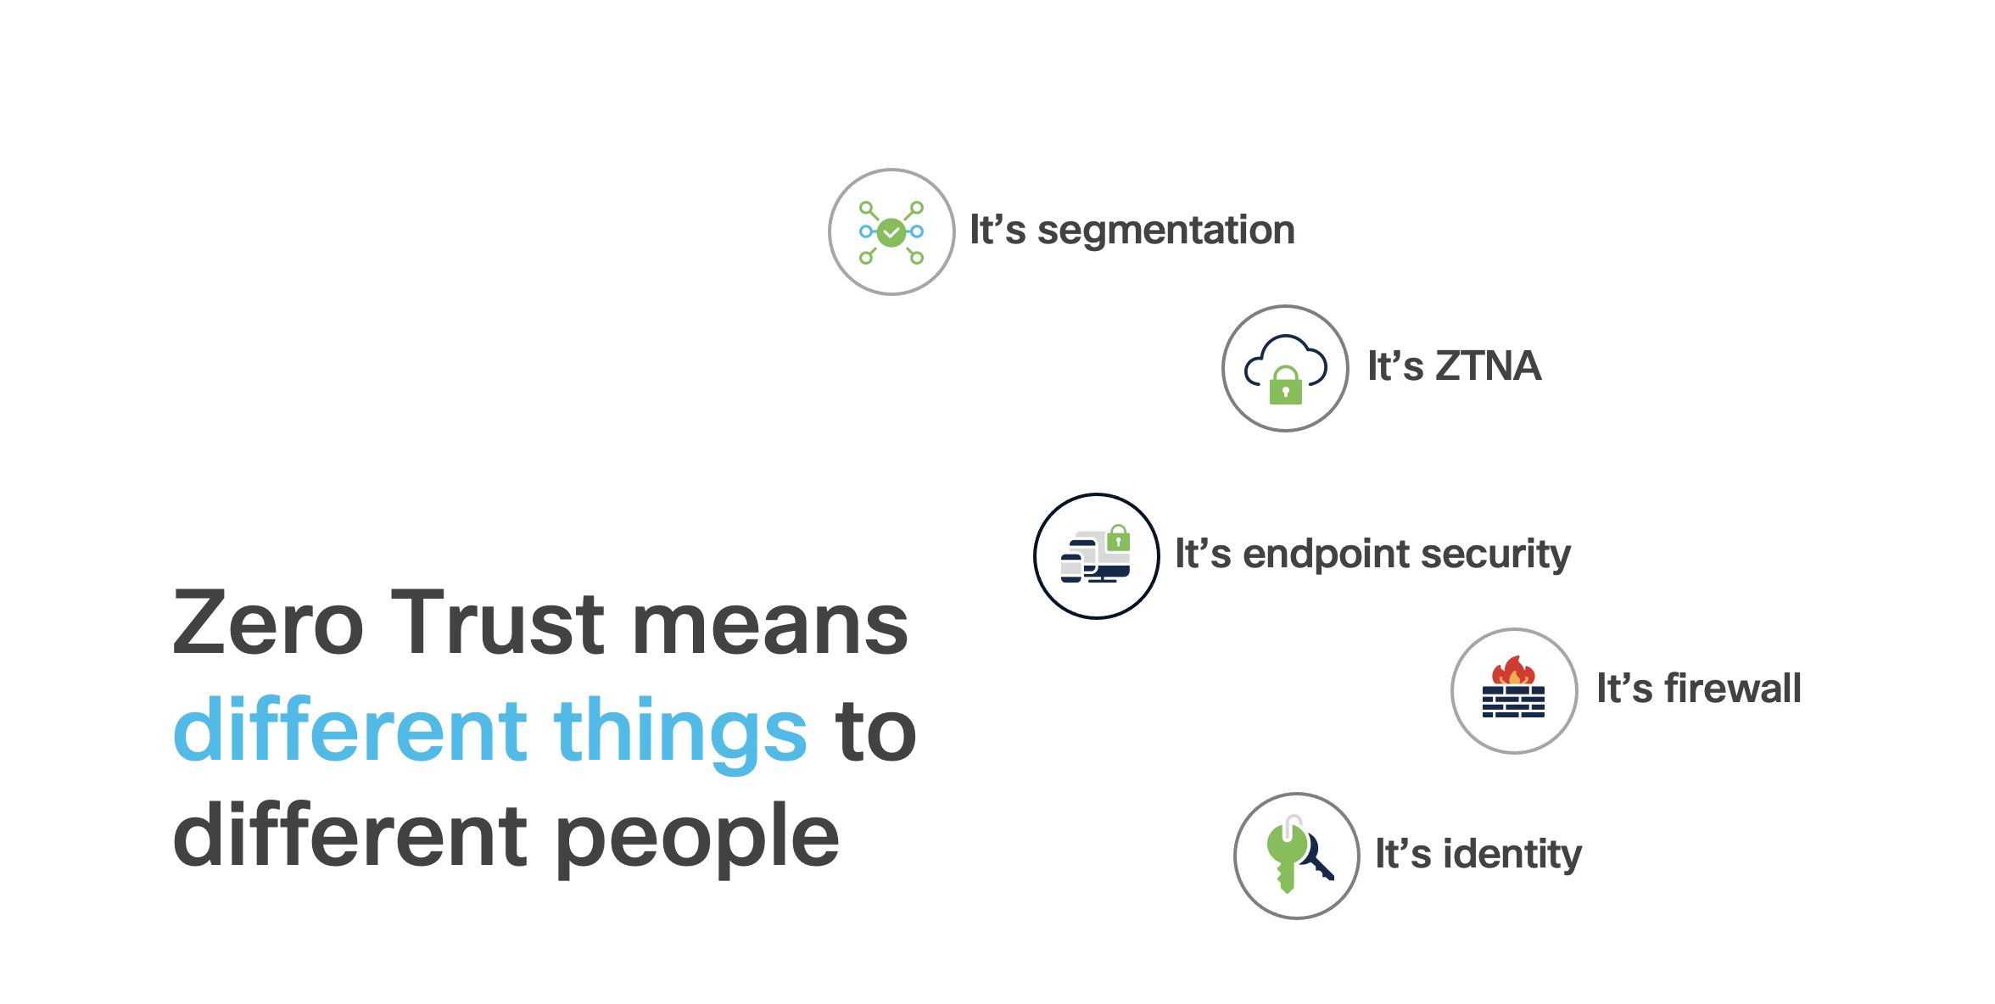

Slide 7
Zero Trust is actually
Zero trust is a strategic approach to security that centers on the concept of eliminating trust from an organization's network architecture.
Notes:
https://www.youtube.com/watch?v=ZFPn1PMyGFU

Slide 8
Zero Trust Principles
Never assume trust
Always verify
Enforce least privilege

Slide 9
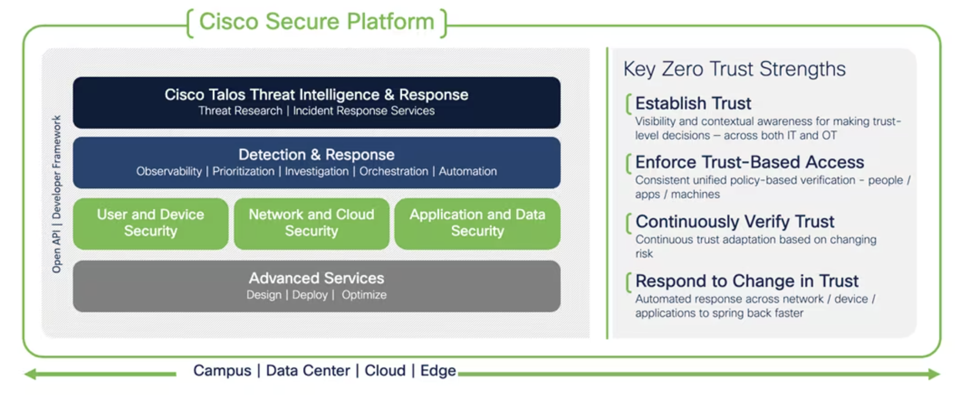
Cisco Zero Trust Framework

Slide 10
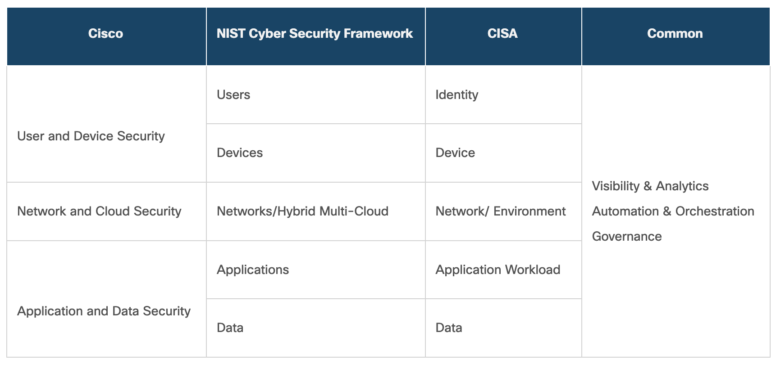
Other Zero Trust Security Frameworks

Slide 11
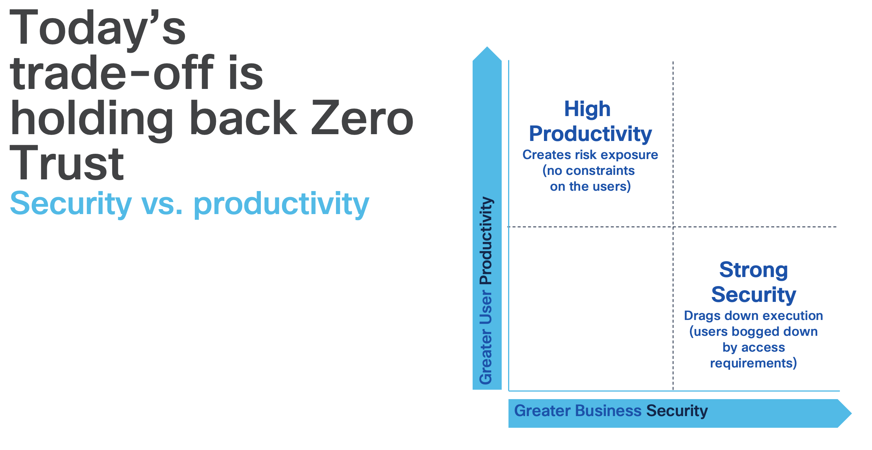

Slide 12
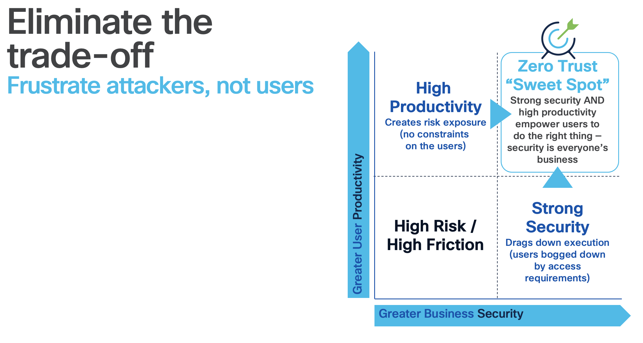

Slide 13
Cisco Duo

Slide 14
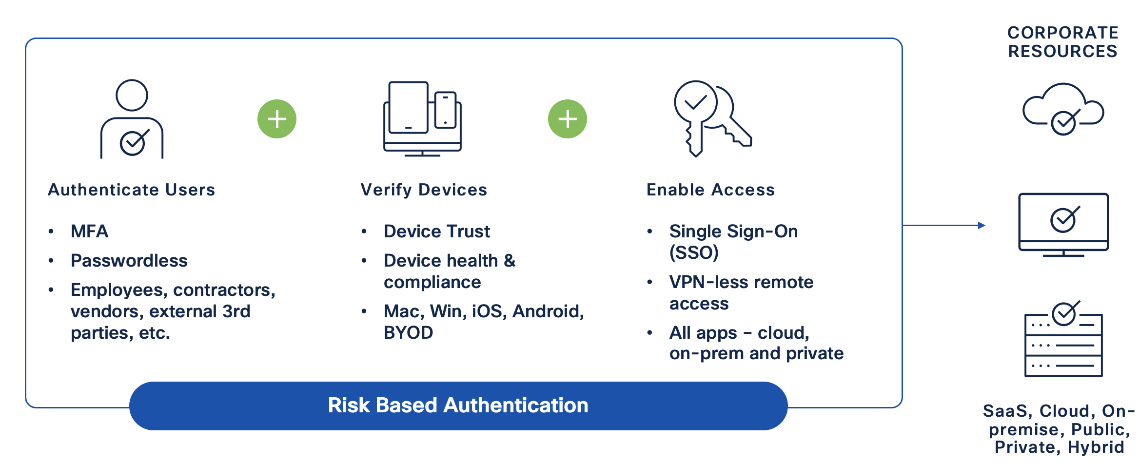
Duo

Slide 15
Identity Services Engine

Slide 16
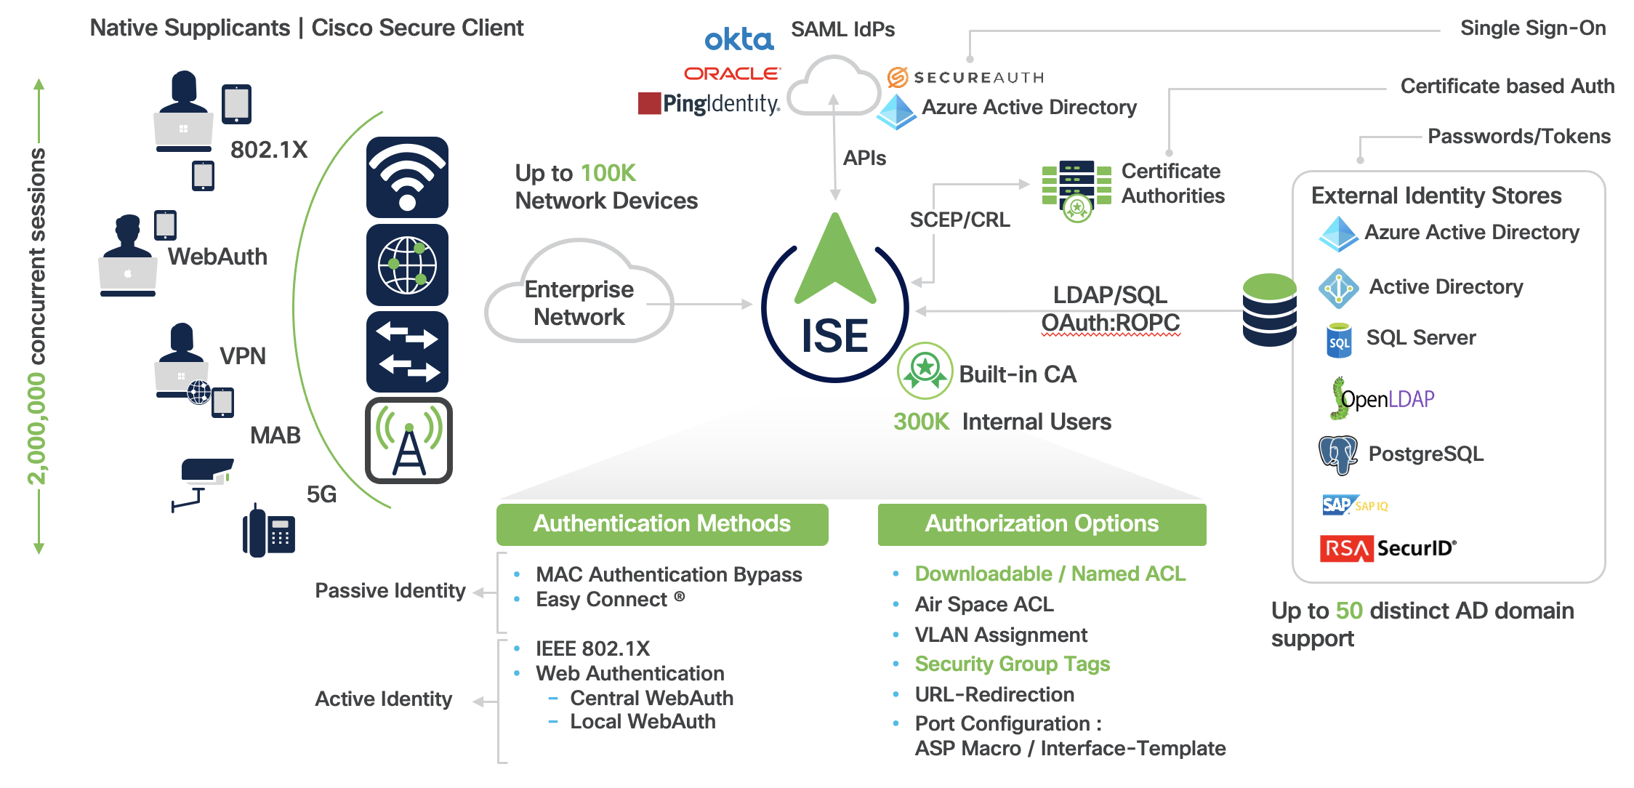
ISE Secure Network Access

Slide 17
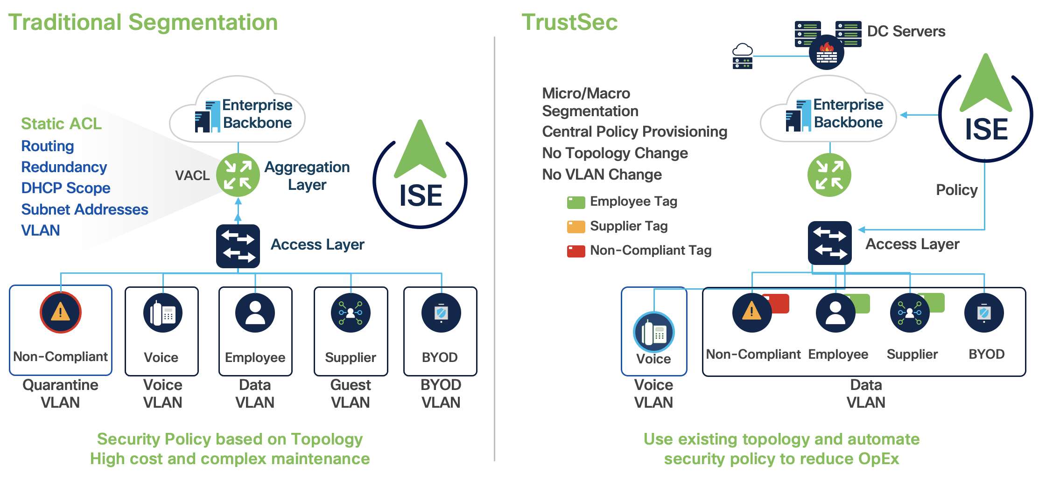
“Intelligent” Segmentation through TrustSec

Slide 18
Cisco Secure Firewall Threat Defense (FTD)

Slide 19
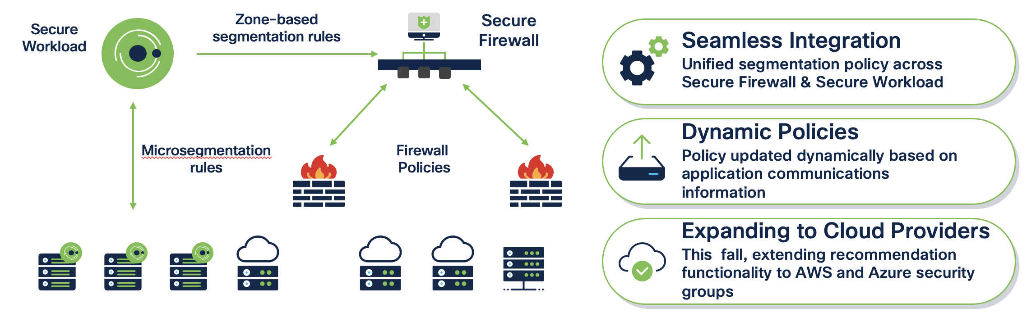
Dynamic Firewall Policy Across Hybrid-Cloud Environments

Slide 20
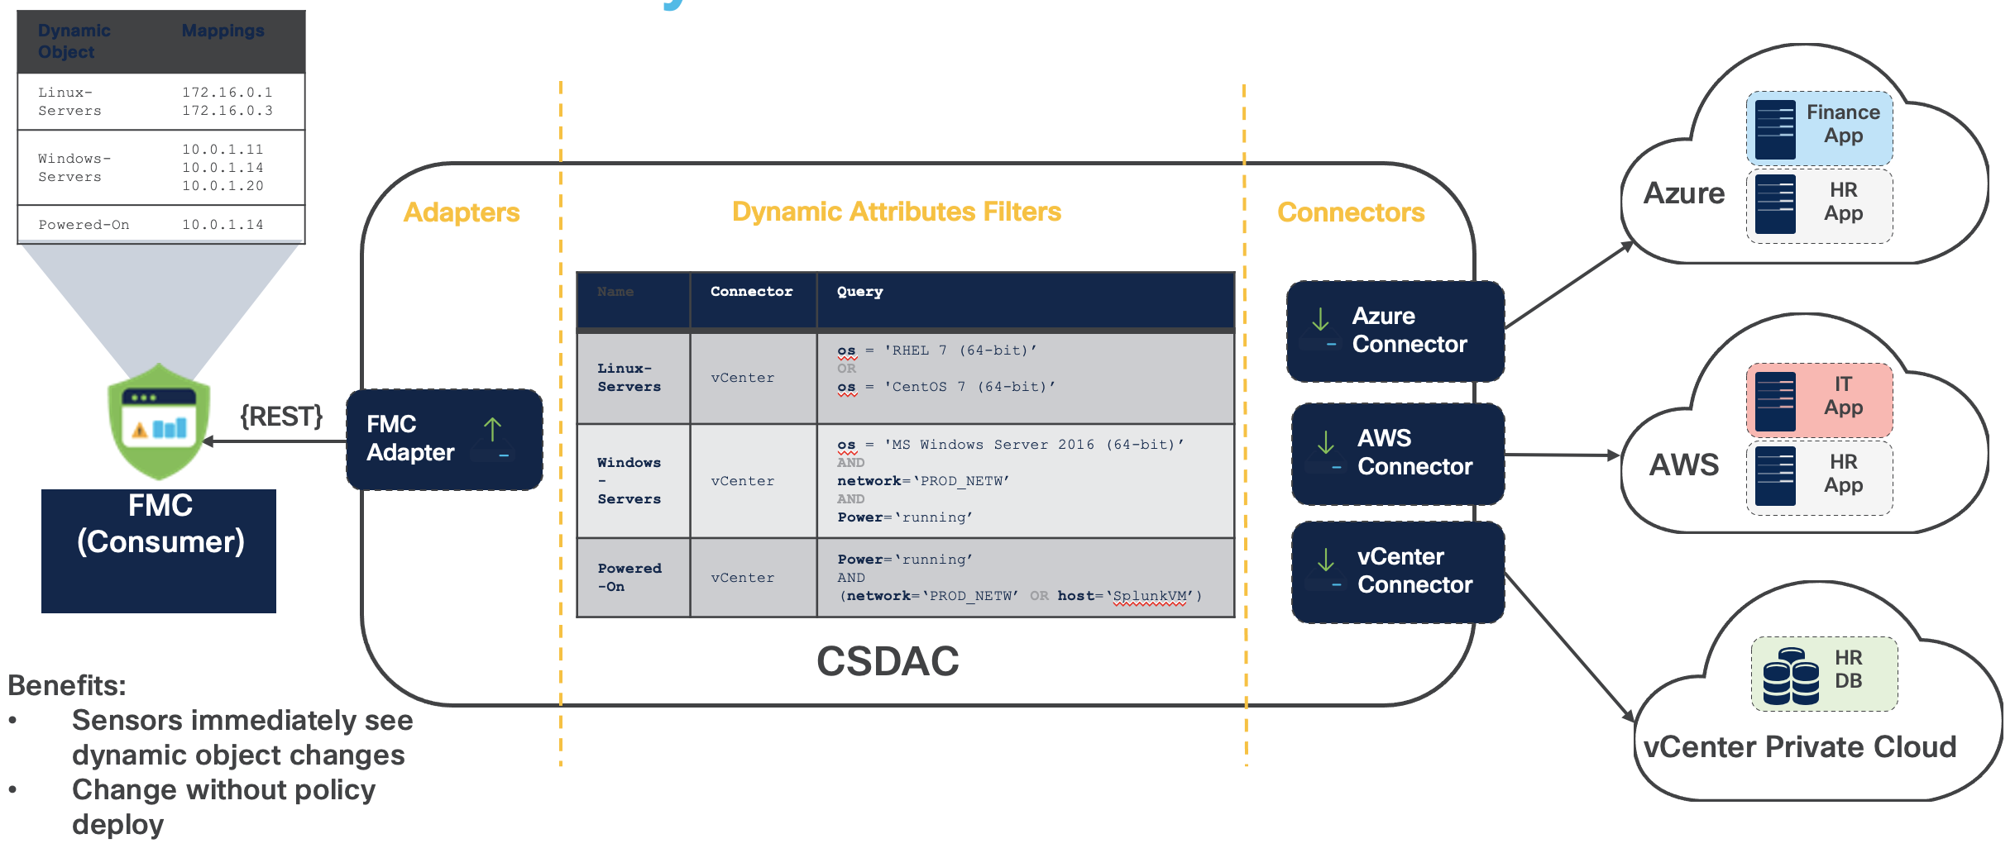
Cisco Secure Dynamic Attribute Connector

Slide 21
Cisco Secure Workload (Tetration)

Slide 22
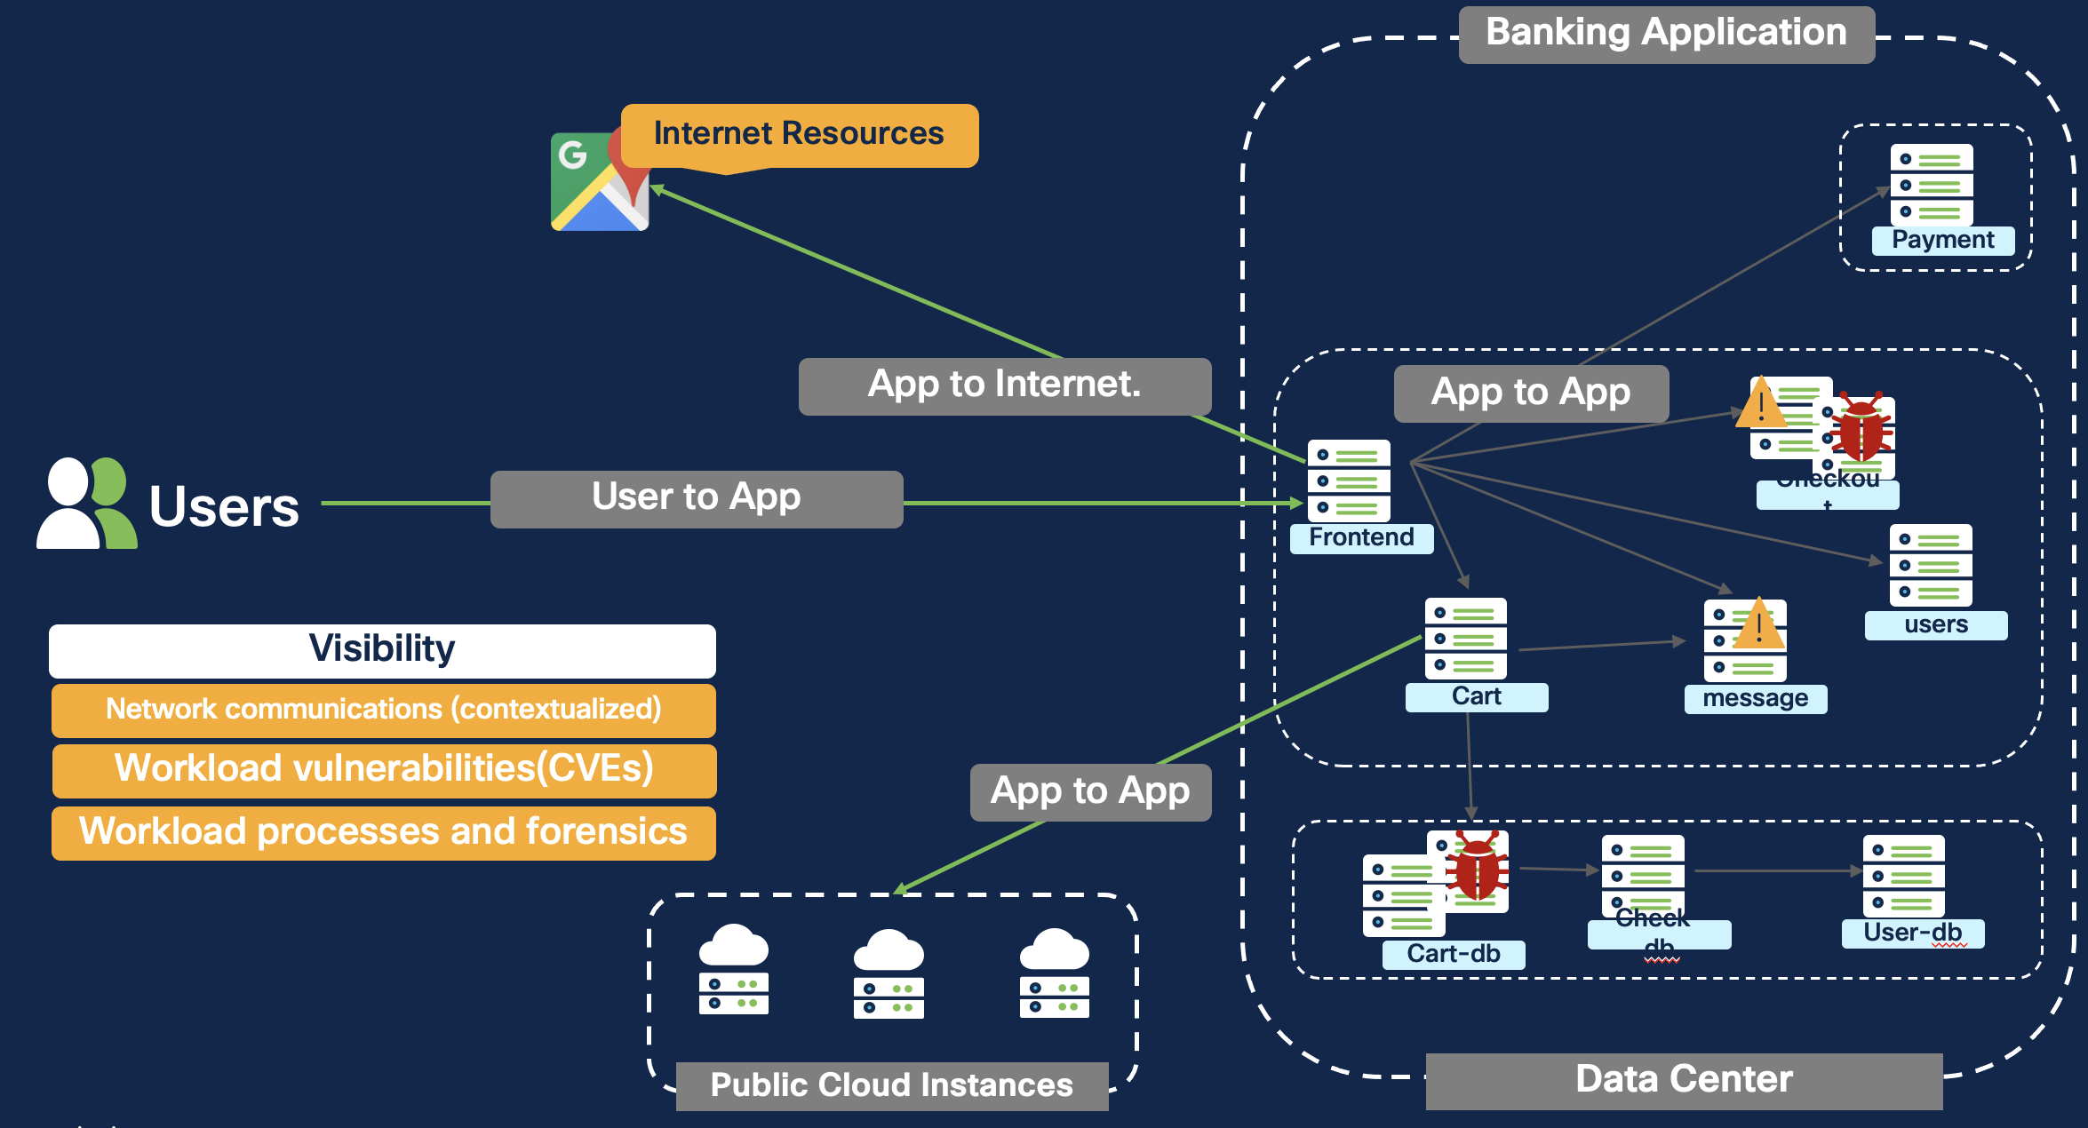
Cisco Secure Workload Visibility

Slide 23
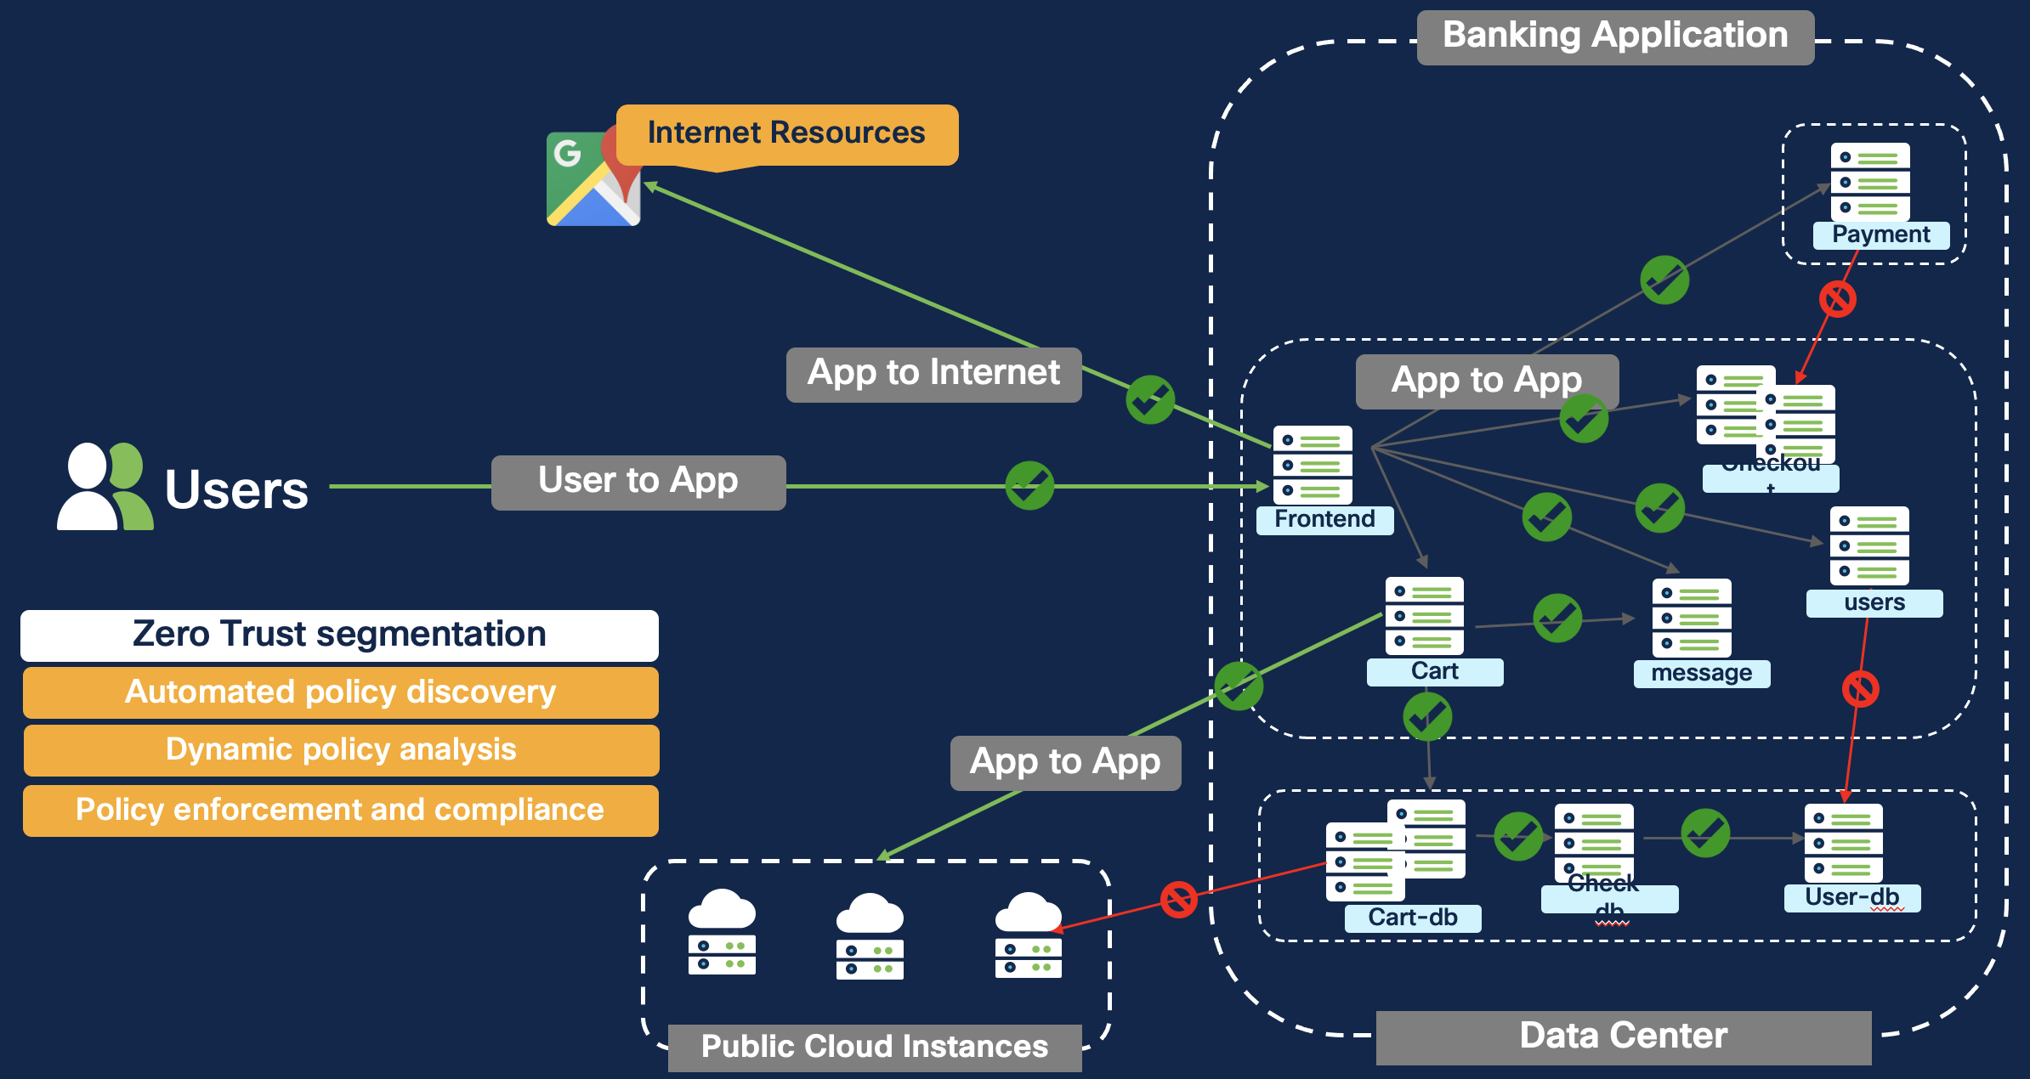
Cisco Secure Workload Enforcement

Slide 24
Thank you

