Slide 1



Slide 2


Slide 3

Cloud Native Application Protection Platform
CNAPP Unveiled
Ulises Martínez Uribe, Sales Specialist, Observability
Victor Ramírez, Solutions Engineer, Observability
Luis Miguel Acosta Guzmán, Solutions Architect, Cybersecurity

Slide 4
Introduction
Applications are now the business
CICD
CNAPP
Cloud Protection Suite Solutions
Conclusion
Q&A

Slide 5

The cloud is our friend… RIGHT?

Slide 6
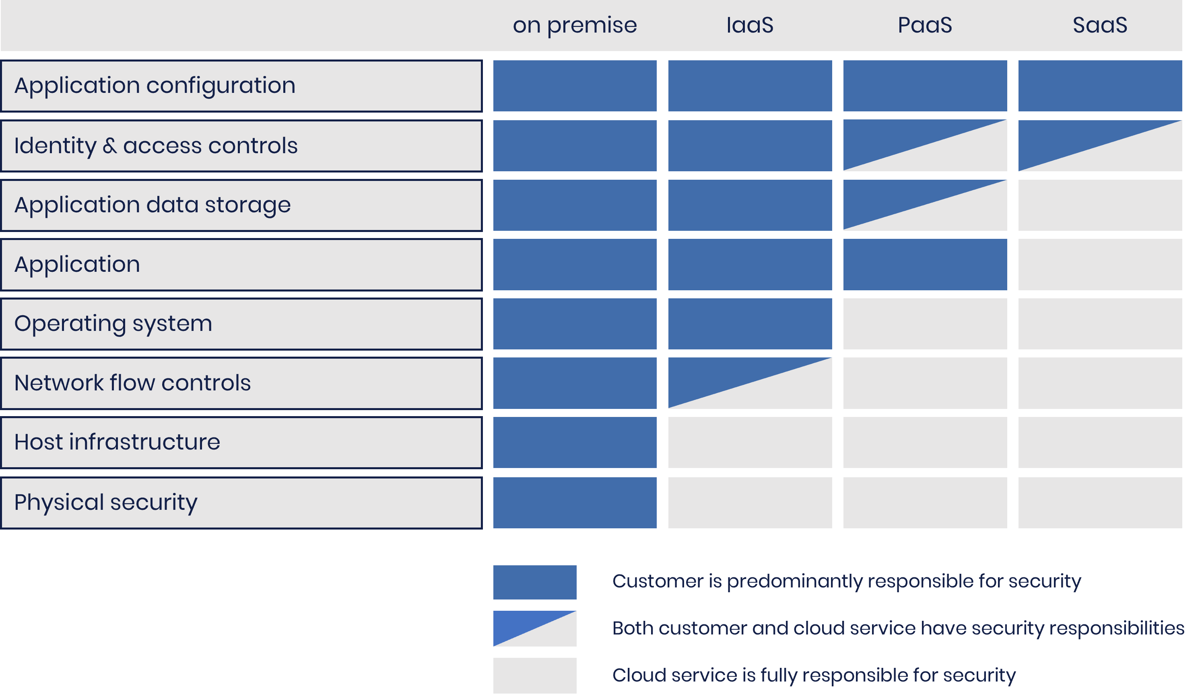
Cloud Security Shared Responsibility Model

Slide 7
Gartner predicted that through 2025, 99% of cloud security failures will be the customer's fault, not the provider's.

Slide 8
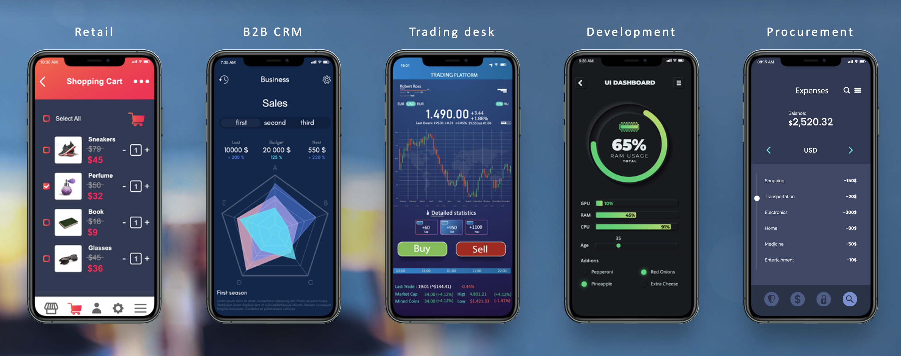
Applications are now the business

Slide 9
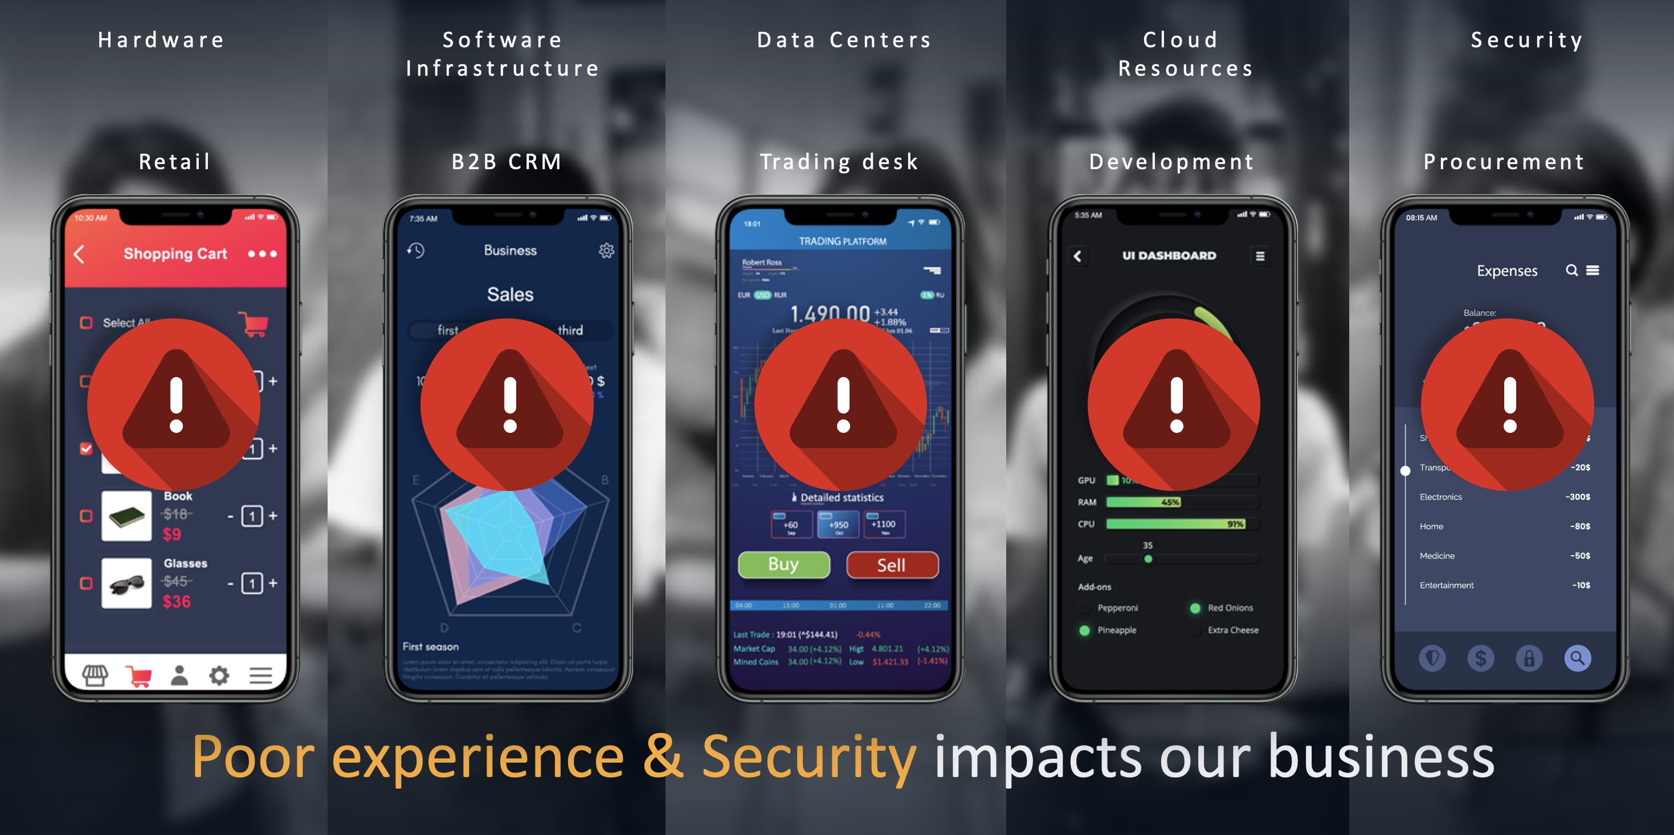
Applications are now the business

Slide 10
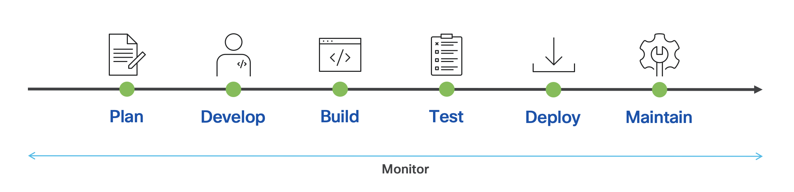
CICD Pipeline

Slide 11
A security vulnerability in the pipeline….
CAN WRECK HAVOC

Slide 12


Slide 13
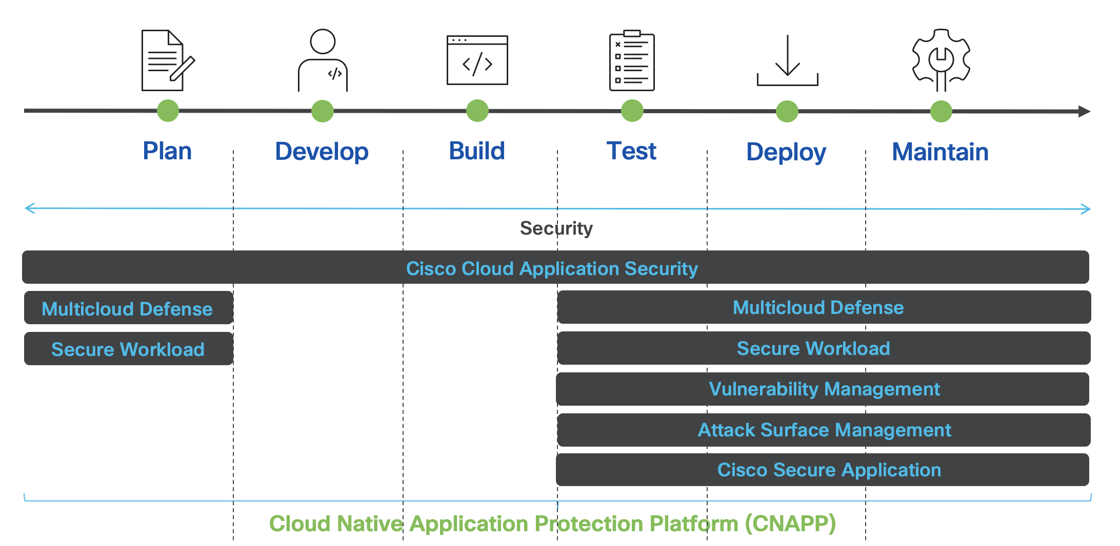
Cloud Native Application Protection Platform (CNAPP)

Slide 14
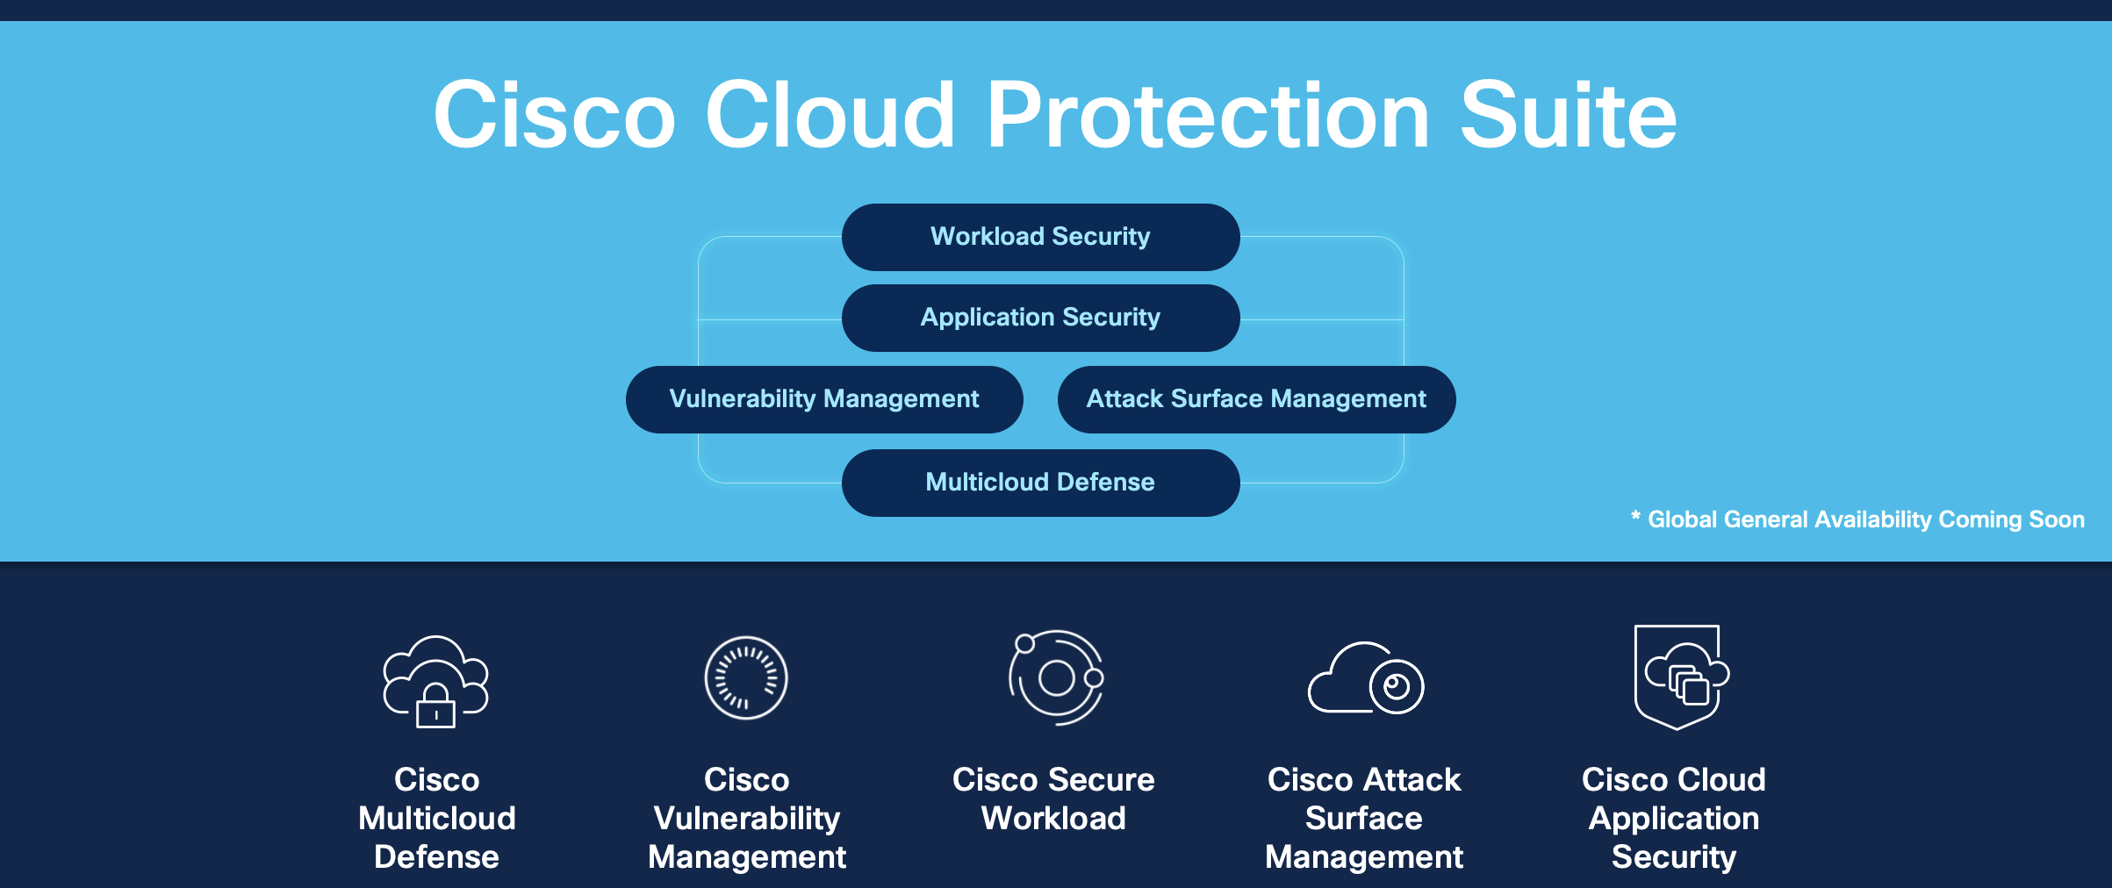
Security only Cisco can deliver

Slide 15
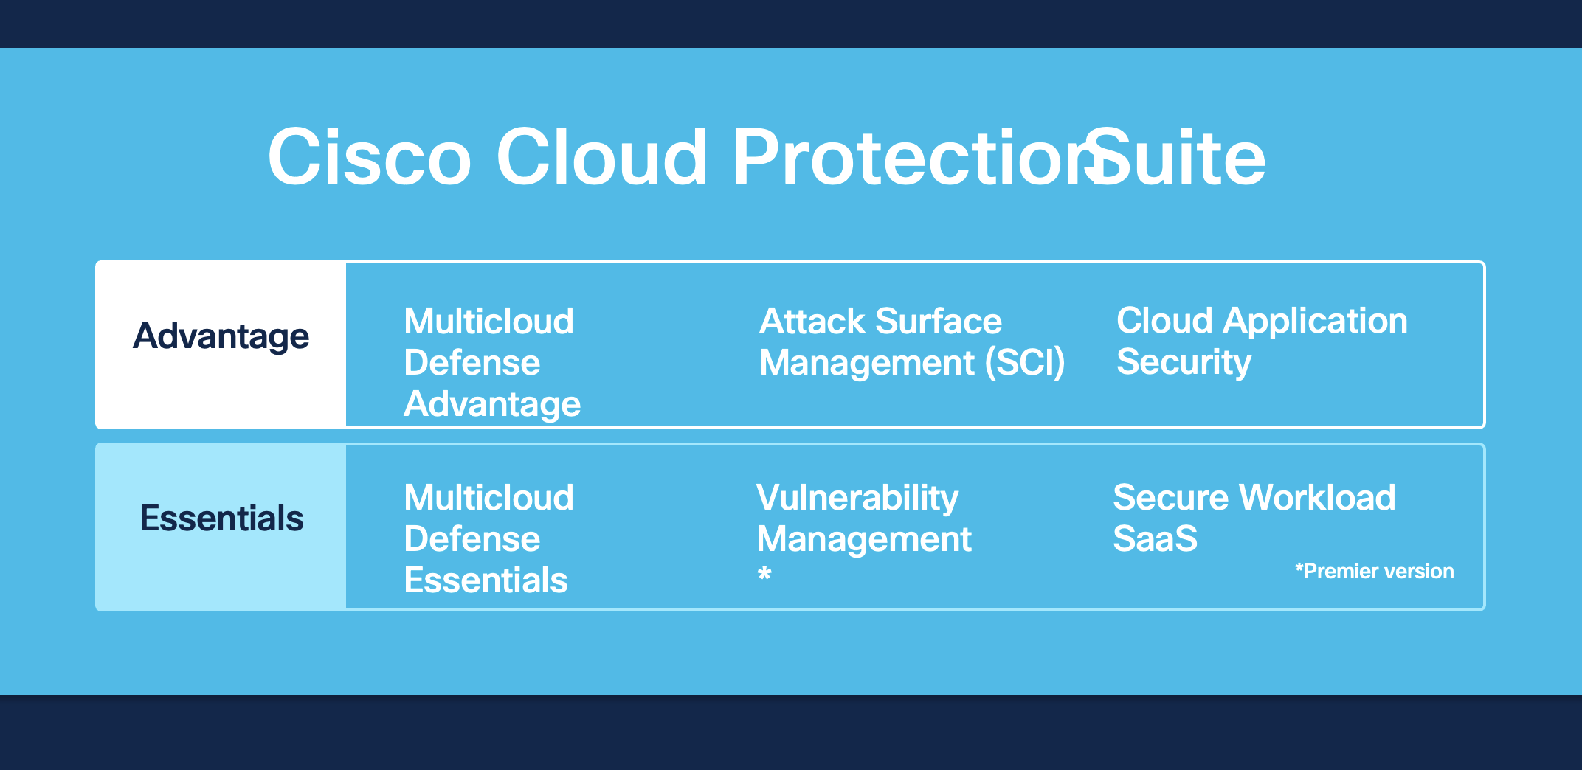

Slide 16
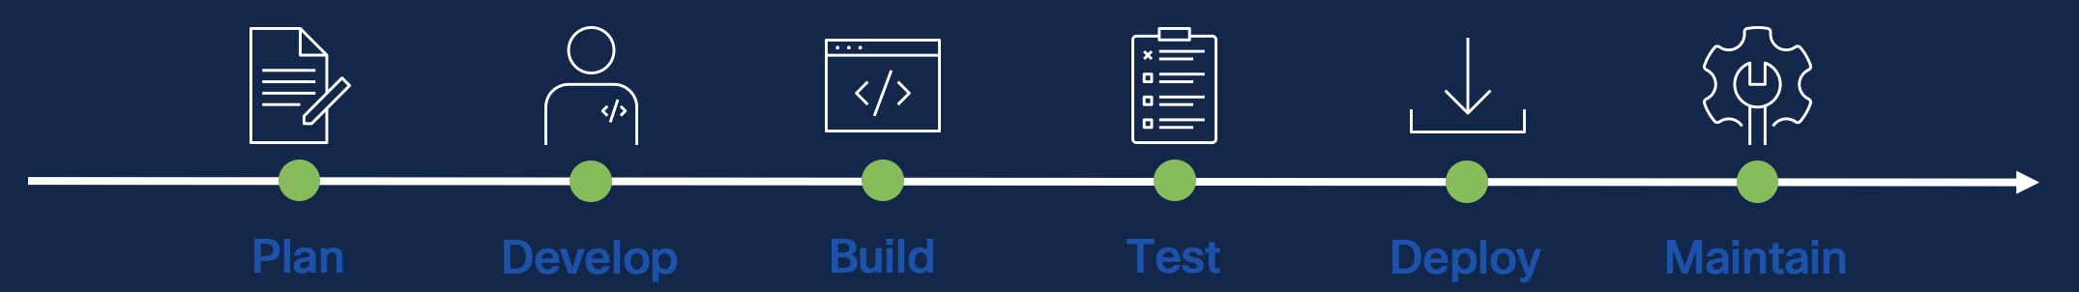
Cisco Cloud Application Security (Panoptica)

Slide 17
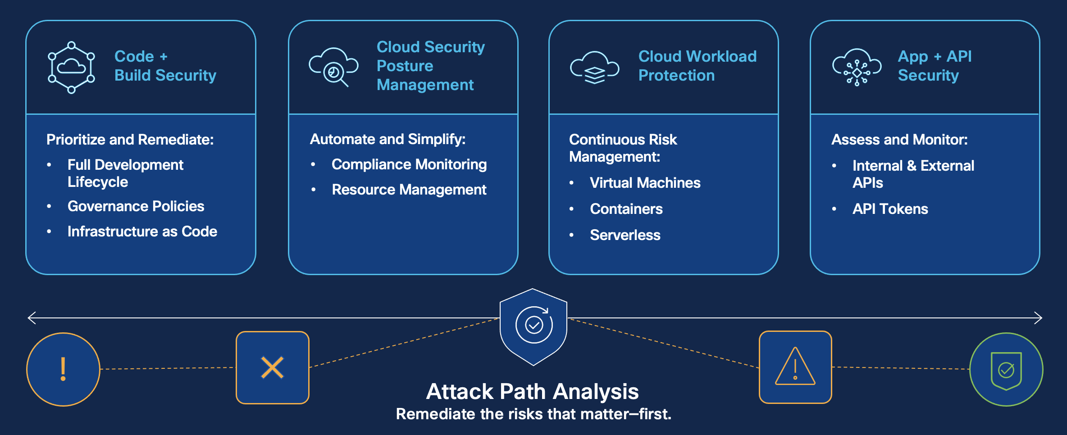
Protection from code to runtime

Slide 18

Demo Time

Slide 19
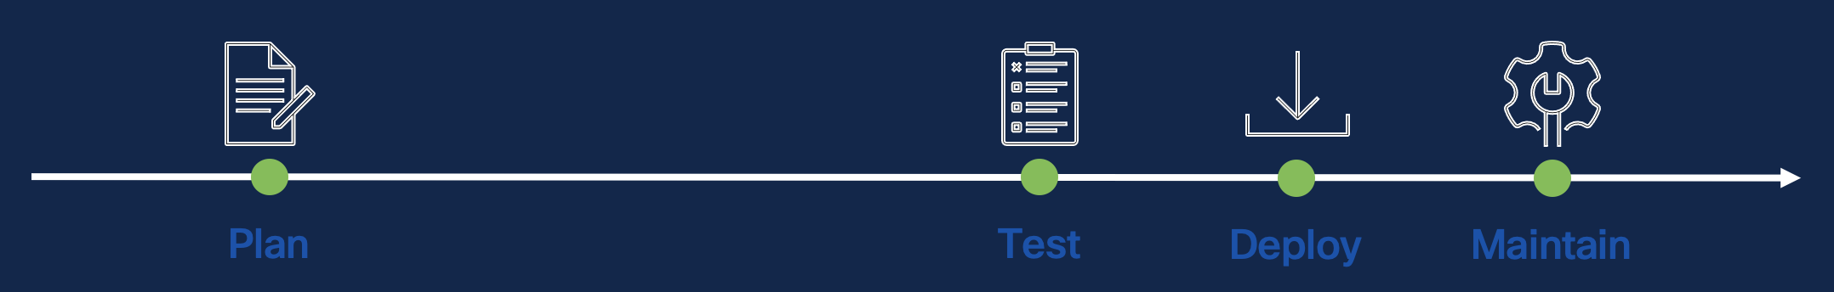
Cisco Multicloud Defense

Slide 20
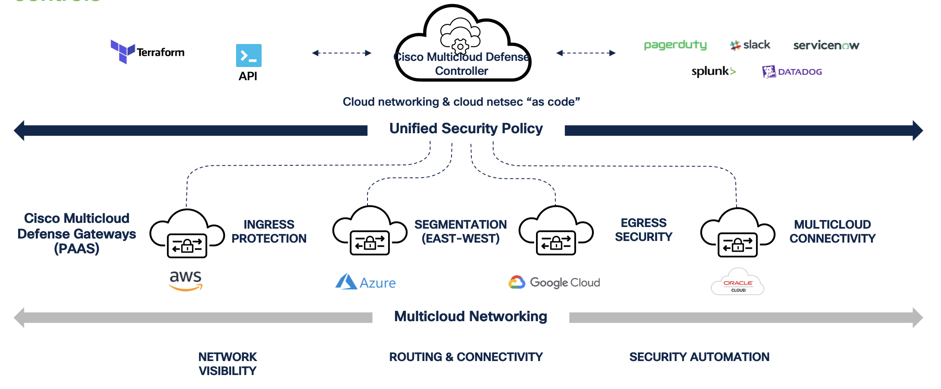
Cisco Multicloud Defense
Combining multicloud networking, automation, and cloud-native network security controls

Slide 21
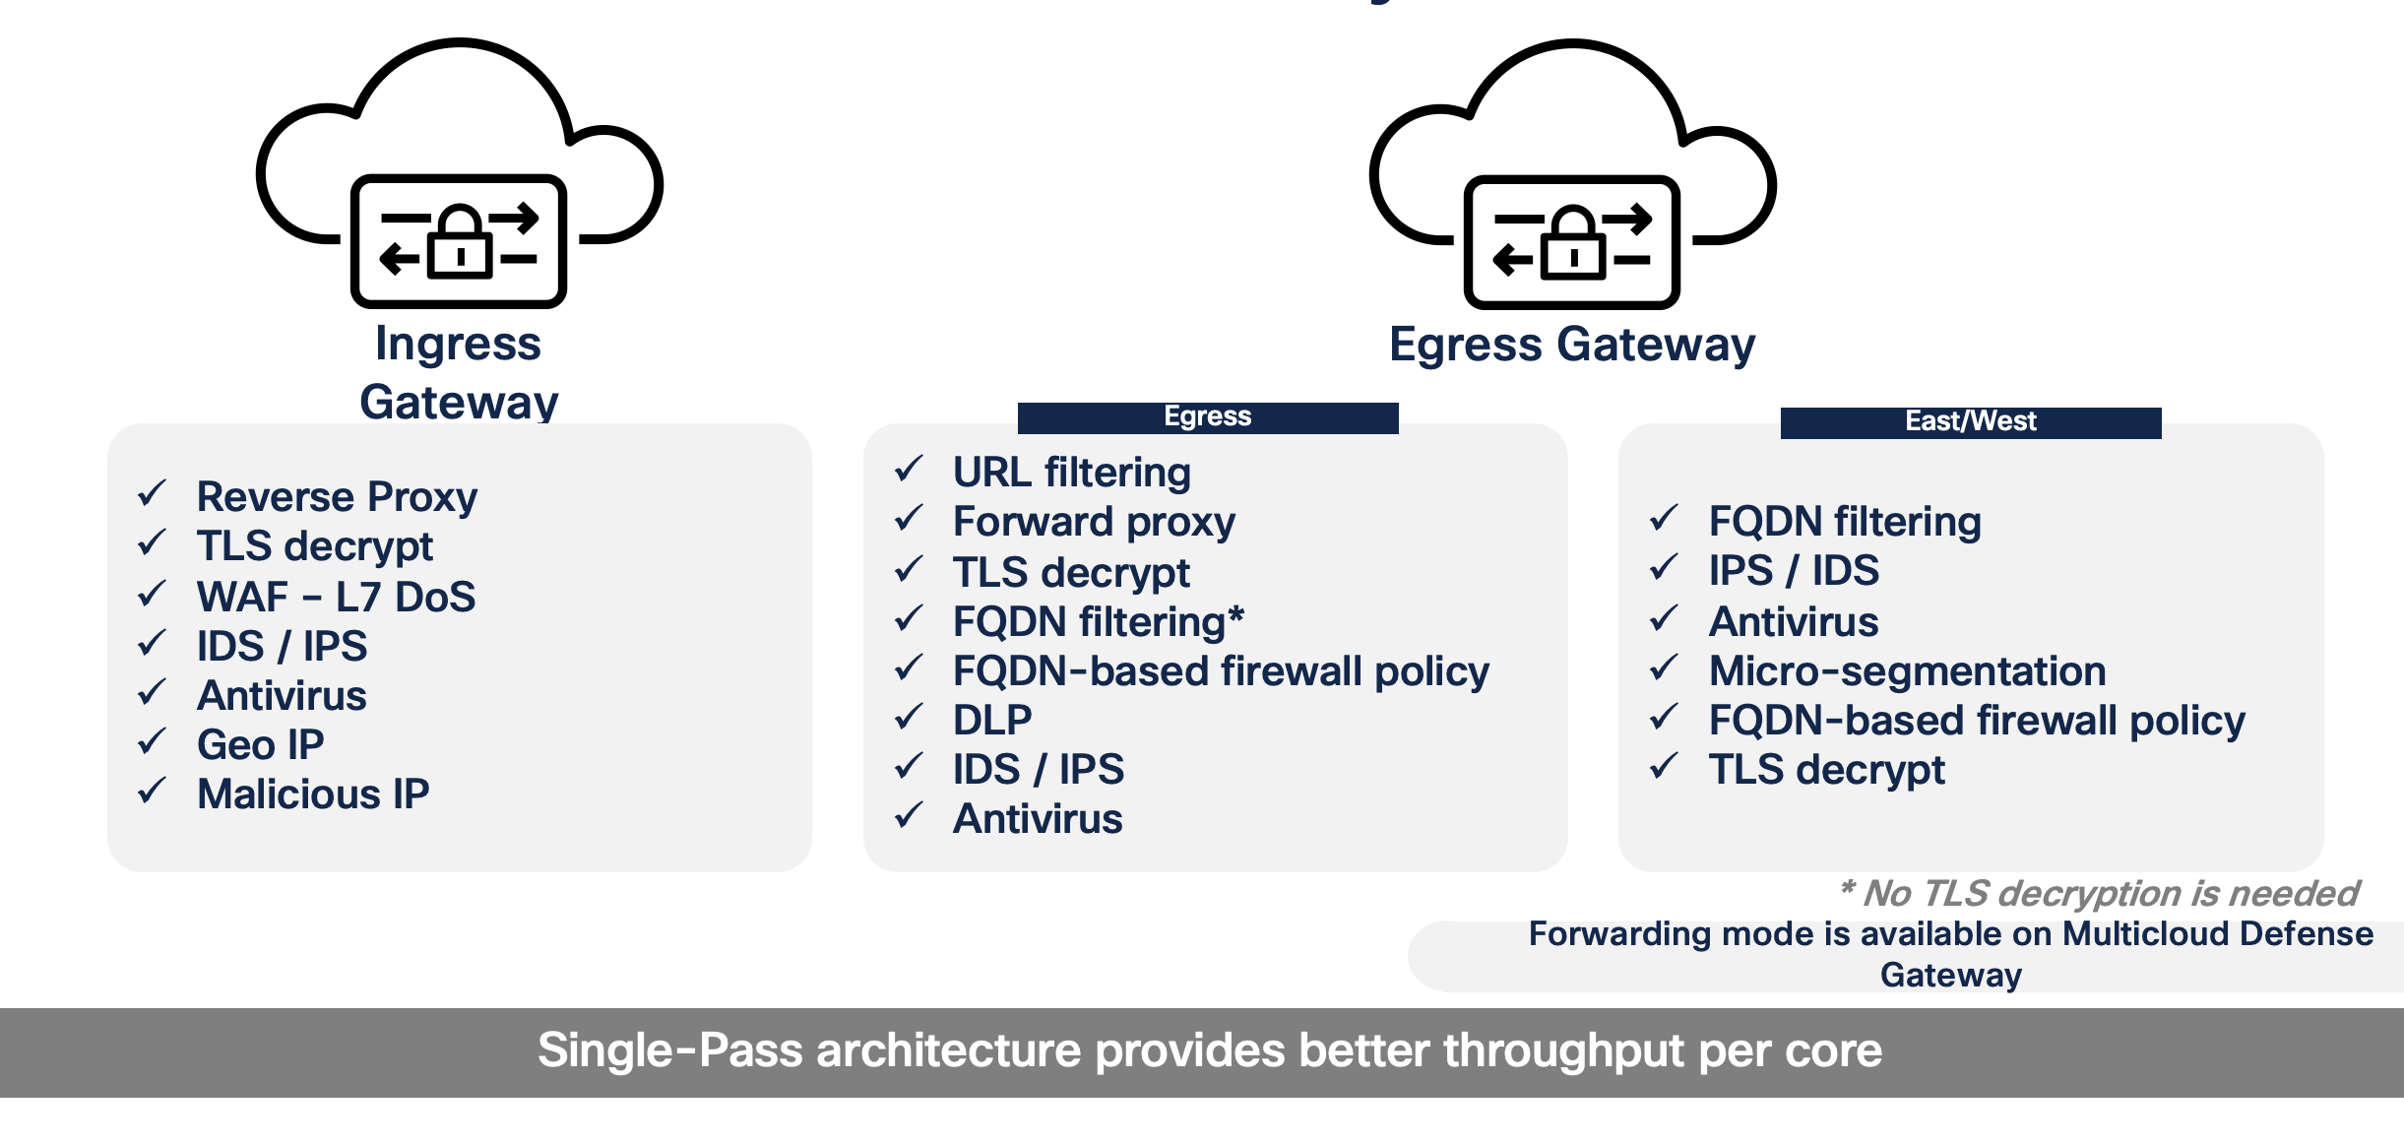
Multicloud Defense Gateways

Slide 22
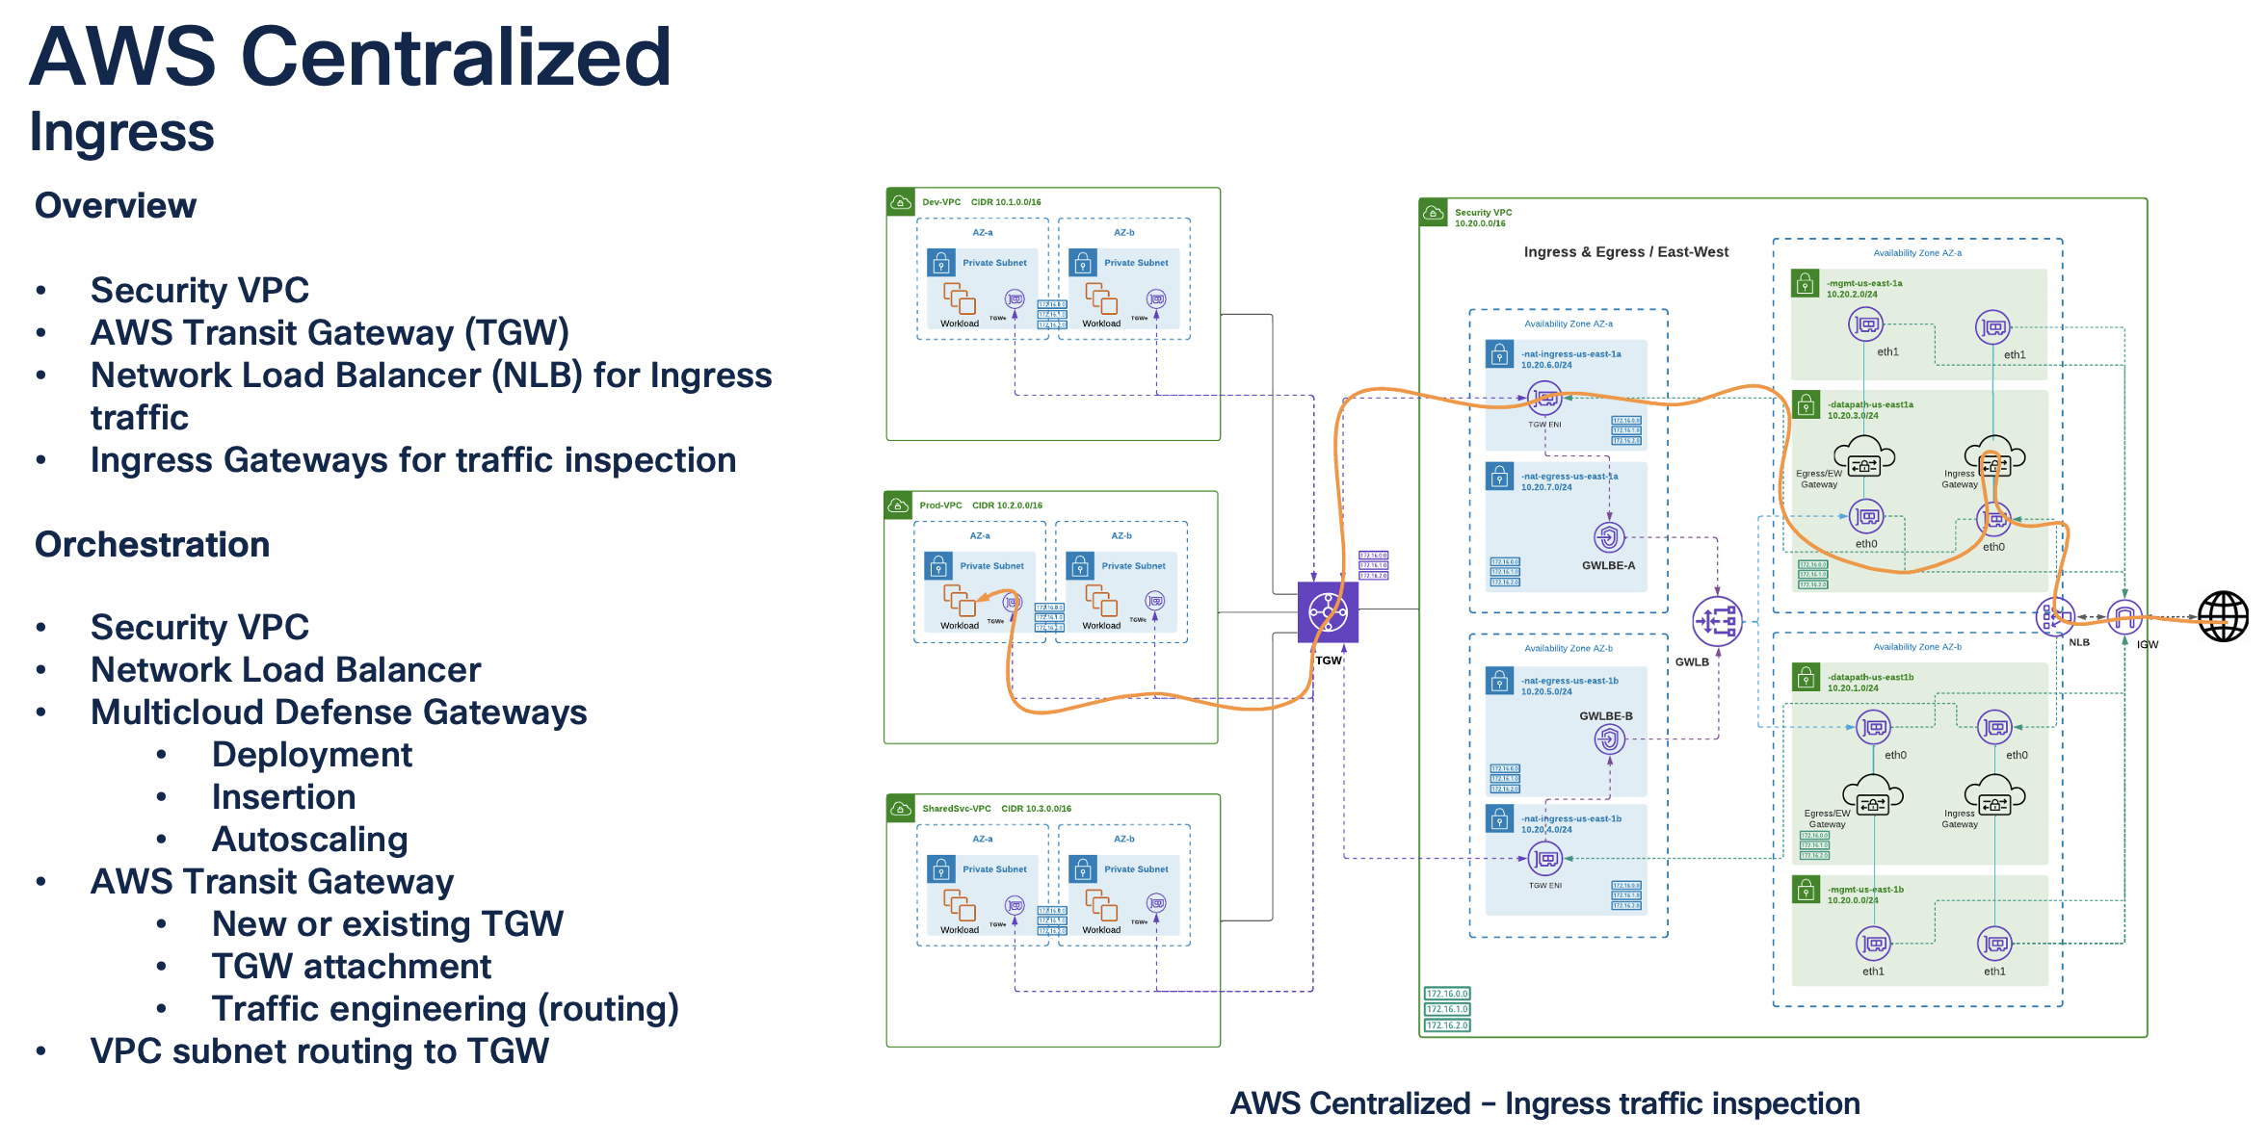

Slide 23
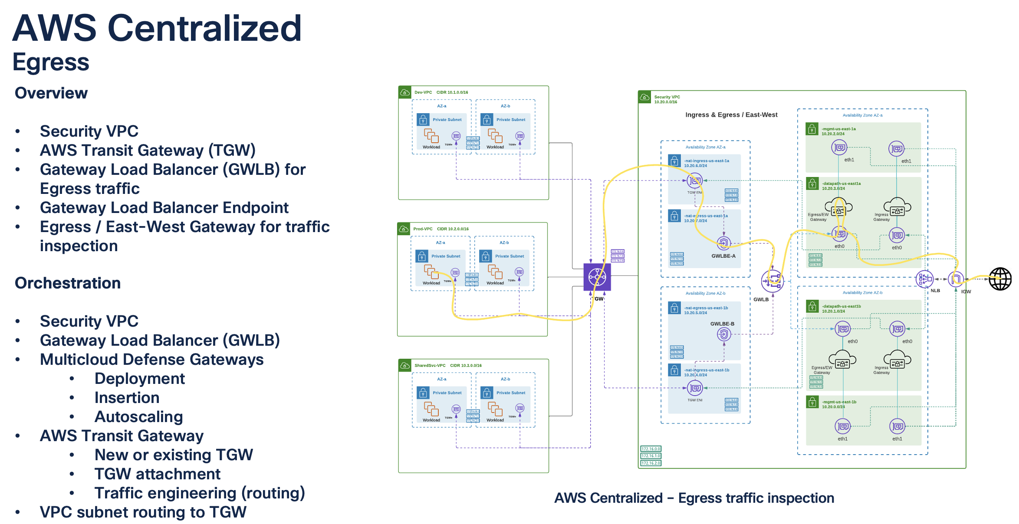

Slide 24
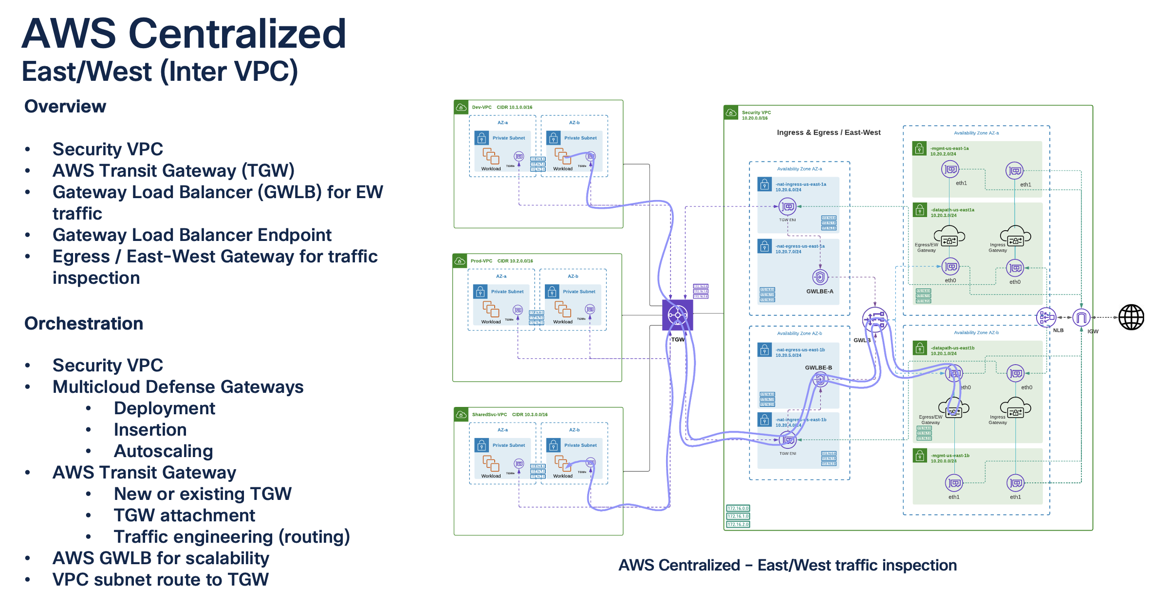

Slide 25
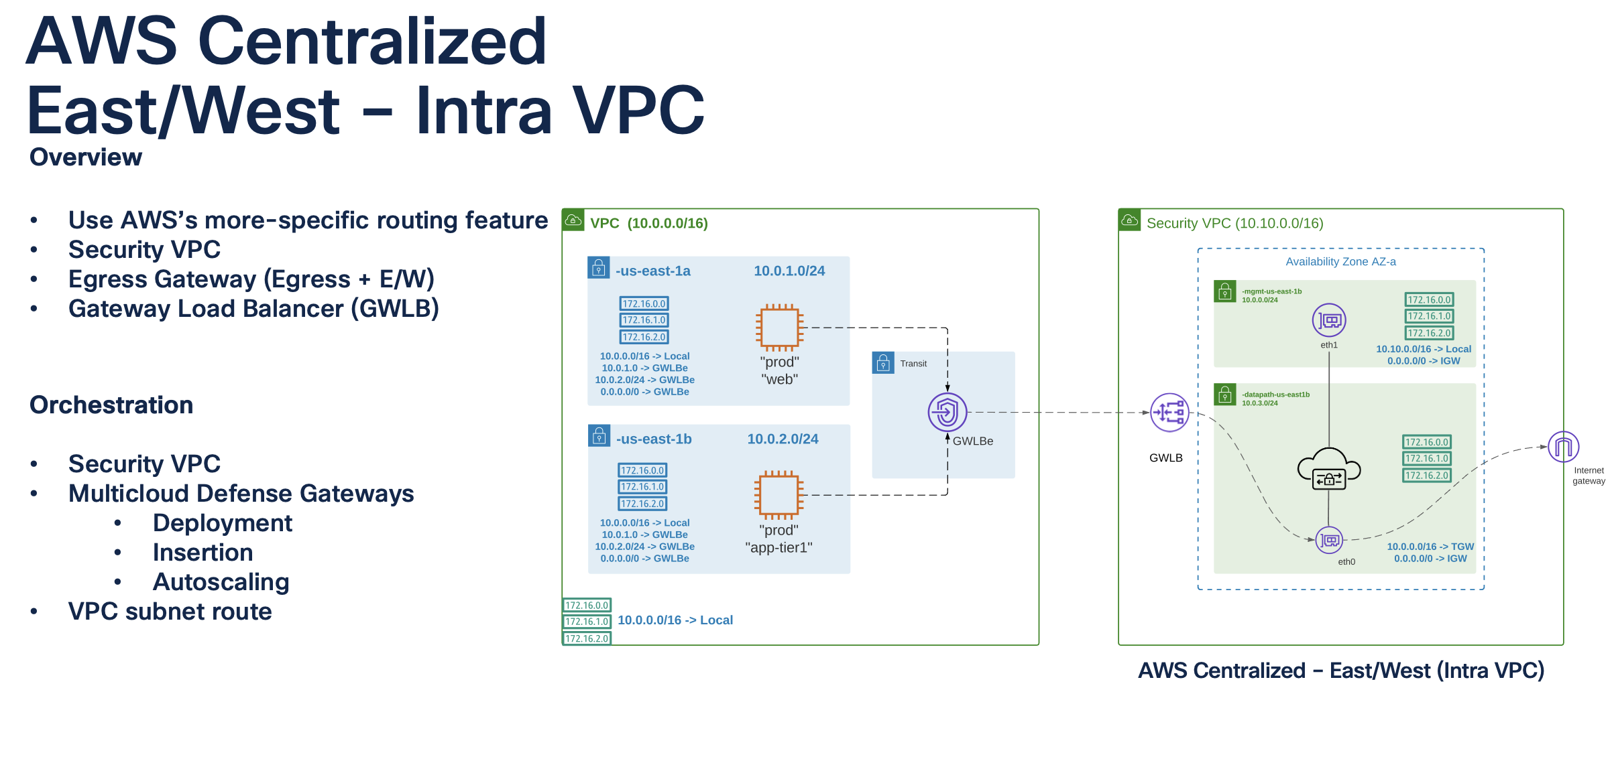

Slide 26
Demo Time

Slide 27
Cisco Secure Workload (Tetration)

Slide 28
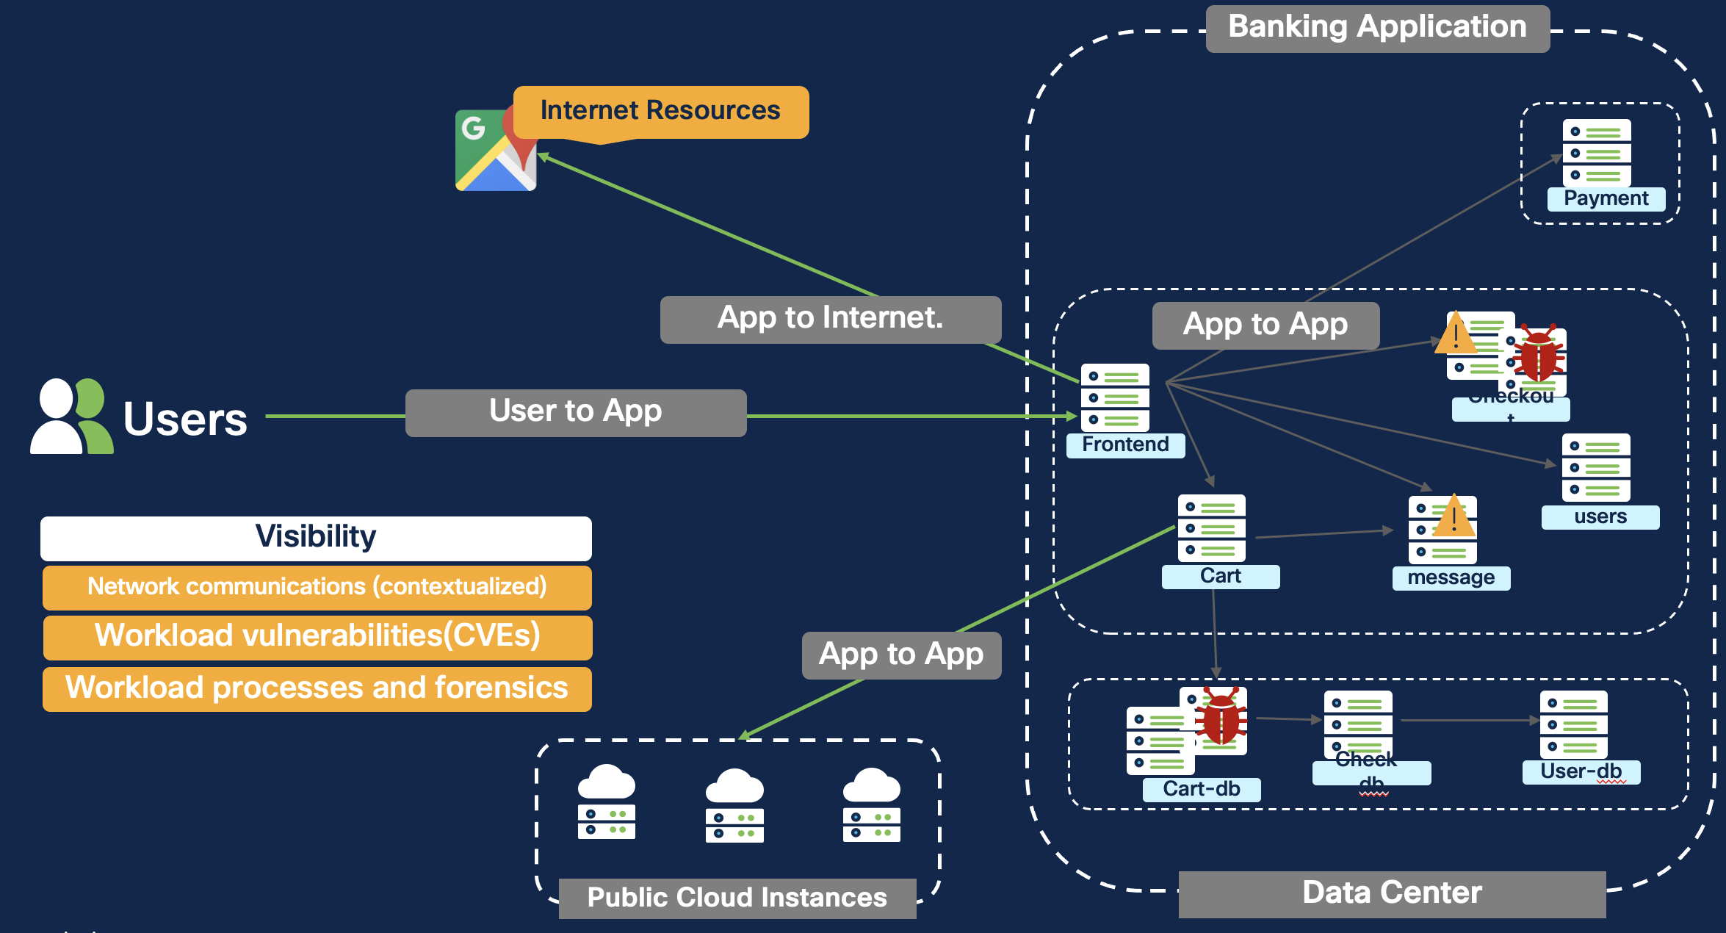
Cisco Secure Workload Visibility

Slide 29
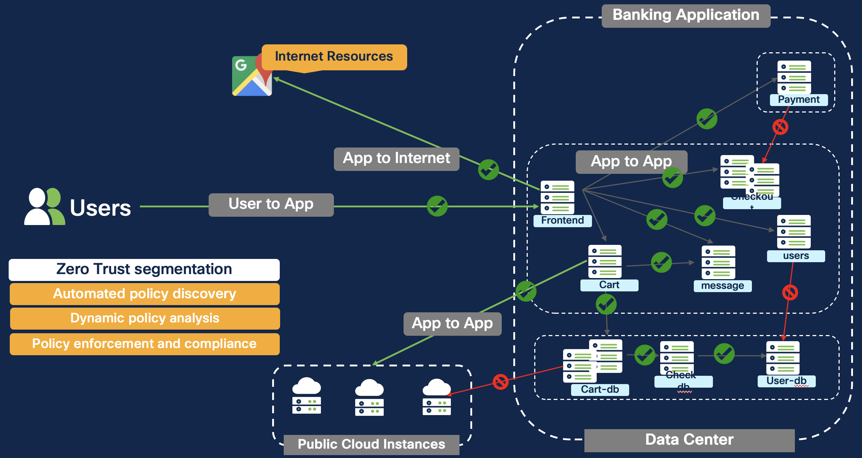
Cisco Secure Workload Enforcement

Slide 30

Cisco Vulnerability Management (Kenna)

Slide 31
Vulnerability Management… expectation vs reality

Slide 32
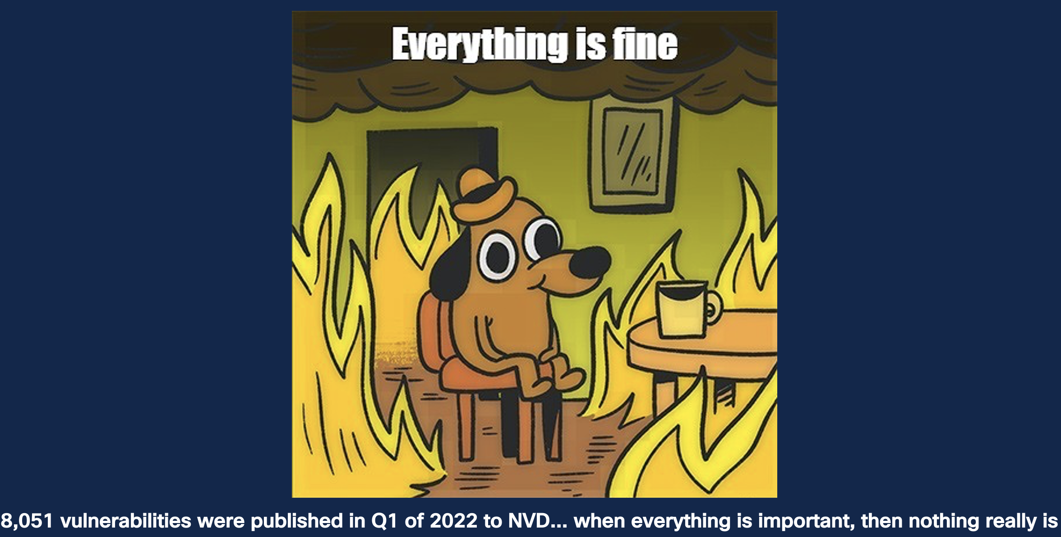

Slide 33
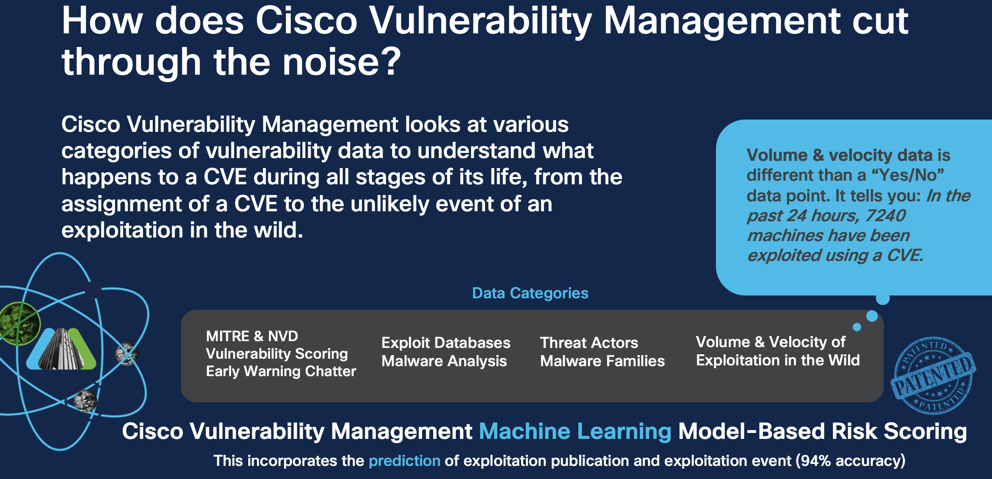

Slide 34
Attack Surface Management

Slide 35
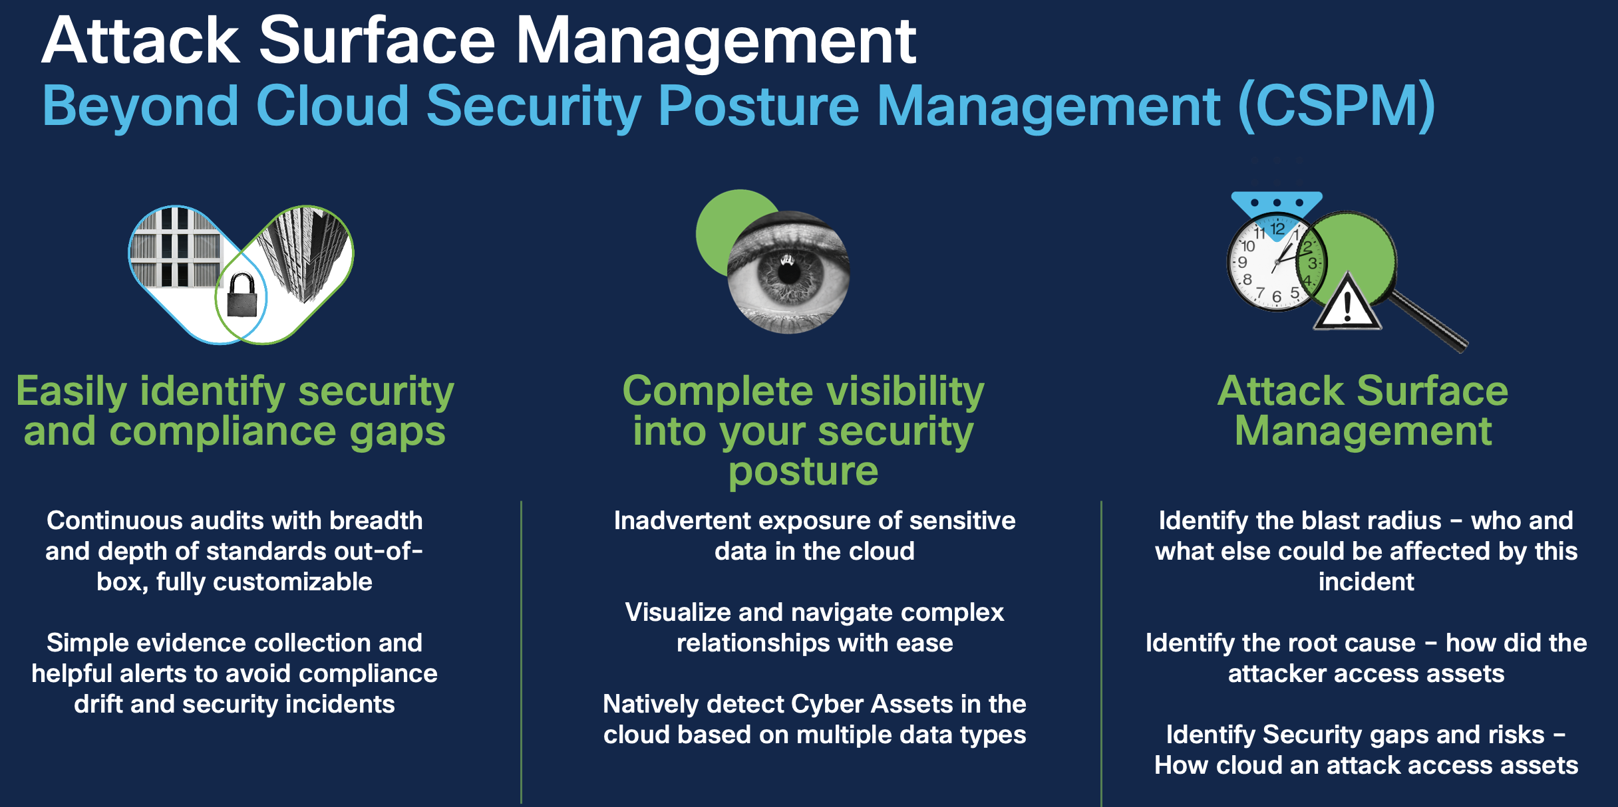

Slide 36
Cisco Secure Application by AppDynamics

Slide 37
Use Cases
      Security Visibility in Application Native Context at the Runtime
      Combines application and security insight to deliver unified user experience.
      Vulnerability Assessment and Remediation/Patching at the Runtime
      Detect and remediate application code dependency and configuration level security vulnerabilities in production at runtime.
      Attack Detection and Response at the Runtime
      Detect what is happening inside of the code and prevent known exploits from occurring at the source in real-time

Slide 38
Vulnerability Assessment and Remediation at runtime
Detect and remediate application code dependency and configuration level security vulnerabilities in production at runtime.

Slide 39
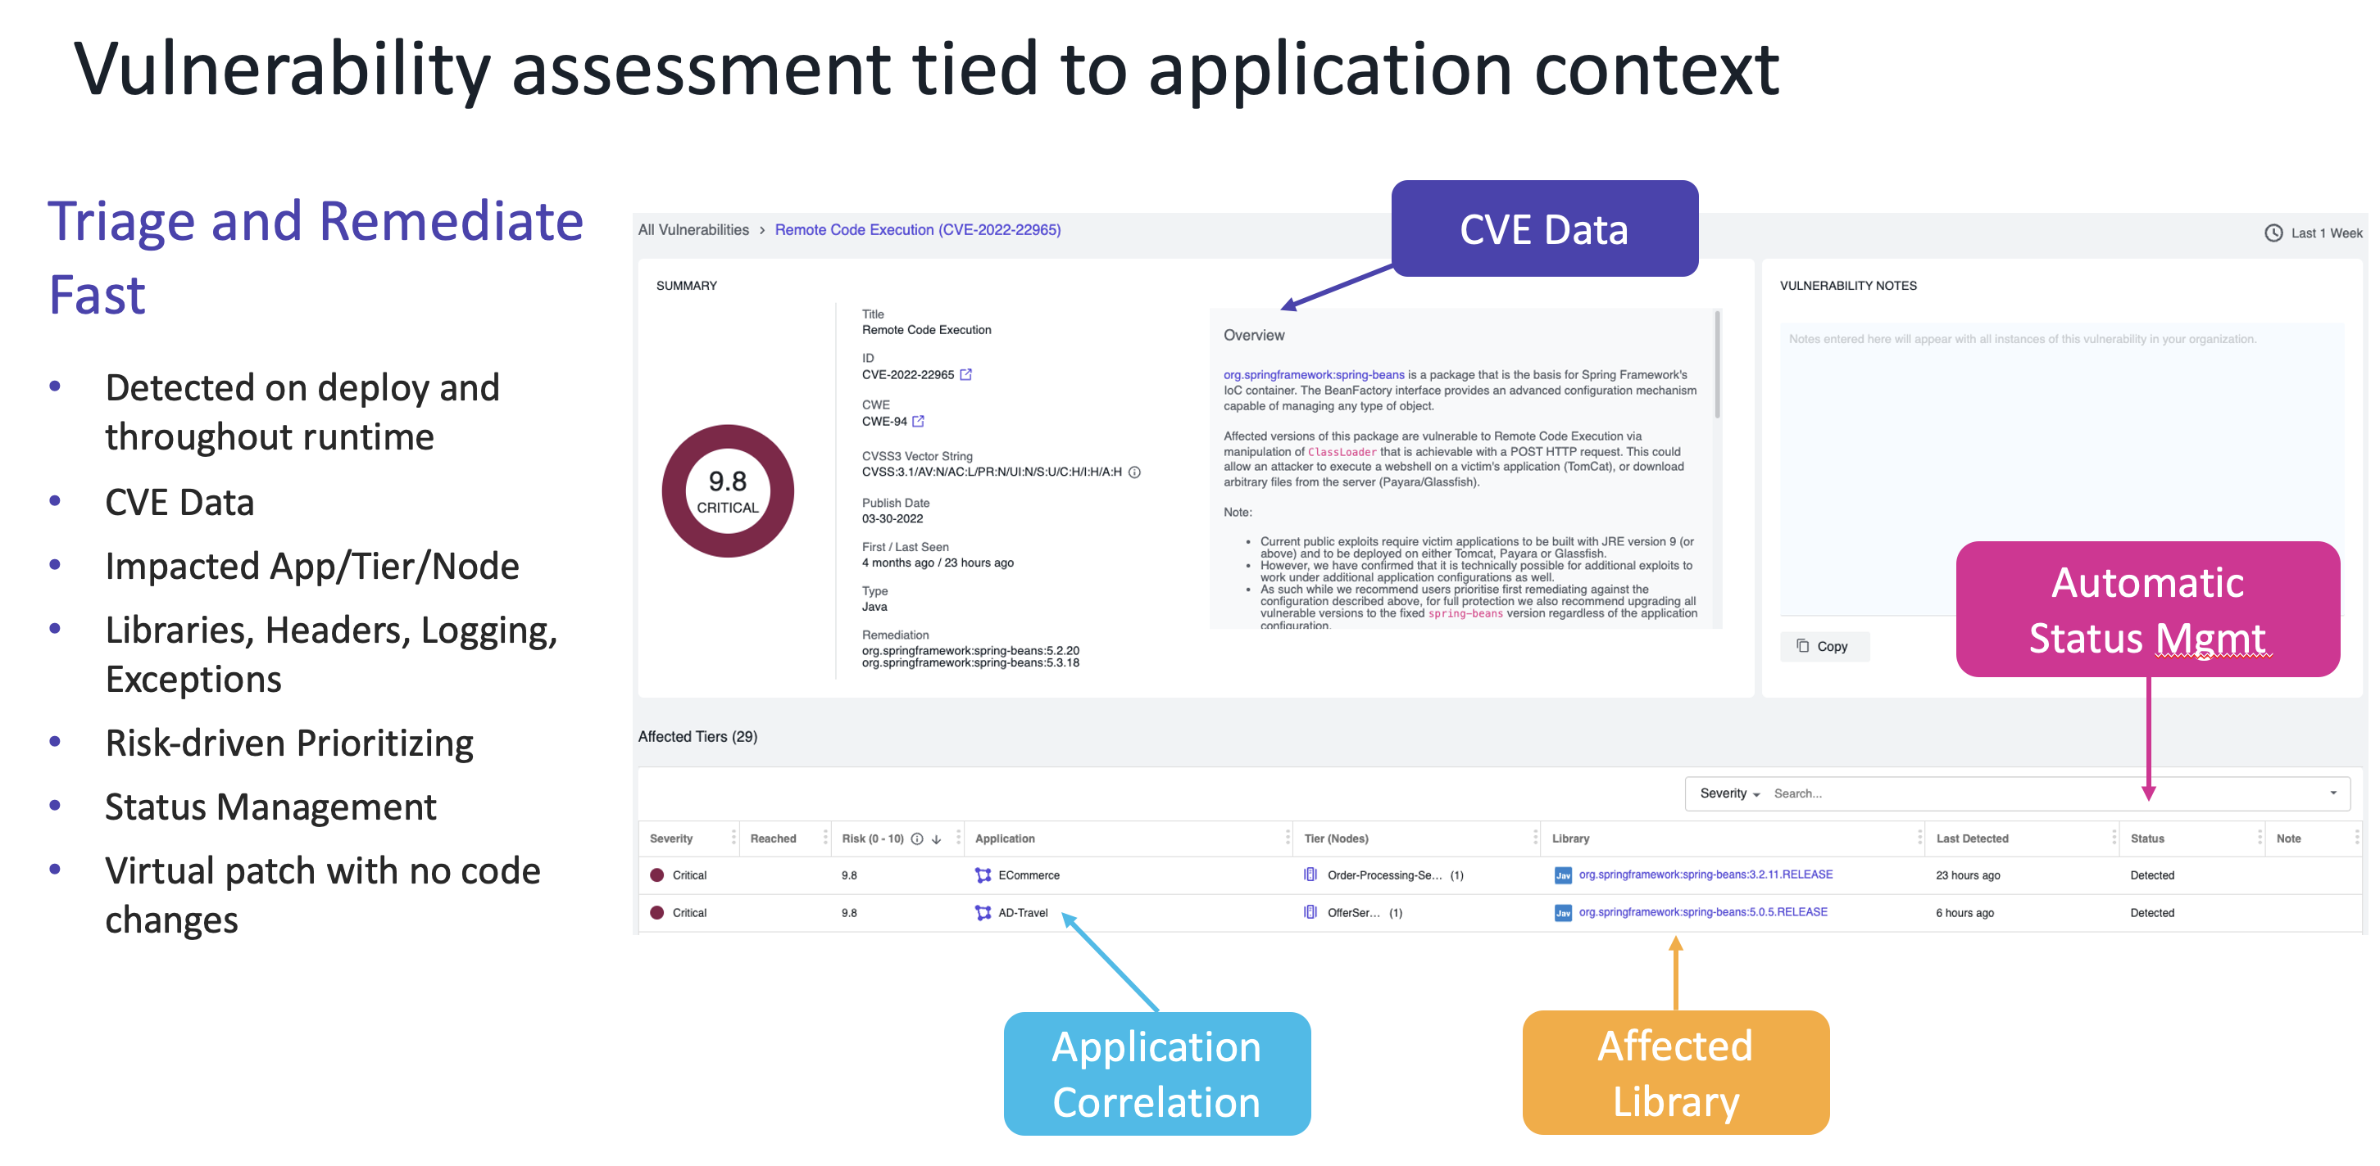

Slide 40
Attack Detection & Response at runtime
      Detect what is happening inside of the code and prevent known exploits from occurring at the source in real-time.

Slide 41
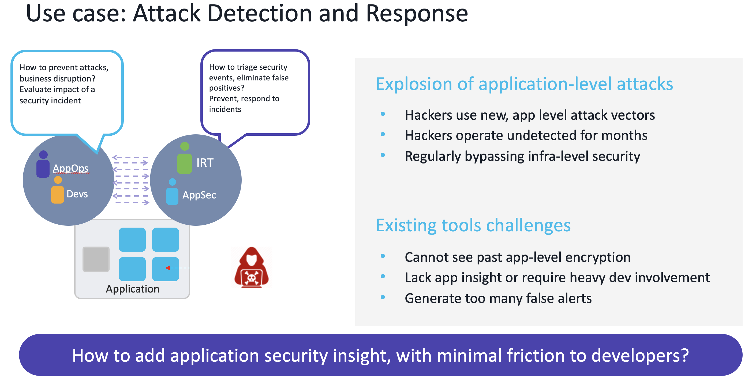

Slide 42
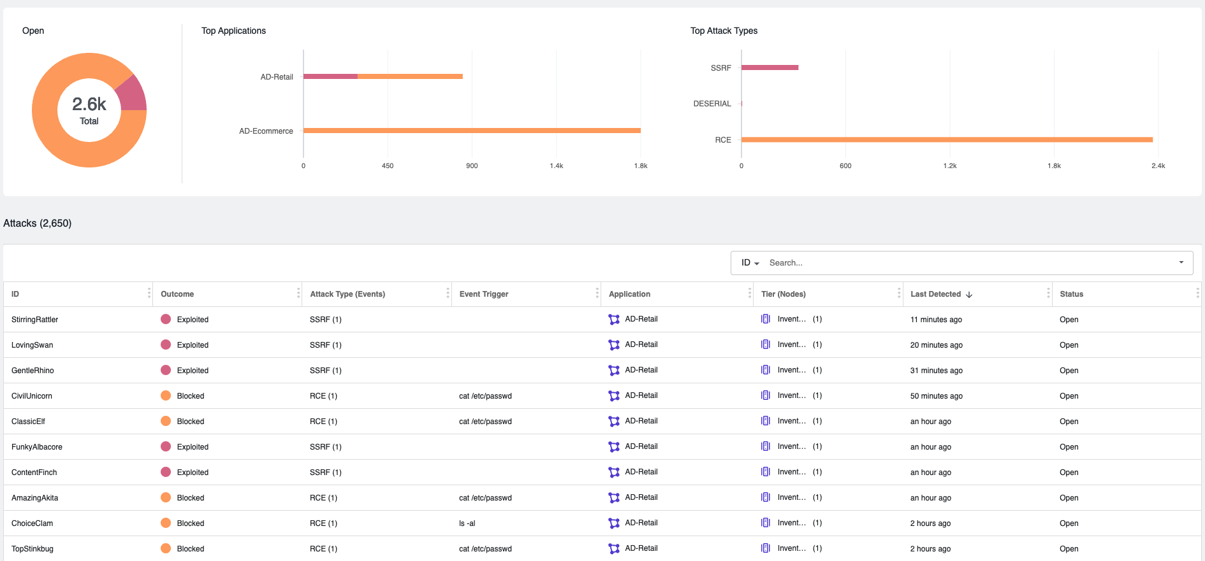
Prioritized attack list tied to application context
Triage Fast
Cisco security insight correlated with app context
Risk based prioritization
Scope and methodology of attack

Slide 43
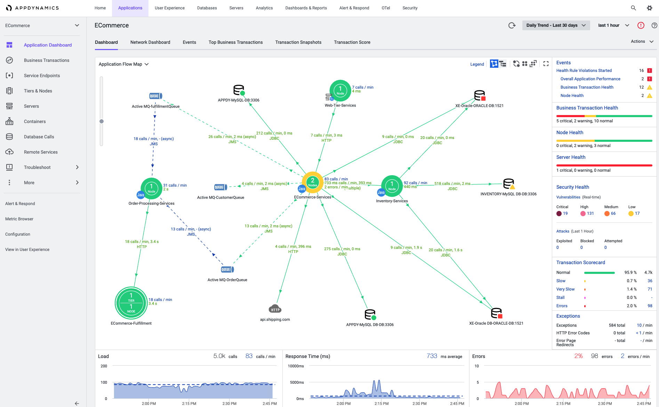
Application Details with Security Summary
AppDynamics UI
Application Details
  Cloud native or legacy or hybrid apps
  Flowmaps, Business transactions, Endpoint context
Security Summary
  Links to Secure Application details

Slide 44
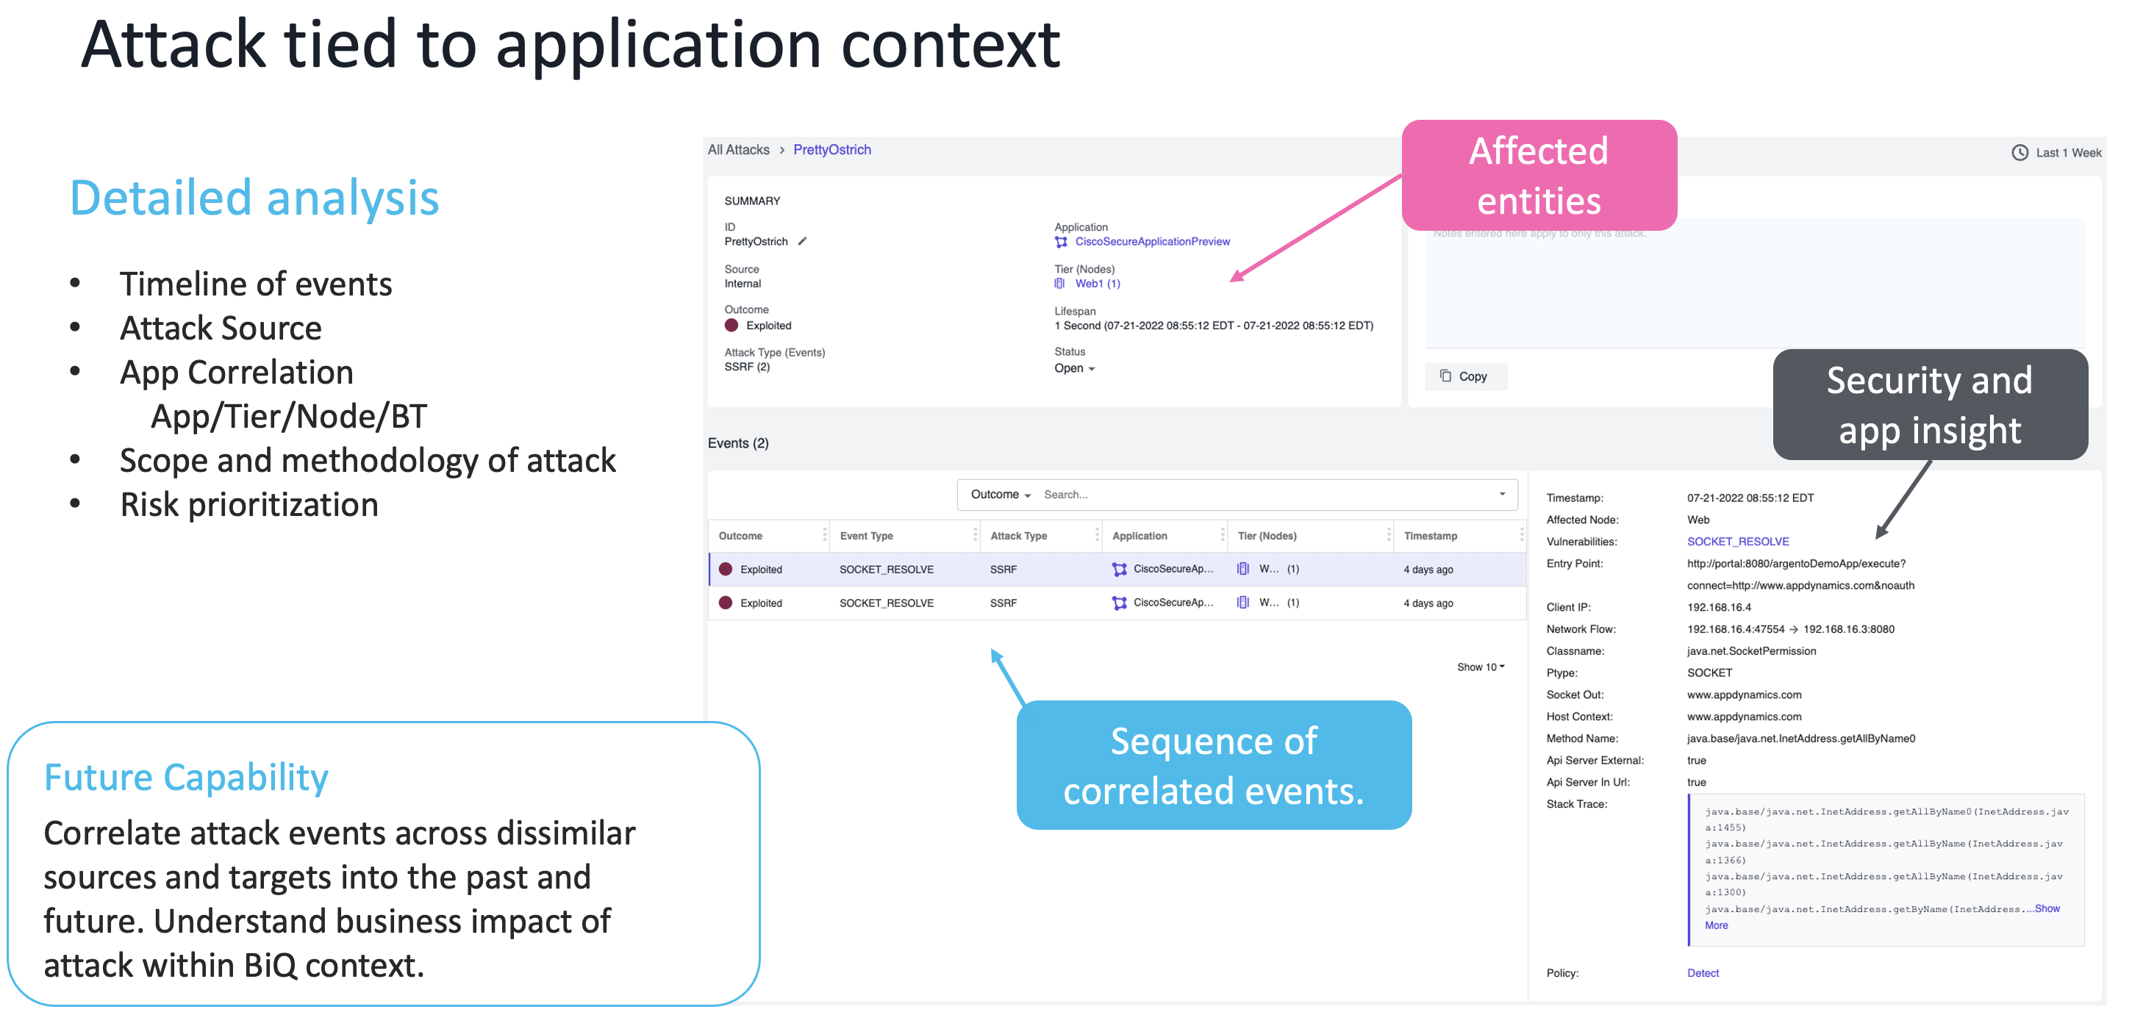

Slide 45
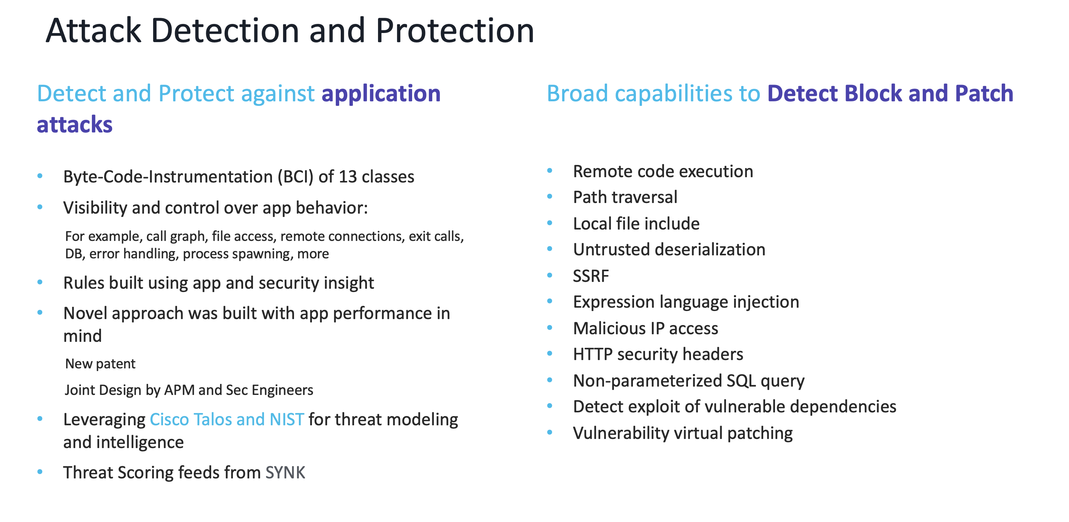

Slide 46
Demo Time

Slide 47
Thank you

