Slide 1
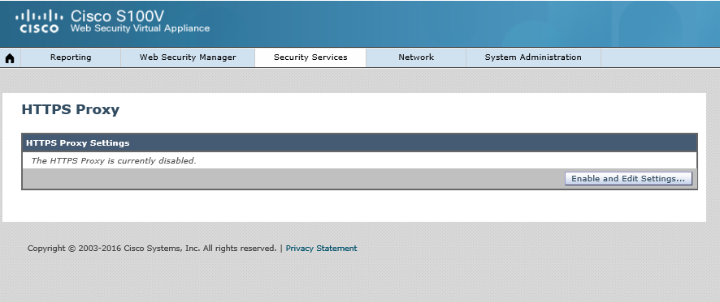
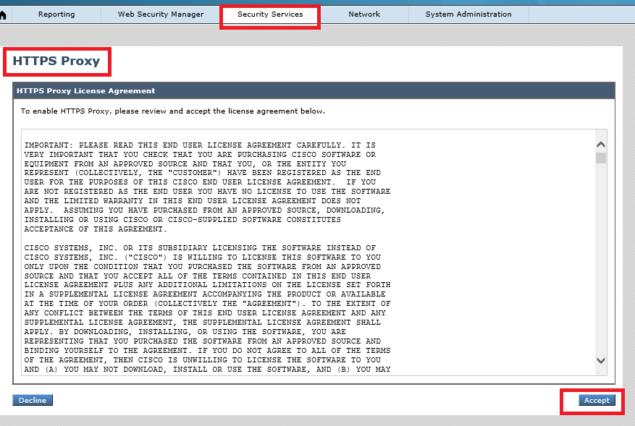
Step 1 of
Accept the license agreement

Slide 2
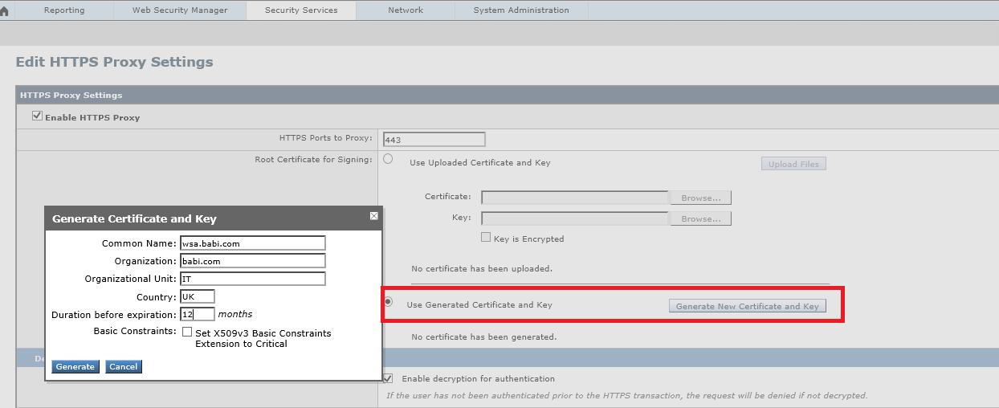
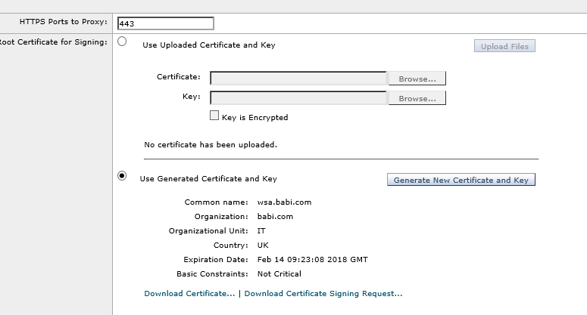
Step 2 of
Generate the Certificate

Slide 3
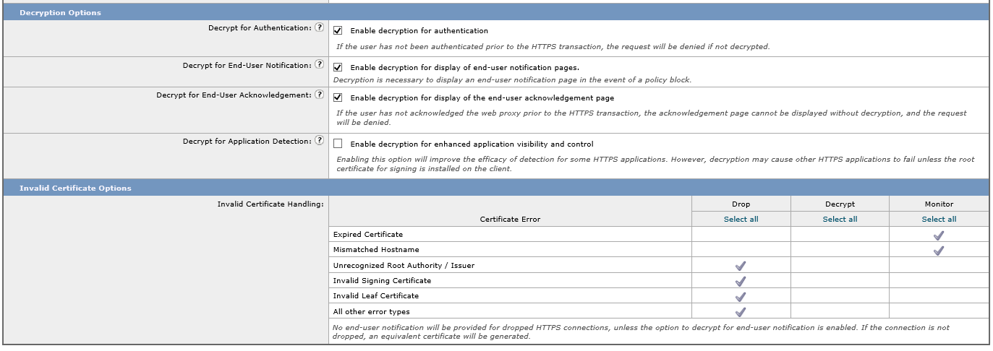
Step 3 of
Decryption Options:
Decrypt for Authentication: User’s both HTTP and HTTPS connection can be authenticated.
Enable decryption for enhanced application visibility and control: WSA will perform application control within HTTPS websites, i.e. within https-gmail, WSA can control google talk.

Slide 4
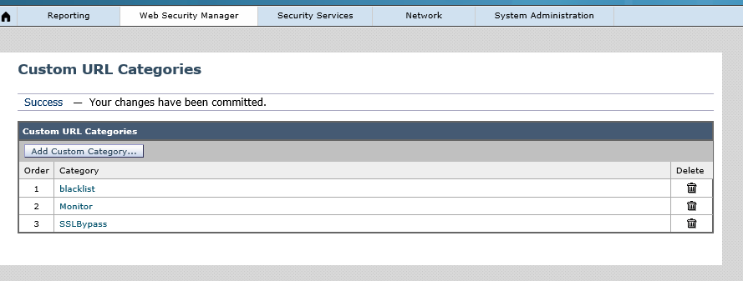
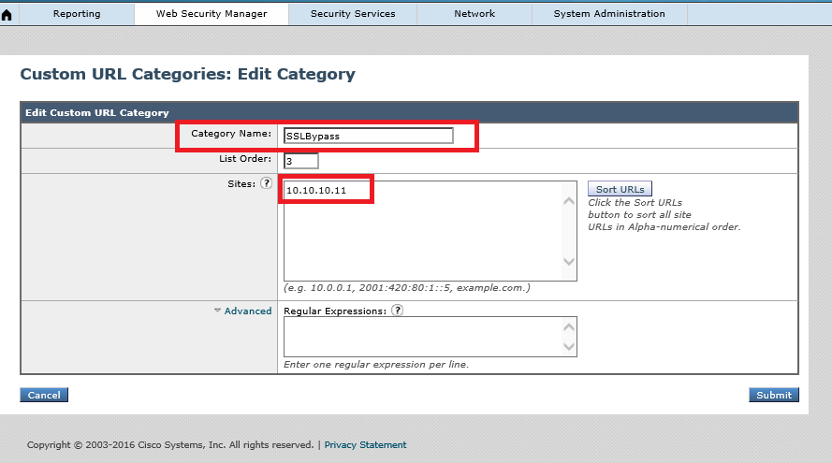

Slide 5
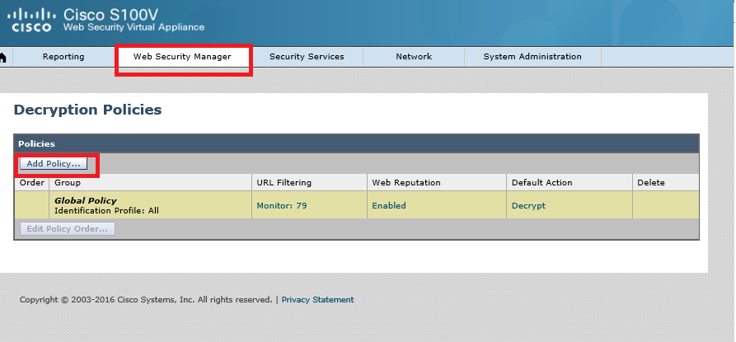
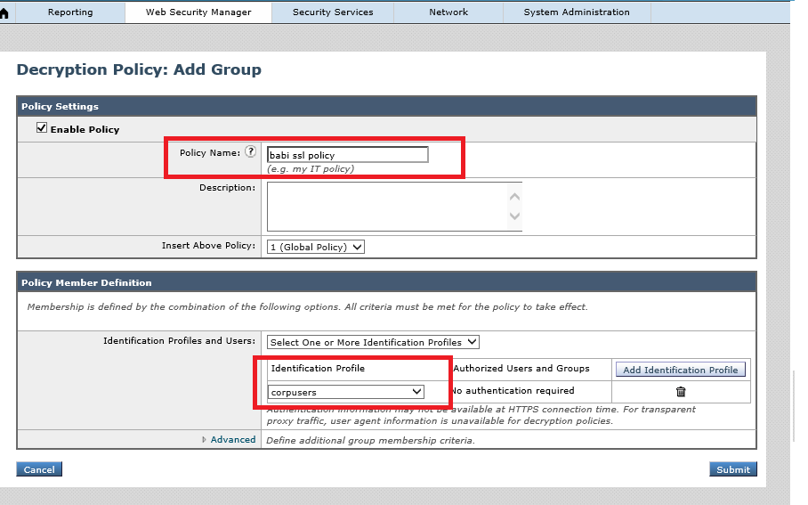

Slide 6
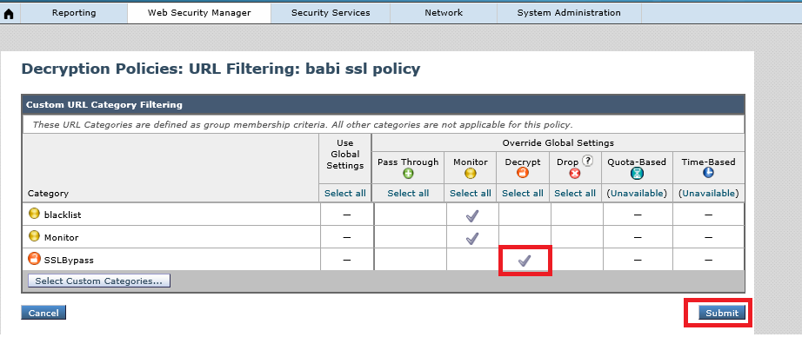
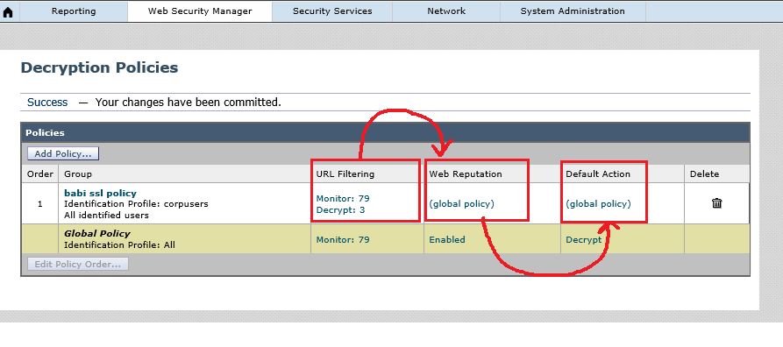

Slide 7
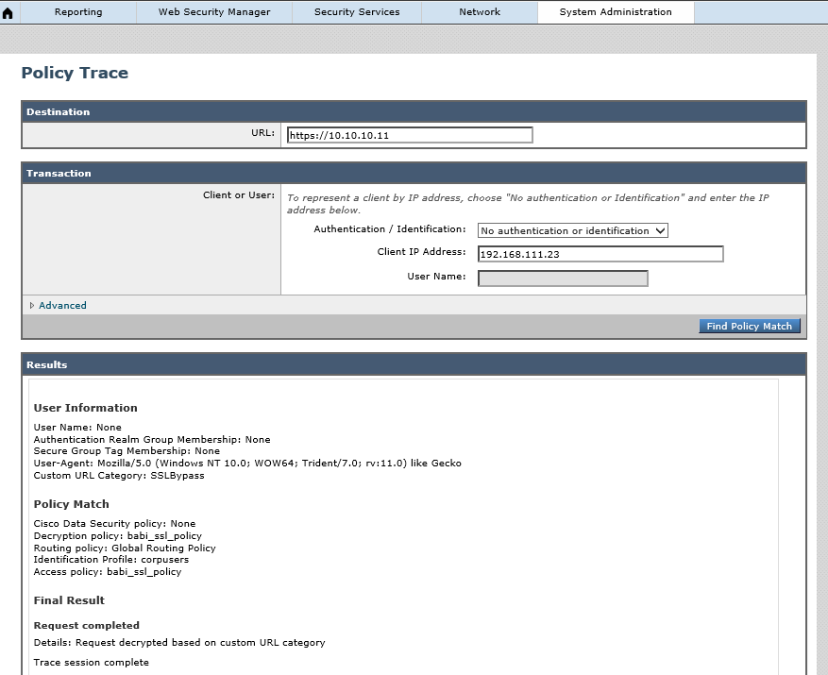

Slide 8



