Slide 1
Precision Routing:
A New Routing Paradigm
Anand Heda – CBABU Product Manager

Slide 2
Disclaimer
The Cisco products, services or features identified in this document may not yet be available or may not be available in all areas and may be subject to change without notice. Consult your local Cisco business contact for information on the products or services available in your area. You can find additional information via Cisco’s World Wide Web server at http://www.cisco.com. Actual performance and environmental costs of Cisco products will vary depending on individual customer configurations and conditions.
Notes:
This presentation does contain forward looking statements.
All feature and product delivery dates are subject to change.

Slide 3
Agenda
Basic Facts
Traditional Skills-Based Routing
Precision Routing Terminology & Overview
Precision Routing Configuration Overview
  Attribute Creation & Assignment
  Precision Queue Creation
  Script Editor
9.0 System Limits
  Reporting
  Migrating to Precision Routing
Precision Routing Roadmap

Slide 4

Precision Routing: Basic Facts
Multi-dimensional routing built on proficiency based Agent attributes
Available starting with UCCE 9.0 (released June 2012)
Enterprise Wide (ie, not peripheral specific)
Web 2.0 & REST API Configuration
Inbound Voice only in UCCE 9.0
Supports flat UCCE instances only in UCCE 9.0
Skills-based Routing still exists

Slide 5
Traditional Skills-Based Routing

Slide 6
Unlocking Expertise Creates
Multiple Skills Groups
Notes:
As skills and attributes are added for the agents, skill groups multiply.
You must group skills and attributes into multiple combinations
As Skills and attributes are added the combinations expand
Adding agents to skill groups becomes Time and Cost intensive

Slide 7
Unlocking Expertise Creates
Multiple Skills Groups
Notes:
As skills and attributes are added for the agents, skill groups multiply.
You must group skills and attributes into multiple combinations
As Skills and attributes are added the combinations expand
Adding agents to skill groups becomes Time and Cost intensive

Slide 8



Unlocking Expertise and Aptitude
Creates Multiplying Skills Groups
JENNIFER
SAMANTHA
JOHN
z
zzzzzzzzzzz
Notes:
Grouping Skills in to Skill Groups in Multiple combinations
As Skills are added the combinations Expand
Adding agents to skill groups becomes Time and Cost intensive

Slide 9
Traditional Skills-based Routing Model
Skills-Based Routing Technology Limits Growth
and the Ability to Easily Extend Business Logic
Administratively Intensive Agent Management
Inability to Take Advantage of
Unique Expertise and Aptitude
Time Consuming
Costly and Complex Administration
Lack of Flexible, Detailed Reporting
© 2011 Cisco and/or its affiliates. All rights reserved.
Cisco Confidential
9
Notes:
Limitations of Skills-based routing when it comes to multi-dimensions & attributes

Slide 10
Precision Routing

Slide 11



Assigning Expertise and Aptitude to Agents
JENNIFER
SAMANTHA
JOHN
© 2011 Cisco and/or its affiliates. All rights reserved.
Cisco Confidential
11
Notes:
With precision Routing agents are assigned Expertise and Aptitude with weights or variables for each one.

Slide 12







Precision Routing Overview
SEEKING BEST MATCH
MATCH FOUND
CUSTOMER
Agent expertise and aptitude defines the step
RYAN
SABRINA
SAMANTHA
STEP 1
API
TYRONE
JOHNSTON
“Your call is important
to us…please hold.”
JENNIFER
TYRONE
“Hello this is Tyrone,
how may I help you?”
© 2011 Cisco and/or its affiliates. All rights reserved.
Cisco Confidential
12
Notes:
Precision Queues are set up and the agents selected by the queue to receive a call based on their attributes and the weight of each attribute of skill and of course their availability. Agents do not need to be added to each skill group. As agents add new skills or attributes, or improve their weighted score for a certain attribute of skill the change need only be made to the agents profile, no changes required to the Precision Queue.
In these steps, Jen would be selected if she was available based on his attributes.
Question, If Jen is good fit for step 1, what if the call moves to step 2 or 3 and Jen becomes available, she will get the call. Precision Routing expands the pool, does not exclude agents from step to step.
ON this slide show the agent pool expanding with each step and then show the agent from that pool being chosen.

Slide 13
Precision Routing Overview
NO MATCH FOUND
SEEKING BEST MATCH
CUSTOMER
Agent expertise and aptitude defines the step
If no match is found in Step 1, move to Step 2
RYAN
SABRINA
SAMANTHA
STEP 1
API
“Your call is important
to us…please hold.”
JENNIFER
TYRONE
© 2011 Cisco and/or its affiliates. All rights reserved.
Cisco Confidential
13
Notes:
Precision Queues are set up and the agents selected by the queue to receive a call based on their attributes and the weight of each attribute of skill and of course their availability. Agents do not need to be added to each skill group. As agents add new skills or attributes, or improve their weighted score for a certain attribute of skill the change need only be made to the agents profile, no changes required to the Precision Queue.
In these steps, Jen would be selected if she was available based on his attributes.
Question, If Jen is good fit for step 1, what if the call moves to step 2 or 3 and Jen becomes available, she will get the call. Precision Routing expands the pool, does not exclude agents from step to step.
ON this slide show the agent pool expanding with each step and then show the agent from that pool being chosen.

Slide 14













Precision Routing Overview
SEEKING GOOD MATCH
MATCH FOUND
CUSTOMER
Each step allows the system to expand the agent search pool
RYAN
SABRINA
SAMANTHA
JENNIFER
STEP 2
API
TYRONE
ADRIANA
JOHN
ANTHONY
ANNA
BOREGA
“Your call is important
to us…please hold.”
“Hello this is Anna,
how may I help you?”
JAMES
ANNA
PRIA
SUSAN
© 2011 Cisco and/or its affiliates. All rights reserved.
Cisco Confidential
14
Notes:
Precision Queues are set up and the agents selected by the queue to receive a call based on their attributes and the weight of each attribute of skill and of course their availability. Agents do not need to be added to each skill group. As agents add new skills or attributes, or improve their weighted score for a certain attribute of skill the change need only be made to the agents profile, no changes required to the Precision Queue.
In these steps, Jen would be selected if she was available based on his attributes.
Question, If Jen is good fit for step 1, what if the call moves to step 2 or 3 and Jen becomes available, she will get the call. Precision Routing expands the pool, does not exclude agents from step to step.
ON this slide show the agent pool expanding with each step and then show the agent from that pool being chosen.

Slide 15
Precision Routing Overview
SEEKING GOOD MATCH
NO MATCH FOUND
CUSTOMER
Each step allows the system to expand the agent search pool
If no match is found in Step 2, move to Step 3
RYAN
SABRINA
SAMANTHA
JENNIFER
STEP 2
API
TYRONE
ADRIANA
JOHN
ANTHONY
“Your call is important
to us…please hold.”
JAMES
ANNA
PRIA
SUSAN
© 2011 Cisco and/or its affiliates. All rights reserved.
Cisco Confidential
15
Notes:
Precision Queues are set up and the agents selected by the queue to receive a call based on their attributes and the weight of each attribute of skill and of course their availability. Agents do not need to be added to each skill group. As agents add new skills or attributes, or improve their weighted score for a certain attribute of skill the change need only be made to the agents profile, no changes required to the Precision Queue.
In these steps, Jen would be selected if she was available based on his attributes.
Question, If Jen is good fit for step 1, what if the call moves to step 2 or 3 and Jen becomes available, she will get the call. Precision Routing expands the pool, does not exclude agents from step to step.
ON this slide show the agent pool expanding with each step and then show the agent from that pool being chosen.

Slide 16


























Precision Routing Overview
SEEKING ADEQUATE MATCH
MATCH FOUND
CUSTOMER
Each step maintains information at each level for real-time and historical reporting
RYAN
SABRINA
SAMANTHA
JENNIFER
HOWARD
TYRONE
ADRIANA
JOHN
API
STEP 3
ANTHONY
GWEN
MARIA
GONZALES
JAMES
ANNA
PRIA
SUSAN
HELEN
“Your call is important
to us…please hold.”
“Hello this is Maria,
how may I help you?”
JORGE
ALISON
BIANCA
MARIA
BEN
MIRASOL
DAVID
GRETEL
AIESHA
JAYSON
© 2011 Cisco and/or its affiliates. All rights reserved.
Cisco Confidential
16
Notes:
Precision Queues are set up and the agents selected by the queue to receive a call based on their attributes and the weight of each attribute of skill and of course their availability. Agents do not need to be added to each skill group. As agents add new skills or attributes, or improve their weighted score for a certain attribute of skill the change need only be made to the agents profile, no changes required to the Precision Queue.
In these steps, Jen would be selected if she was available based on his attributes.
Question, If Jen is good fit for step 1, what if the call moves to step 2 or 3 and Jen becomes available, she will get the call. Precision Routing expands the pool, does not exclude agents from step to step.
ON this slide show the agent pool expanding with each step and then show the agent from that pool being chosen.

Slide 17
Precision Routing Overview
SEEKING ADEQUATE MATCH
NO MATCH FOUND
CUSTOMER
Each step maintains information at each level for real-time and historical reporting
RYAN
SABRINA
SAMANTHA
JENNIFER
HOWARD
TYRONE
ADRIANA
JOHN
API
STEP 3
ANTHONY
GWEN
JAMES
ANNA
PRIA
SUSAN
HELEN
“Your call is important
to us…please hold.”
JORGE
ALISON
BIANCA
MARIA
BEN
MIRASOL
DAVID
GRETEL
AIESHA
JAYSON
© 2011 Cisco and/or its affiliates. All rights reserved.
Cisco Confidential
17
Notes:
Precision Queues are set up and the agents selected by the queue to receive a call based on their attributes and the weight of each attribute of skill and of course their availability. Agents do not need to be added to each skill group. As agents add new skills or attributes, or improve their weighted score for a certain attribute of skill the change need only be made to the agents profile, no changes required to the Precision Queue.
In these steps, Jen would be selected if she was available based on his attributes.
Question, If Jen is good fit for step 1, what if the call moves to step 2 or 3 and Jen becomes available, she will get the call. Precision Routing expands the pool, does not exclude agents from step to step.
ON this slide show the agent pool expanding with each step and then show the agent from that pool being chosen.

Slide 18
Precision Routing: New Terminology
Attributes - Objects to define agent characteristics and expertise with values
Precision Queue – Multi-dimensional and multi-step queue made up of Steps
  Steps – Set of criteria to escalate or grow/shrink agent pool
      Terms/Step Criteria – Conditions based on attributes that determine the agent pool within each step
      Wait Time – Configurable input which specifies how long to wait at a step for an available agent matching Step criteria
Notes:
PQs are made up of attribute combinations defined in Steps
Steps are made up criteria and a wait time

Slide 19
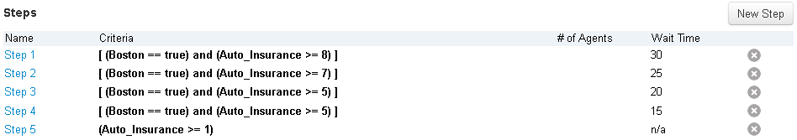
Precision Routing: New Terminology
Sample Precision Queue:
Terms / Step Criteria
Wait Time
Attributes

Slide 20
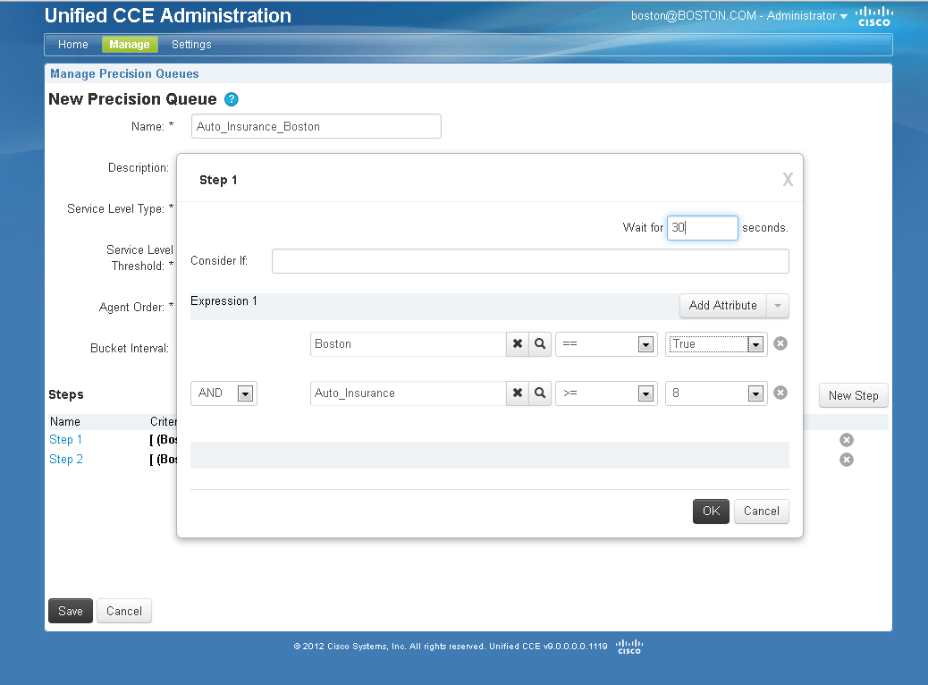
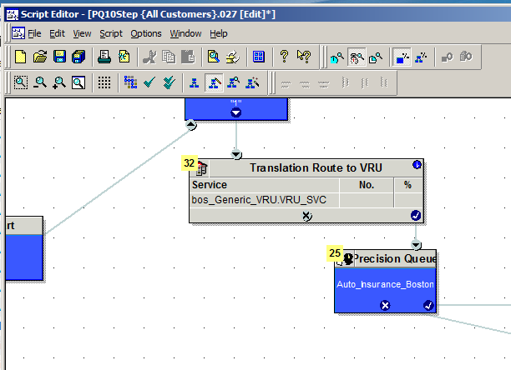
Precision Routing: Configuration Overview
3
Create Attributes
Assign Attributes to Agents
Create Precision Queues based on Attributes
Invoke Precision Queues via call scripts
1
4
2
Notes:
High level overview of PQ Config. Attributes are in the middle of Agents & PQs.

Slide 21
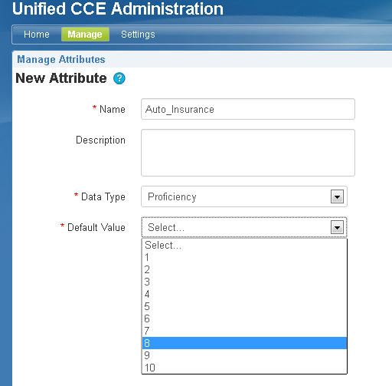
Precision Routing Configuration Overview
Attribute Creation
2 Data Types Supported:
  Proficiency
    1-10 Rating
    Used for quantifying agent’s expertise (or lack of) in that attribute
  Boolean:
    True or False
    Used to indicate an “exists or not” condition. (ie, Certified, Location, etc)
Notes:
Examples to discuss:
Proficiency: Sales, Support, TechSupport, etc. 10 is the best, 1 the worst.
Boolean: Certified, English (speaks English or not), North America (North America agent or not)

Slide 22
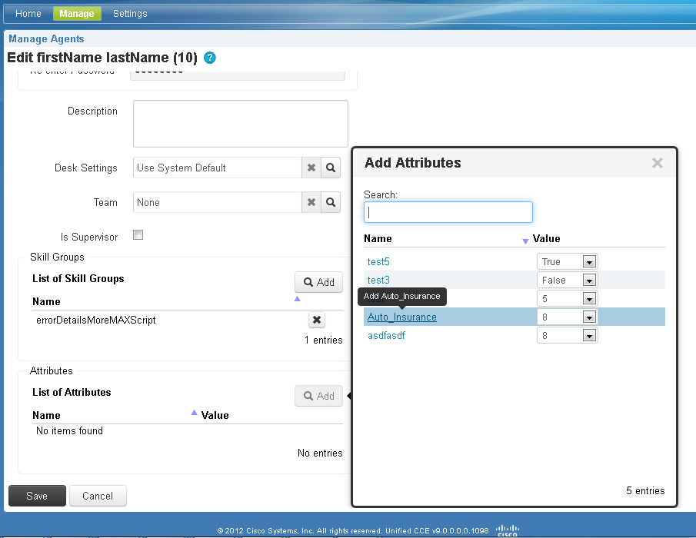
Precision Routing Configuration Overview
Attribute Assignment
Attribute Assignment:
  Can assign many attributes to an agent at once (50 max)
  Agent can inherit default value or have a specific proficiency assigned
Notes:
Can also assign via the API

Slide 23
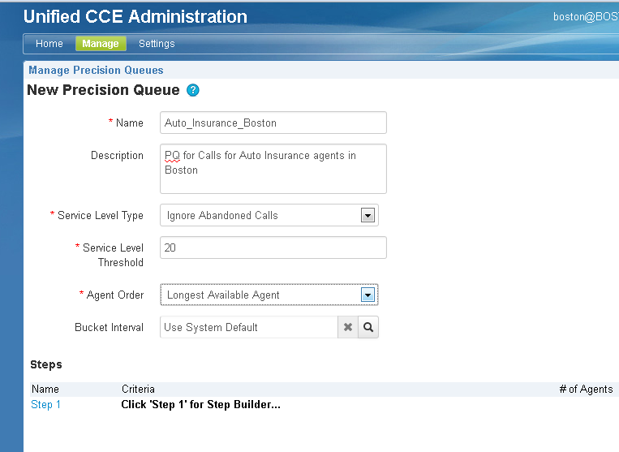
Precision Routing Configuration Overview
PQ Creation – Basic Info
Basic Information:
  SL Type/Threshold (similar to SkillGroup)
  Agent Ordering:
    Longest Agent Available
    Most Skilled Agent
    Least Skilled Agent
Notes:
Agent Ordering :
LAA: Longest Agent Available, straighforward
Most Skilled : Calculates the sum of all the agent’s proficiency attributes referenced in the Step and picks the highest value. For example, if Agent A had value of 9 for Auto_Insurance Attribute and Agent B had value of 8, Agent A gets the call.
Least Skilled : Opposite of Most Skilled

Slide 24
Precision Routing Configuration Overview
PQ Creation – Steps
Steps
  Create Step criteria based on Attributes using Step Builder interface
  Wait Time per Step indicates how long the call waits for an available agent that matches criteria
  Consider If – Determines whether to execute step based on formula evaluated at runtime (ie, Caller Variables, # Logged on Agents, etc)
  Wait Time / Consider If are optional and not available on last Step of PQ
Notes:
Steps:
General idea is to expand the pool as the call progresses down the Steps
Wait Time of 0 - System will check if any agents are available meeting the criteria. If not , it will immediately proceed to the next Step.
Consider If examples:
Reserve best agents for premium customers
Controlled overflow across products
Manage mission control, state of emergency

Slide 25
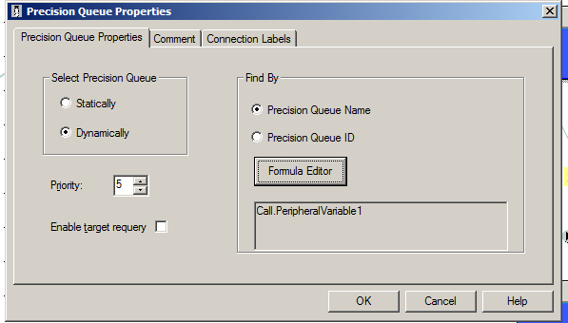
Precision Routing Configuration Overview
Script Editor
Script Editor
  Precision Queue node - New node to specify PQ
  Invoke PQs either:
    Statically – Specify the exact PQ
    Dynamically – Calls a PQ based on formula evaluated at runtime
  Can apply IVR/external treatment while the call is progressing within a PQ
  New - Dynamic Call Type feature (independent of Precision Routing)
Notes:
Call can be queued to multiple Precision Queues as well as Skill Groups
Dynamic Node Feature for PQ/CT:
Dynamically look up a PQ/CT based on formula (reduces script complexity by condensing multiple If/Then statements into one node)

Slide 26
Precision Routing: 9.0 System Limits
Limit | Maximum
Precision Queues / System | 2,000
Attributes / System | 10,000
Steps / System | 5,000
Steps / PQ | 10
Attributes / PQ (Distinct) | 5
Attributes / Agent | 50
Precision Queues +Skillgroups / Agent (Combined) | 50 (Any combination of PQs and Skillgroups)
Notes:
Note: As you get to more PQs/Agent then the number of agents /system decrease

Slide 27
Reporting – New Reports
New Reports for Precision Routing:
Name | Type | Description
Precision Queue Real Time | Real Time | Precision Queue real time metrics
Precision Queue 10-Step Real Time | Real Time | Precision Queue real time metrics per Step
Agent Precision Queue Membership | Real Time | Agent’s current Precision Queue membership
Precision Queue Interval | Historical | Precision Queue historical metrics
Precision Queue Efficiency | Historical | Precision Queue Performance by Step
Notes:
More granular data with minimal learning curve

Slide 28
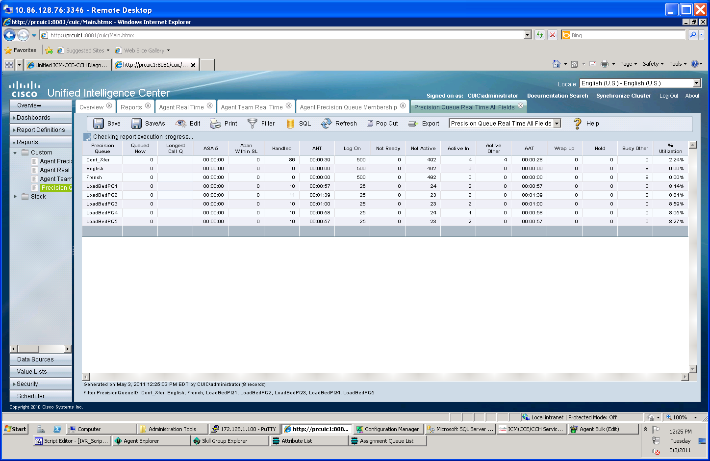
Precision Queue Real Time
New CUIC template to report on Precision Queue real time metrics (analogous to Skill Groups)

Slide 29
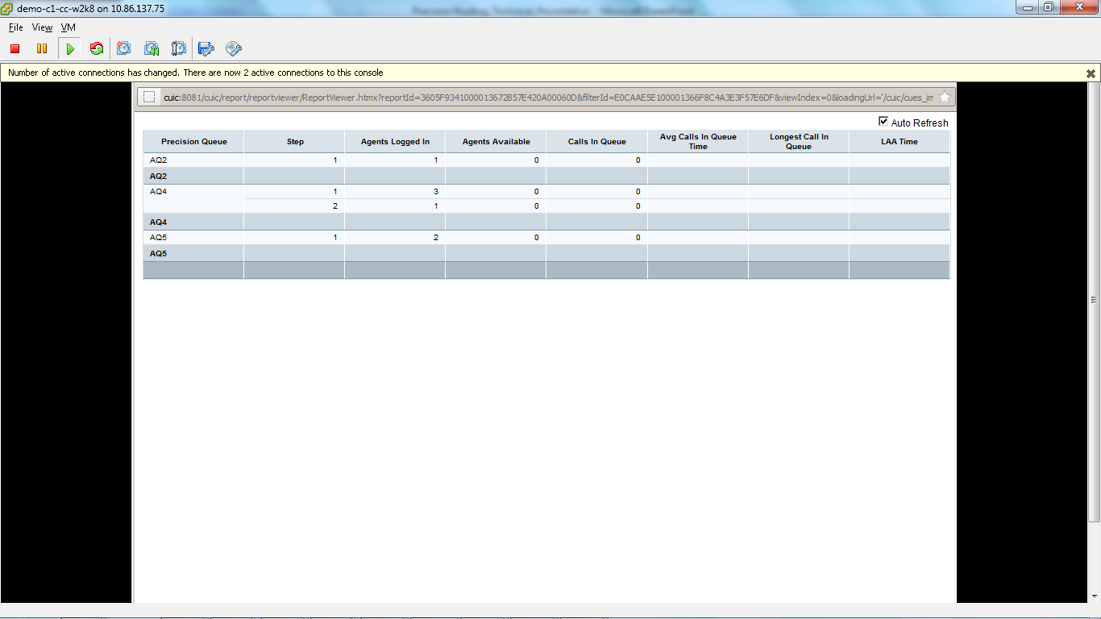
Precision Queue 10 Step Real Time
New CUIC template to report on Precision Queue real time info per Step

Slide 30
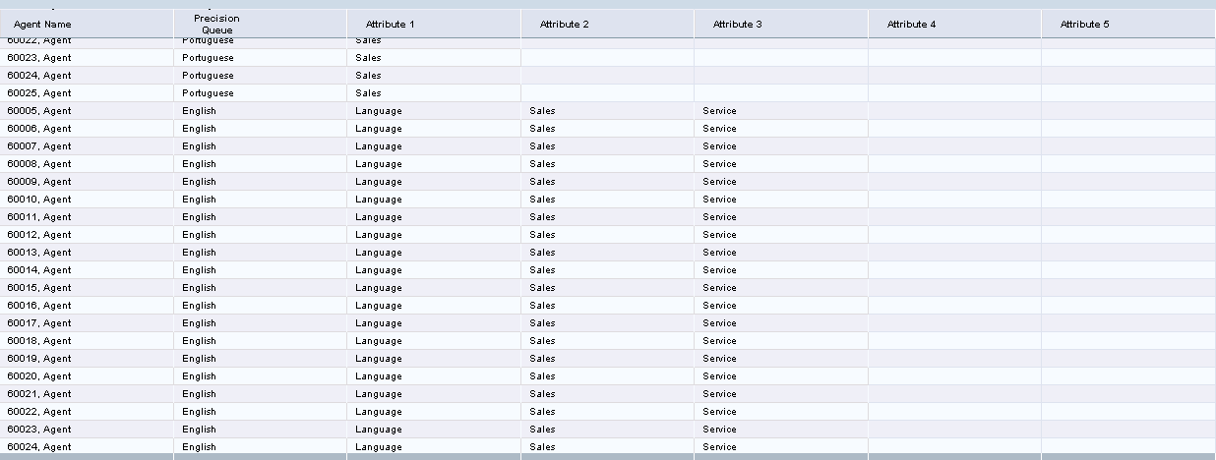
Agent Precision Queue Membership
New CUIC template that displays Agent’s Precision Queues and its attributes

Slide 31
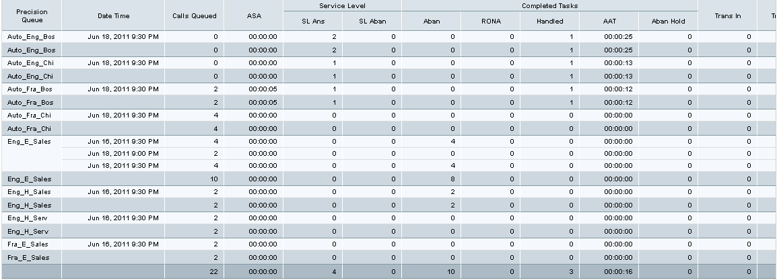
Precision Queue Interval All Fields
New CUIC template to report on Precision Queue historical metrics (analogous to Skill Groups)

Slide 32
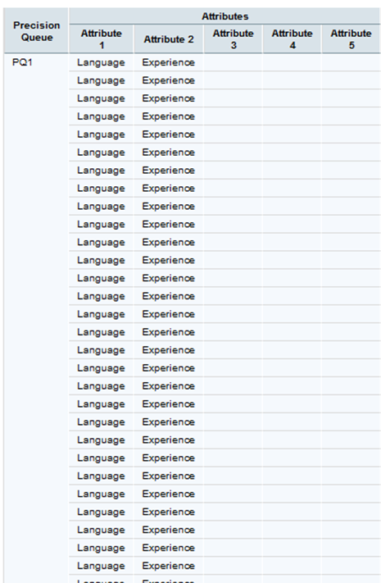
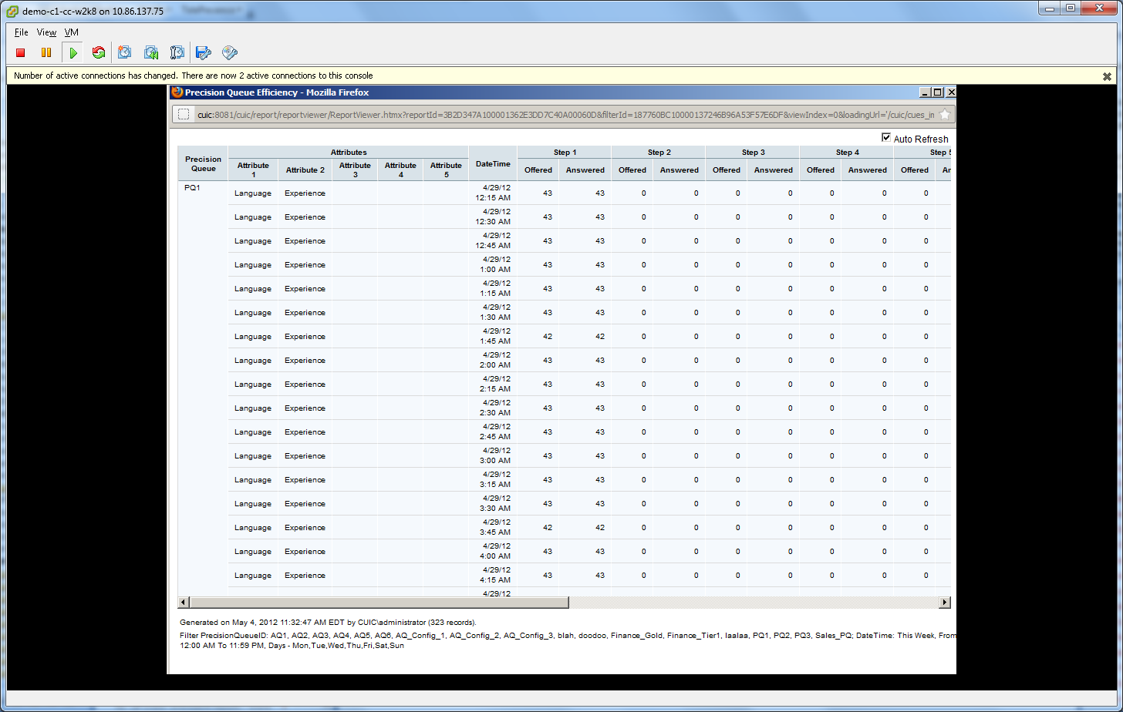
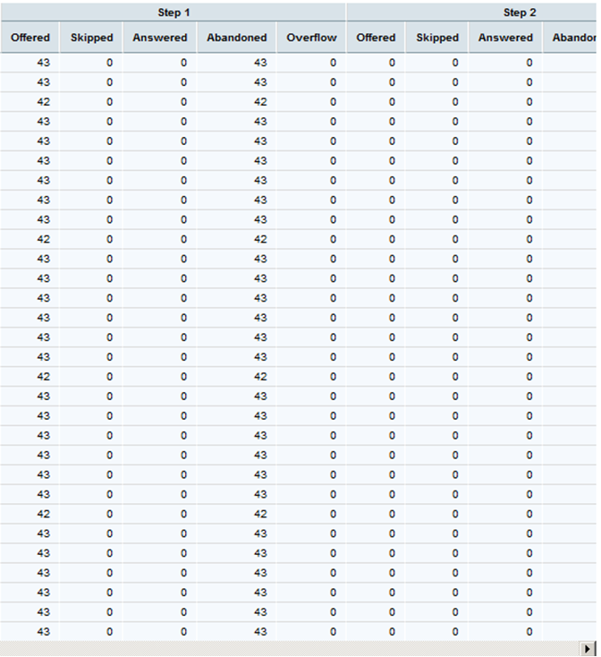
Precision Queue Efficiency
New CUIC template which displays Precision Queue performance by Step

Slide 33
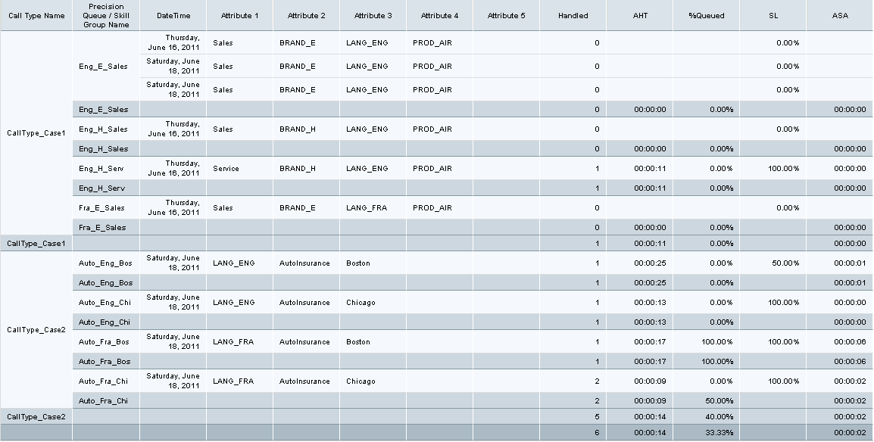
Updates to Existing Reports
Agent Real Time
Agent Team Real Time
Agent Queue Interval
Call Type Queue
Reports modified to combine PQ/Skill Group in one column and to show PQ Attributes (example shown below)

Slide 34

Migrating to Precision Routing
Designed for a smooth migration process:
✓Agents can exist in both Skill Groups and Precision Queues
  Gradually migrate agents to Precision Routing by assigning a few attributes at a time
✓ Queue calls to any combination of Precision Queues and Skill Groups
  Pilot by allocating a certain percentage of calls to Precision Queues
✓ Existing reports updated to show both Precision Queue & Skill Group information
  Easily compare Precision Queue & Skill Group metrics using familiar CUIC templates

Slide 35
Precision Routing – UCCE 9.0 and Beyond
Roadmap
Summer 2012
Precision Routing - UCCE 9.0
Features:
  10 Step PQ
  Wait Time
  Consider If
  Dynamic PQ Node
  Dynamic CT Node
  Dual-skilled (PQ/SG) Agent
  REST APIs
  Web 2.0 Config
Reports (New):
  PQ Real Time
  PQ 10 Step Real Time
  Agent Precision Queue Membership
  Precision Queue Interval
  Precision Queue Efficiency
Outbound Support
Multi-Channel Support
Bulk Configuration
Agent Utilization Ordering
Weighting Criteria
Scalability Increases
UI / Report Enhancements
Notes:
35
Agent Utilization Ordering - To order the available and matching agents in a step by a formula which determines how busy they have been. This would be in cases where customers do not want the same agent taking a large volume of calls while other agents are not as utilized.

Slide 36
Precision Routing & UCCE 9.0
Customer Engagement
Four Avenues for Engagement (16 total participants):
  Hosted Alpha
  Sprint Demos
  Early Field Trials
  Surveys
Feedback - Early & Often
  Real World Use Case Validation
  Enhancements & Suggestions
Key customers included:
  Global Consumer Technology Company
  Large North American Bank
  US Investment Management Firm
  Large European Bank
  Credit Card & Financial Services Firm
  International Media Conglomerate
“…amazing to see how hard Cisco has worked to improve their product to meet our needs…definitely very interested in moving to Precision Routing...it is our next step”
Large North American Bank (Alpha Customer)
June 2012
Notes:
Hosted Alpha
5 participants – Individual systems updated on a regular basis
6 month program – Started in December 2011
Early Field Trials
6 participants
3 month program - Multiple code drops & status calls
Sprint Demos
10+ total participants
Bi-weekly demonstrations of latest progress – opportunity for immediate feedback

