Slide 1
Restrict guest endpoint to 1hr per 24hr period
Use Case example: airports/hotels
Access based on guest type:
Self-reg granted 1 hour
sponsor created accounts ex: 8 hrs
Use Hotspot portal to give a restricted message
Purging set to 1 day (24 hrs) or days
Flow
Users logs into portal, device is registered
Device gets internet access (guestendpoint with a portaluser)
Account expires, COA sends endpoint to blocked message portal
When device is purged then can login again with same device

Slide 2
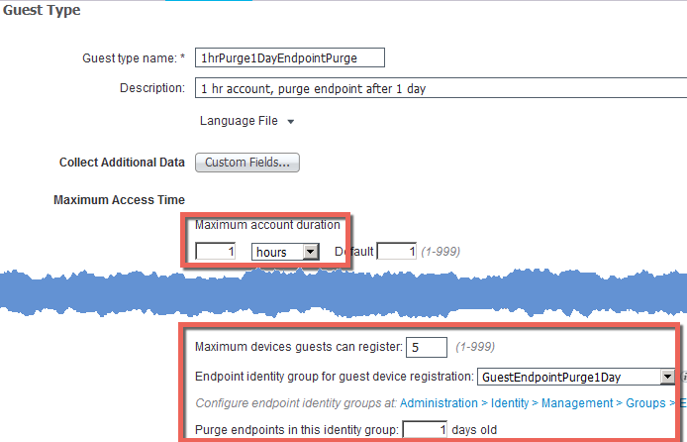
Restrict guest endpoint to 1hr per 24hr period
Guest Access > Configure > GuestTypes > Add Guest Type
Guest Type Changes
change maximum account duration
Max devices no change
ChangeEndpoint group if using special group
Purge endpoint set to 1 day

Slide 3
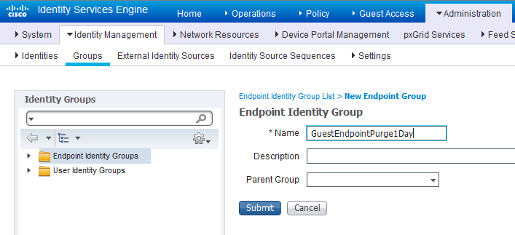
Restrict guest endpoint to 1hr per 24hr period
Admin > Identity Mgmt > Groups > Endpoint ID Groups > Add Special Endpoint Group

Slide 4
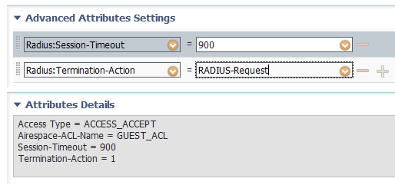
Restrict guest endpoint to 1hr per 24hr period
Authorization Profile for Guest Permit > Session Timeout
Radius-Session-Timeout
Permit Access Authorization use 900s(15m) to block close to 1hr
Create another profile for BlockMessage use 3600s(1h)

Slide 5
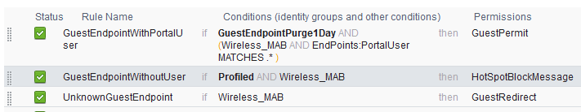
Restrict guest endpoint to 1hr per 24hr period
Authorization Policy
After account expires/suspended/deleted the device is removed from Endpoint Group
Since its still a known endpoint we are able to redirect to a message portal
but still profiled as its known endpoint

Slide 6
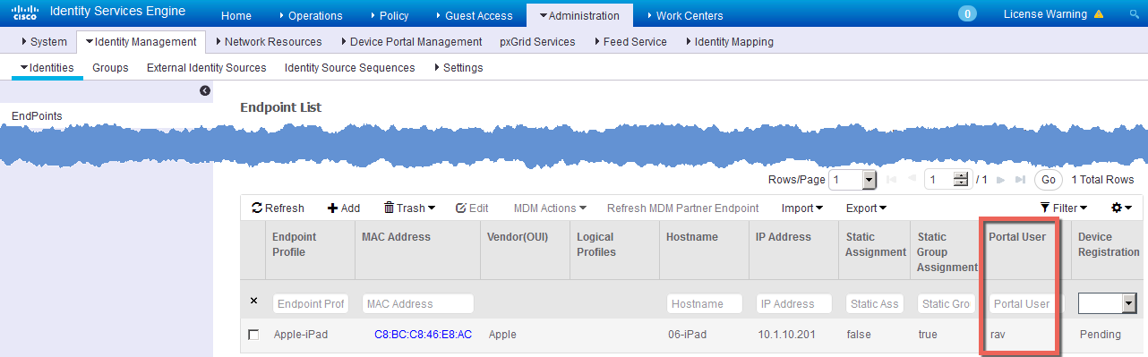
Restrict guest endpoint to 1hr per 24hr period
Valid User info

Slide 7
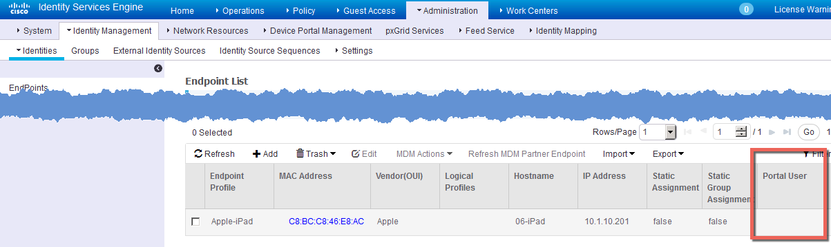
Restrict guest endpoint to 1hr per 24hr period
Suspended/Expired – to re-register need to clear the endpoint

Slide 8
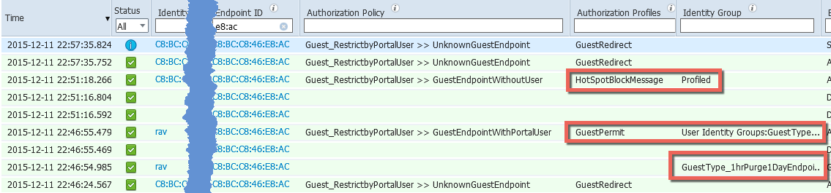
Restrict guest endpoint to 1hr per 24hr period
RADIUS Livelog

Slide 9

Restrict access 8hrs out of 23 using AUP
For Your Reference
Use Hotspot portal to give a restricted message
supports entry of AUP hour value greater than 7 or less than 23
Set by endpointgroup (not guest-type)
Flow:
User accesses network, redirected to hotspot accepts AUP
After 8 hrs > Device Re-auth happens per session time-out (or device has left and comes back)
Device gets new authorization redirect to blocked message
After 23 hrs is able to register endpoint again

Slide 10
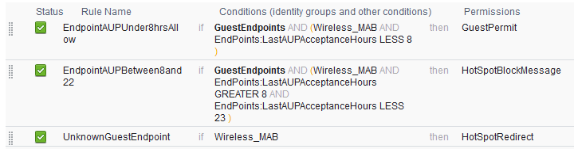
Restrict access 8hrs out of 23 using AUP
Authorization Policy
For Your Reference

Slide 11
Restrict access 8hrs out of 23 using AUP
Authorization Profile for Guest Permit > Session Timeout
For Your Reference
AuthzProfilePermitAccess:
RADIUS-Request for re-auth for 900s(15m) to block close to 1 hr mark
set higher if not critical to disconnect close to mark
AuthzProfileBlockRedirect:
Use 3600s(1 h) for BlockMessagePortal

Slide 12

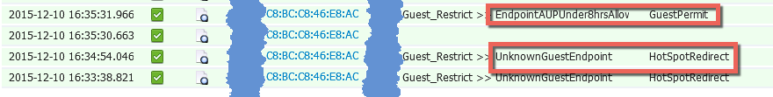

Restrict access 8hrs out of 23 using AUP
RADIUS Livelog
For Your Reference
Endpoint Details
AUP Value stops at 23

