Slide 1
Control Hub
September 2021
Analytics & Reports

Slide 2
Collaboration Shift
In the past
Going forward
14%
at least one remote participant
98%
at least one remote participant
Notes:
Collaboration will be different
Before COVID, only 8% of all meetings included remote participants
Now, 98% of all meetings will have at least one remote participant
Can't afford either group to feel excluded
Fundamental mindset shift needs to take place.

Slide 3


Office space
In the past
Going forward
Individual
workspaces
Collaborative
workspaces
87%
of executives expect to make changes to their real estate strategy in next 12 months. 2021 PWC
Notes:
This is a bigger tectonic shift than even what we’ve seen over the past year we need better solutions
You need to push vendors like us to support this new shift by doing better

Slide 4
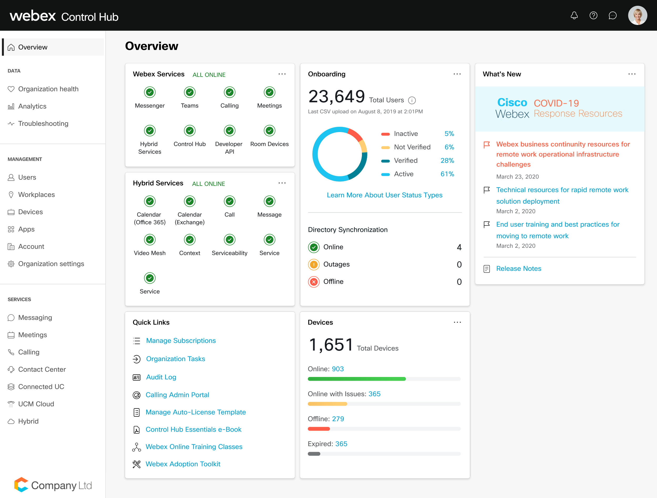
Managed
Modern infrastructure, frictionless administration
Centralized Dashboard

Slide 5



Control Hub Monitoring
Insights into Webex Experience with Realtime Monitoring across all services!
Analytics
Real-Time Troubleshooting
Reports
Interactive data visualizations about usage and adoption of Meetings, Messaging, Calling, Devices, Video Mesh and more
Diagnose Meetings and Calling users experiencing problems in real-time and proactive alerts
Low level details and summary on Meetings, Messaging, Events, Calling, Devices, Onboarding, and more

Slide 6

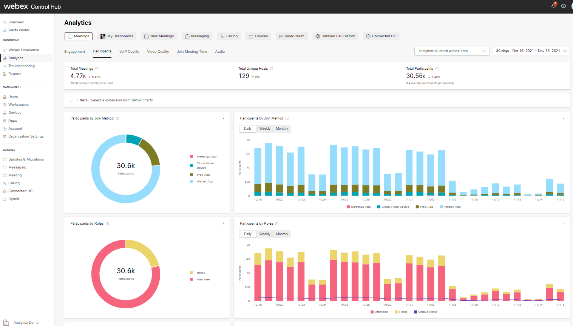
Analytics
Insights at your fingertips with interactive real-time data visualization across your entire Webex portfolio
User Friendly UI with Contextual Filters
Real time data (within 10 minutes)
13 months of historical data
Sub-second load times
Award Winning Accessible Colors for Data Visualization

Slide 7
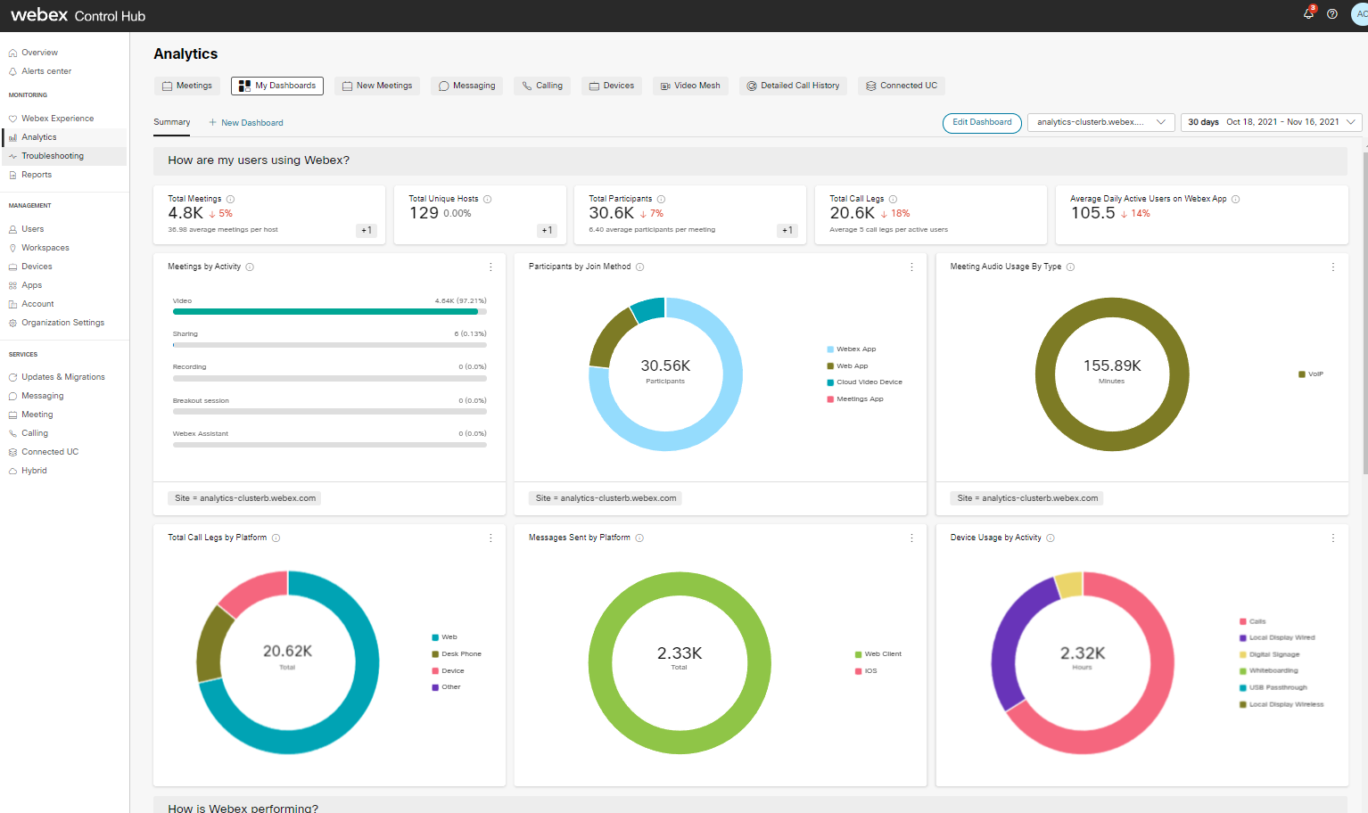
Custom Dashboards for IT Admins
Customers need a view of what's happening, in their organization, across workloads!
Allow our Admins to create their own views using the Analytics data.
Library of KPIs and Charts
Placement and resizing capabilities
Section Naming
Create up to 10 pages
Default Summary page

Slide 8
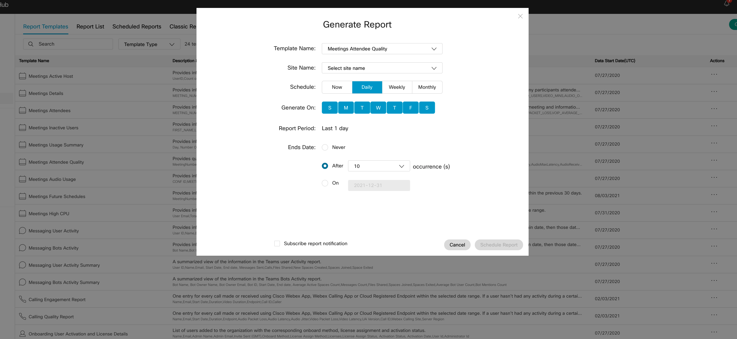
Reports
Direct access to important metric in CSV file format
Schedule or On Demand reports generation via Control Hub
API available to automate report generation and download
Reports for Meetings, Messaging, Calling, Onboarding, Events and Devices

Slide 9
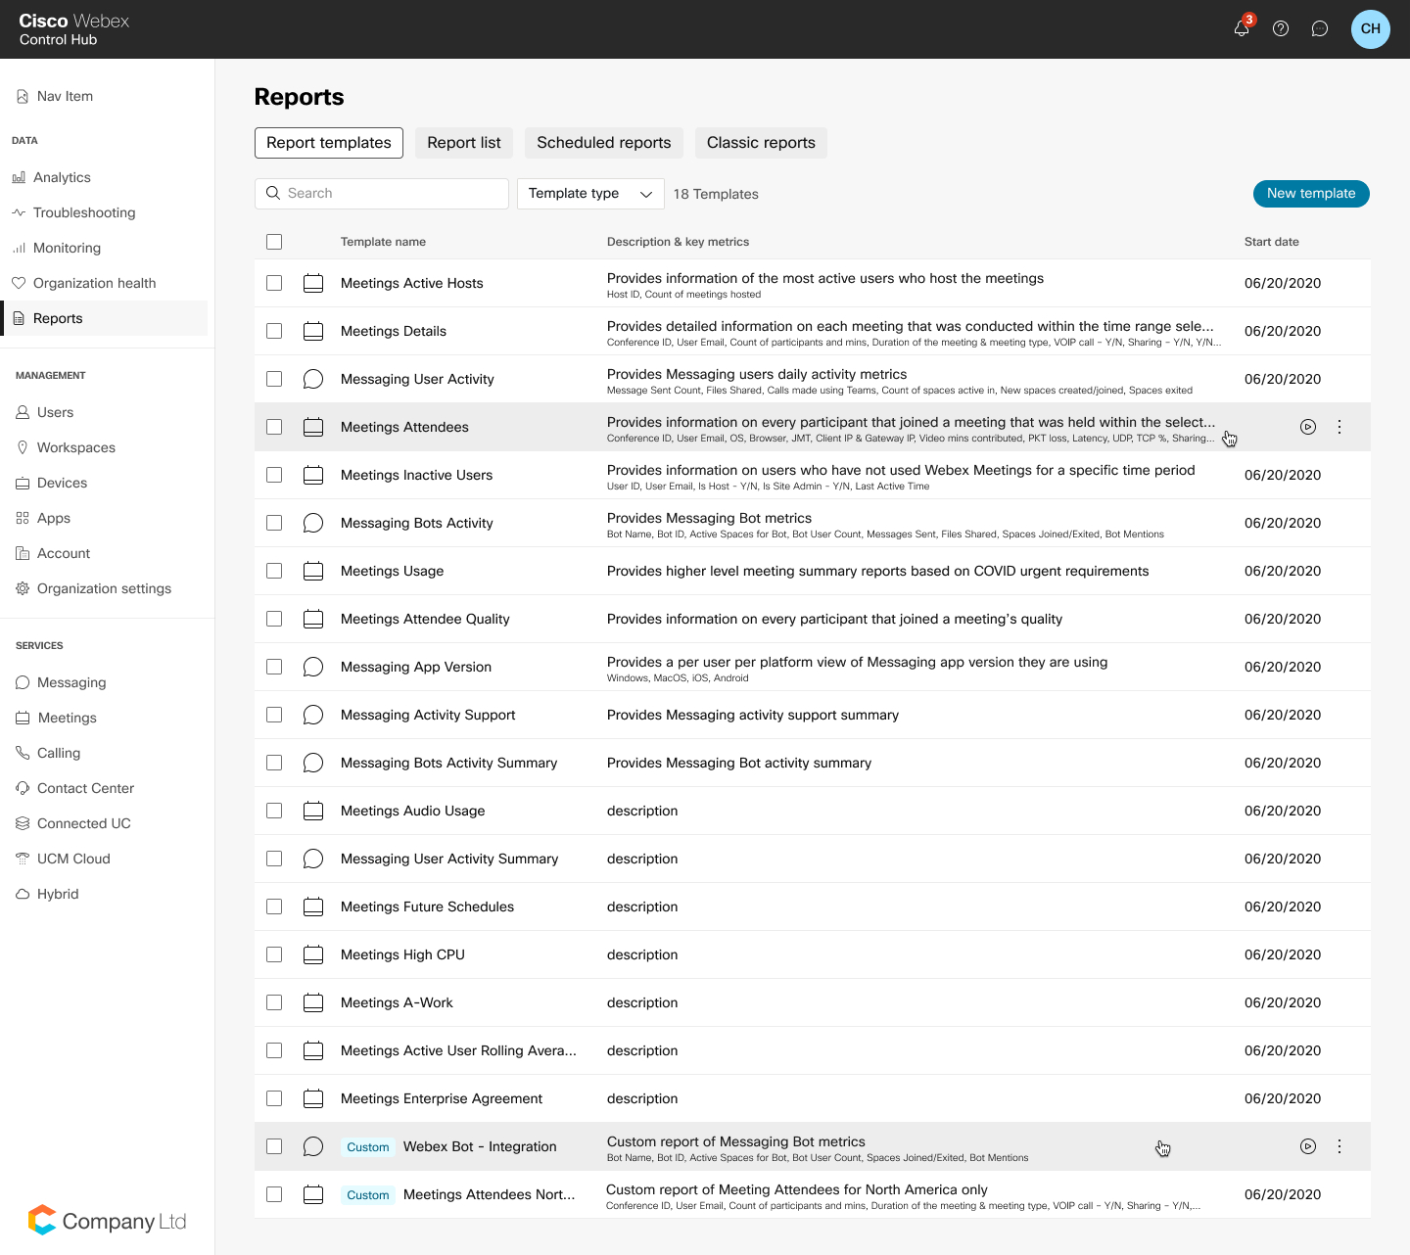
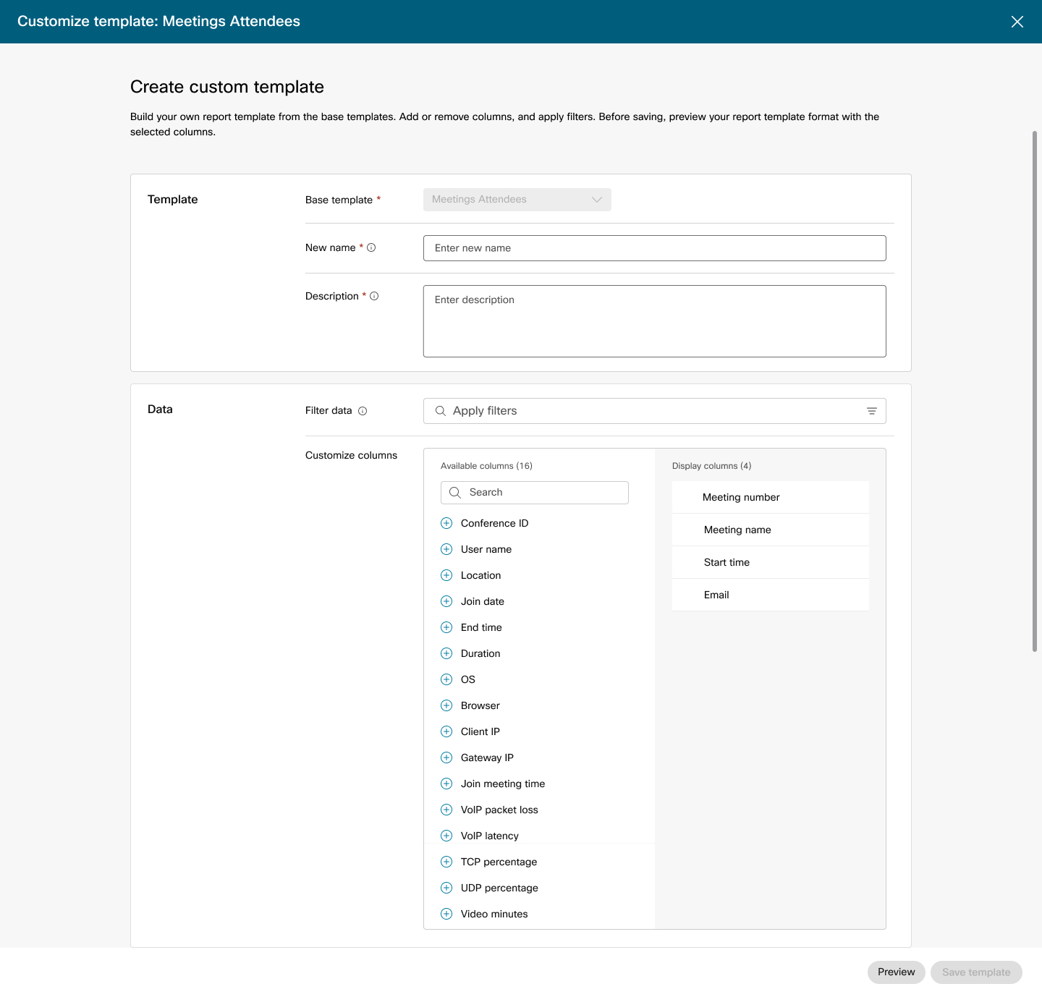
Custom Reports
Build your own custom report templates
Select and re-order columns
Apply filters
Schedule automated runs

